Slide 1
Windows Server 2008 Chapter 9
Last Update 2012.06.07
1.0.0

Slide 2
Objectives
Understand Windows Server 2008 remote access services
Implement and manage a virtual private network
Configure a VPN server

Slide 3
Objectives
Configure a dial-up remote access server
Troubleshoot virtual private network and dial-up remote access installations
Install and configure Terminal Services

Slide 4
Introduction to Remote Access
Routing and Remote Access Services (RRAS)
Enable routing and remote access through two means virtual private networking and dial-up networking
Virtual private network (VPN)
Like a tunnel through a larger network that is restricted to designated member clients only
Dial-up networking
Means using a telecommunications line and a modem (or other telephony device) to dial into a network or specific computers on a network

Slide 5
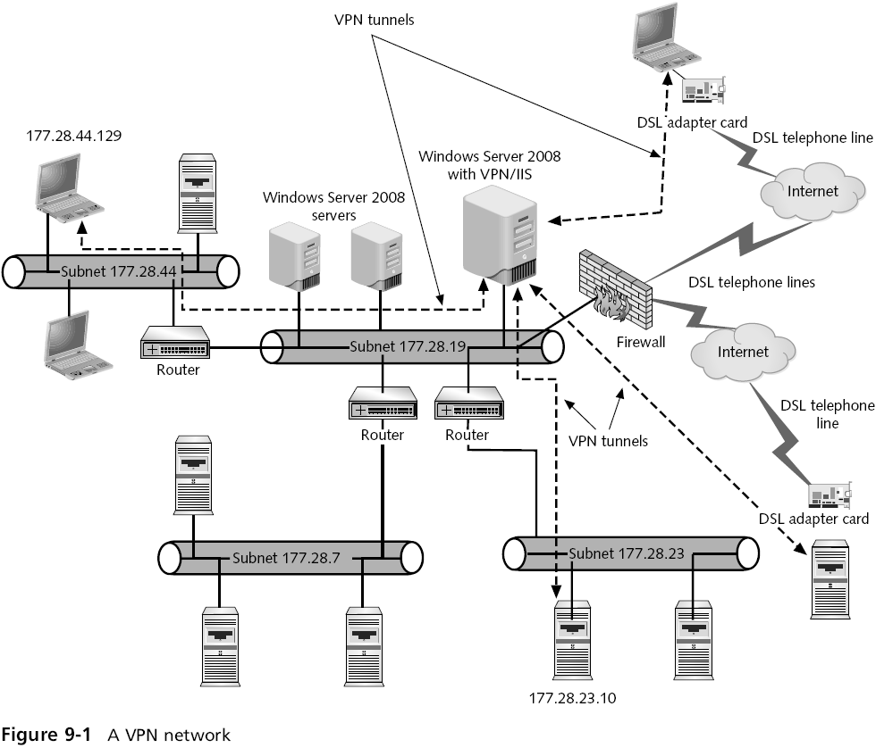

Slide 6
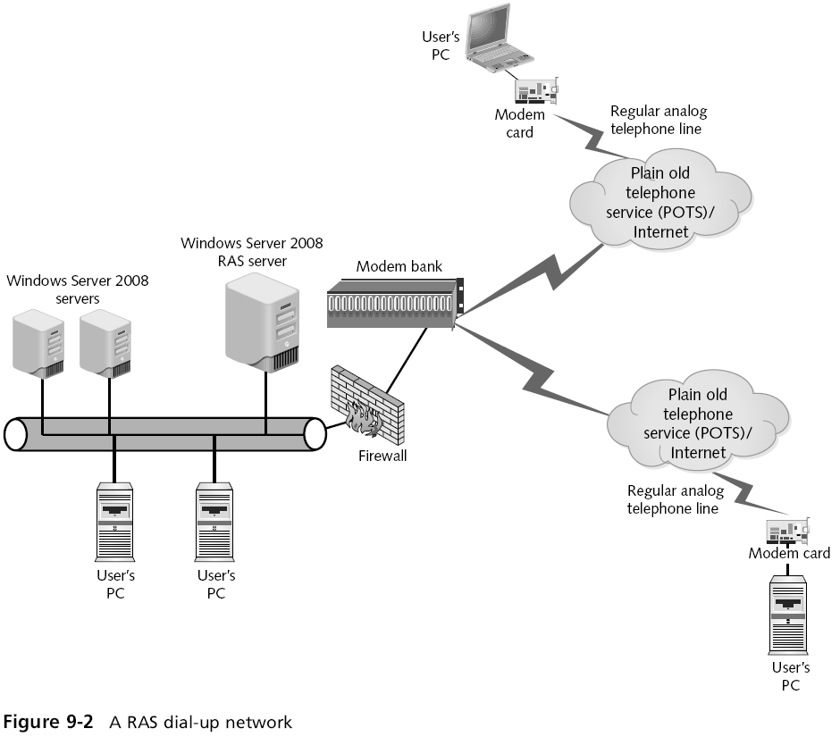

Slide 7
Virtual Private Network
A VPN uses LAN protocols as well as tunneling protocols
To encapsulate the data as it is sent across a public network such as the Internet
Benefit of using a VPN
Users can connect to a local ISP and connect through the ISP to the local network
VPN is used to ensure that any data sent across a public network, such as the Internet, is secure
VPN creates an encrypted tunnel between the client and the RAS server

Slide 8
Virtual Private Network
To create this tunnel, the client first connects to the Internet by establishing a connection using a remote access protocol
Once connected to the Internet, the client establishes a second connection with the VPN server
The client and the VPN server agree on how the data will be encapsulated and encrypted across the virtual tunnel

Slide 9
Using Remote Access Protocols
Remote access protocol carries the network packets over a wide area network (WAN) link
Encapsulates a packet, usually TCP/IP, so that it can be transmitted from a point at one end of a WAN to another point
TCP/IP is the most commonly used transport protocol
Legacy transport protocols
IPX for legacy NetWare networks
NetBEUI for legacy Microsoft networks

Slide 10
Using Remote Access Protocols
Serial Line Internet Protocol (SLIP)
Originally designed for UNIX environments for point-to-point communications among computers, servers, and hosts using TCP/IP
Compressed Serial Line Internet Protocol (CSLIP)
A newer version of SLIP that compresses header information in each packet sent across a remote link
Both SLIP and CSLIP do not support network connection authentication

Slide 11
Using Remote Access Protocols
Point-to-Point Protocol (PPP)
Used more commonly than either version of SLIP for remote communications because it has more capability
Also supports more network protocols
When you implement a Windows Server 2008 VPN server, one of three remote access protocols are used
Point-to-Point Tunneling Protocol
Layer Two Tunneling Protocol
Secure Socket Tunneling Protocol

Slide 12
Using Remote Access Protocols
Point-to-Point Tunneling Protocol (PPTP)
Offers PPP-based authentication techniques
Encrypts data carried by PPTP through using Microsoft Point-to-Point Encryption
Layer Two Tunneling Protocol (L2TP)
Works similarly to PPTP
Uses Layer Two Forwarding that enables forwarding on the basis of MAC addressing
Uses IP Security for additional authentication and for data encryption

Slide 13
Using Remote Access Protocols
Secure Socket Tunneling Protocol (SSTP)
Employs PPP authentication techniques
Encapsulates the data packet in the Hypertext Transfer Protocol (HTTP) used through Web communications
Additionally uses a Secure Sockets Layer channel for secure communications

Slide 14
Configuring a VPN Server
General steps
Installing the Network Policy and Access Services role
Configuring a Microsoft Windows Server 2008 server as a network’s VPN server, including configuring the right protocols to provide VPN access to clients
Configuring a VPN server as a DHCP Relay Agent for TCP/IP communications
Configuring the VPN server properties
Configuring a remote access policy for security

Slide 15
Configuring a DHCP Relay Agent
DHCP Relay Agent
Broadcasts IP configuration information between the DHCP server on a network and the client acquiring an address
You can use the Routing and Remote Access tool to configure the VPN server as a DHCP Relay Agent
You can further configure the DHCP Relay Agent by specifying the maximum number of DHCP servers that can be reached through routers

Slide 16
Configuring VPN Properties
After the VPN server is set up, you can further configure it from the Routing and Remote Access tool
By right-clicking the VPN server in the tree and clicking Properties

Slide 17
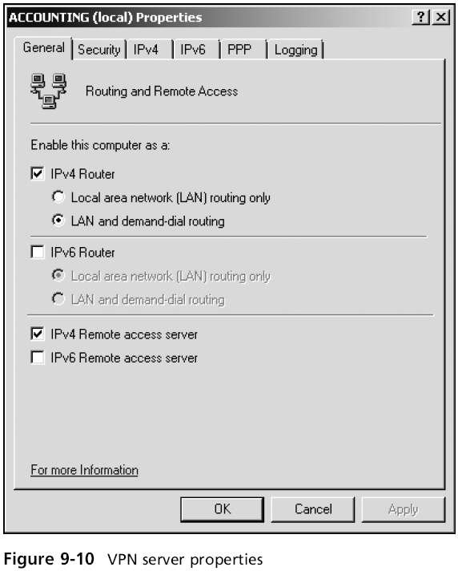

Slide 18
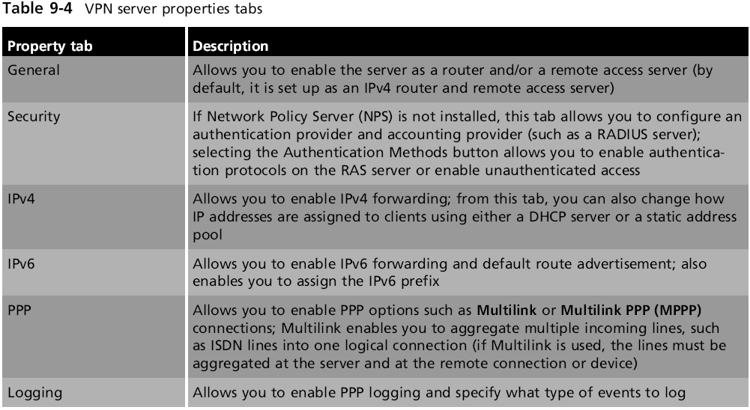
Configuring VPN Properties

Slide 19
Multilink PPP
Multilink (also called Multilink PPP)
Enables to combine or aggregate two or more communications channels so they appear as one large channel
The limitation of using Multilink
It must be implemented in the client as well as in the server
On its own, Multilink cannot change the bandwidth, or drop or add a connection as needed

Slide 20
Bandwidth Allocation Protocol
Bandwidth Allocation Protocol (BAP)
Ensures that a client’s connection has enough speed or bandwidth for a particular application
Helps ensure that the amount of bandwidth increases to the maximum needed for the aggregated channels
And reciprocally contracts as the need becomes less
Links are dynamically dropped or added as needed
To configure Multilink and BAP, right-click the VPN/RAS server in the Routing and Remote Access tool, click Properties, and then click the PPP tab

Slide 21
Configuring VPN Security
You can set up VPN security through a remote access policy
Greatly reduces administrative overhead and offers more flexibility and control for authorizing connection attempts
Elements of a remote access policy
Access permission
Conditions
Constraints
Settings

Slide 22
Configuring VPN Security
Establishing a remote access policy
You can use the Routing and Remote Access tool to create and configure a remote access policy
To create a new remote access policy, right-click the Remote Access Logging & Policies folder in the tree under the VPN or dial-up RAS server
Click Launch NPS to launch the Network Policy Server tool

Slide 23
Dial-Up Remote Access Server
Access server
A single network device that can house multiple modems, ISDN connections, T-carrier line connections, and other types of connections
A dial-up remote access server is compatible with the following types of connections
Asynchronous modems
Synchronous modems through an access or communications server
Null modem communications
Regular dial-up telephone lines

Slide 24
Dial-Up Remote Access Server
Types of connections
Leased telecommunication lines, such as T-carrier
ISDN lines (and digital ‘‘modems’’)
X.25 lines
DSL lines
Cable modem lines
Frame relay lines
Install RAS using the Routing and Remote Access tool
Steps are very similar to installing a VPN server

Slide 25
Configuring Dial-Up Security
You can configure dial-up security at the user account
Enables you to employ callback security
With callback security set up, the server calls back the remote computer
To verify its telephone number in order to discourage a hacker from trying to access the server

Slide 26
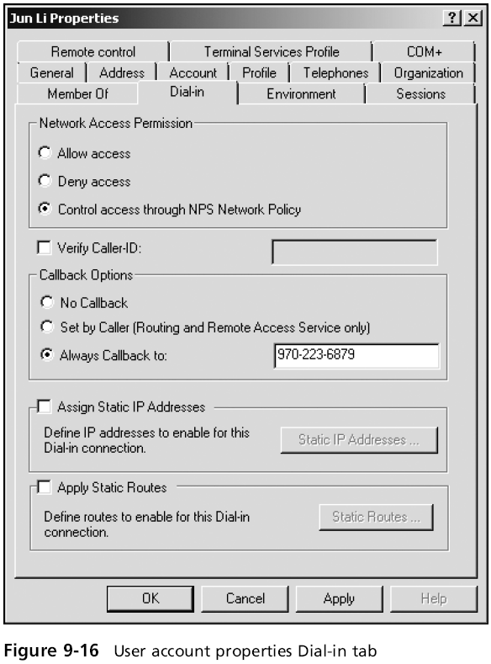

Slide 27
Dial-Up Connection for a RAS Server
After RAS is installed and configured, and you have created a remote access policy
You might need to create one or more ways for the RAS server to connect to the network so clients can access it

Slide 28
Configuring Clients to Connect to RAS
General steps
Click Start and click Control Panel.
Click Network and Internet Connections
Click Create a connection to the network at your workplace
Click Next when the New Connection Wizard starts
Choose Dial-up connection. Click Next
Enter the name of your company, such as JR’s Company, and click Next
Type the telephone number of the ISP, and click Next
Click Finish

Slide 29
Troubleshooting VPN and RAS
Troubleshooting a VPN or dial-up RAS server communications problem can be divided into hardware and software troubleshooting tips

Slide 30
Hardware Solutions
Use Device Manager to make sure network adapters, WAN adapters, and modems are working properly
Make sure the telephone line(s) is (are) connected to the modem(s) and to the wall outlet(s)
Make sure the modem cable is properly attached, that you are using the right kind of cable, and that the modem has power
For internal modems or adapter cards, make sure they have a good connection inside the computer

Slide 31
Hardware Solutions
Test the telephone wall connection and cable
For an external DSL adapter or a combined DSL adapter and router, make sure the device is properly configured and connected
Call your ISP to determine if problems are present on the ISP’s WAN

Slide 32
Software Solutions
Use the Computer Management tool or Server Manager to make sure services are started
Ensure that the Windows Firewall is set up to allow remote access
Make sure that the VPN or dial-up RAS server is enabled
Check the remote access policy to be sure that access permission is granted
Be certain that the VPN or dial-up RAS server is started

Slide 33
Software Solutions
In the Routing and Remote Access tool, check the network interface
If TCP/IP connectivity is used, make sure that the IP parameters are correctly configured to provide an address pool for either a VPN or dial-up RAS server
If you are using a RADIUS server, make sure that it is connected and working properly and that Internet Authentication Service (IAS) is installed
Check to be sure the remote access policy is consistent with the users’ access needs

Slide 34
Software Solutions
If only certain clients but not all are having connection problems, try these solutions
Check the dial-up networking setup on the clients
Make sure the clients are using the same communications protocol as the server
Make sure that each client has a server account and that each knows the correct account name and password
Make sure that each user account that needs access is in the appropriate group

Slide 35
Software Solutions
If only certain clients but not all are having connection problems, try these solutions
Make sure the client accounts have been granted dial-up access capability and have the correct callback setup
For a dial-up RAS connection, determine if the clients’ modems are compatible with the modems on the dial-up RAS server

Slide 36
Terminal Services
Terminal server
Enables clients to run services and software applications on Windows Server 2008 instead of at the client
Which means nearly any type of operating system can access Windows Server 2008
The Windows Server 2008 Terminal Services are used for two broad purposes
To support thin clients
To centralize program access

Slide 37
Terminal Services
Windows Server 2008 Terminal Services not only support thin clients
But other types of client operating systems
When you install Terminal Services, you can install different role services for specific purposes

Slide 38
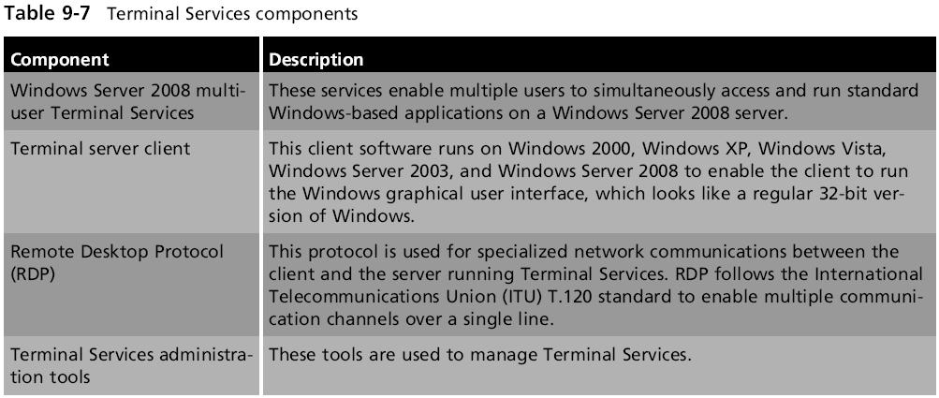
Terminal Services

Slide 39
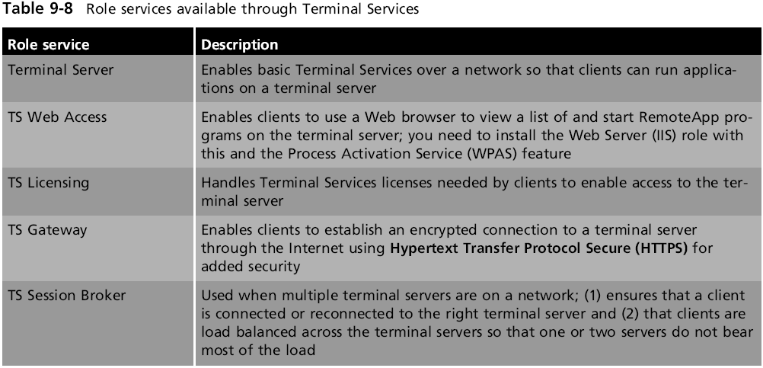
Terminal Services

Slide 40
Installing Terminal Services
When you install the Terminal Services role, you also need to install the TS Licensing role service
To manage the number of terminal server user licenses you have obtained from Microsoft
The TS Licensing role server can be installed when you install the Terminal Services role
Licenses can be purchased either per user account or by client device
When you install the Terminal Services role, you can choose to implement the new Network Level Authentication option

Slide 41
Installing Terminal Services
Network Level Authentication (NLA)
Enables authentication to take place before the Terminal Services connection is established
Which thwarts would-be attackers
Another element to consider before you install the Terminal Services role is who will be allowed to access the terminal server
Create groups of user accounts in advance so that you can add these groups during the installation

Slide 42
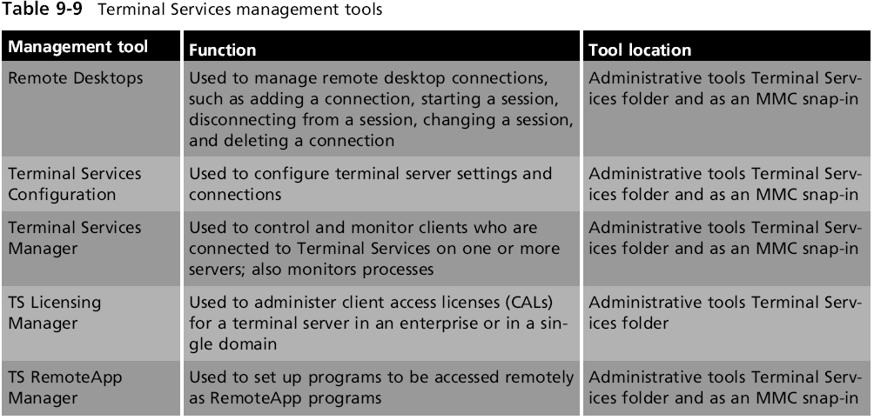
Installing Terminal Services

Slide 43
Configuring Terminal Services
Begin by using the Terminal Services Configuration tool to configure the remote connection properties
Only one connection is configured for each NIC in the server, which is used to handle multiple clients

Slide 44
Managing Terminal Services
Terminal Services Manager allows you to
Monitor the number of users connected to the terminal server
Add additional terminal servers to monitor
Determine if a user session is active
Determine which programs are running in a user’s session
Disconnect a user’s session or log off a user
Reset a connection that is having trouble
Send a message to a user

Slide 45
Configuring Licensing
When you set up a terminal server, you must
Activate the Terminal Services licensing server
Configure the licensing by using the TS Licensing Manager

Slide 46
Accessing a Terminal Server
Terminal Services client computers can log on using the Remote Desktop Connection (RDC) client
The general steps to start RDC in Windows Vista or Windows Server 2008 are as follows
Click Start, point to All Programs, and click Accessories
Click Remote Desktop Connection
Enter the name of the computer to access and click Connect
Provide the username and password and proceed with the connection

Slide 47
Accessing a Terminal Server
The steps for using RDC in Windows XP are as follows
Click Start, point to All Programs, point to Accessories, and point to Communications
Click Remote Desktop Connection
Enter the name of the computer to access and click Connect
Provide the username and password and proceed with the connection

Slide 48
Applications on a Terminal Server
After you configure a terminal server, applications are installed to be compatible with this mode
For this reason, you might need to reinstall some applications that were installed before you installed the Terminal Services role

Slide 49
Summary
Windows Server 2008 offers Routing and Remote Access Services to enable users to have remote access to a server
Routing and Remote Access Services includes virtual private network (VPN) and dial-up services that can be installed individually or together on a server
Remote access protocols include SLIP, CSLIP, PPP, PPTP, L2TP, and SSTP
Use Server Manager to install the Network Policy and Access Services role in Windows Server 2008

Slide 50
Summary
To install and configure a VPN, use the Routing and Remote Access tool
After a VPN is installed, it should be configured to be a DHCP Relay Agent
A VPN has many properties that can be configured
Plan to configure a remote access policy to govern how a VPN server is accessed
A dial-up remote access server can be configured using the Routing and Remote Access tool

Slide 51
Summary
Many troubleshooting strategies can be used if your VPN or dial-up RAS server is having problems
Use Server Manager to install the Terminal Services role
After a terminal server is installed, configure the connection properties and the access permissions
Configure Terminal Services client access licenses to enable users to access a terminal server
Terminal Services clients use the Remote Desktop Connection client to log onto a terminal server

