Slide 1
802.11b Frame Details
Last Update 2008.02.18
1.2.1

Slide 2
Introduction
After acquiring an understanding of how an 802.11b wireless network does its work from the discussion on 802.11 Basic Operation, the next level is presented here
That is to look at the details of how this type of network functions
In this section we will look at the frames used at the data link layer in an 802.11b wireless network

Slide 3
Introduction
This is the AiroPeek version

Slide 4
Frames
A local area network, no matter if it is wired or wireless, operates at layers 1 and 2 of the OSI model
At layer 1 the details of how the bits are put on the media, in this case wireless, are of concern
At layer 2 these bits are formed into a structure that can be used to carry useful information across that media

Slide 5
Frame Types
This structure is supplied by a frame
There are several types of frames used in an 802.11b network including
  Management Frame
    Used to exchange management information
  Control Frame
    Used to control access to the media
  Data Frame
    Used to send the important stuff

Slide 6
Management Frame Types
The management frames are
  Association request
  Association response
  Reassociation request
  Reassociation response
  Probe request
  Probe response
  Beacon

Slide 7
Management Frame Types
  ATIM
  Disassociation
  Authentication
  Deauthentication

Slide 8
Management Frame Types
Association request
  This frame carries information about the NIC – Network Interface Card, such as the supported data rates and the SSID of the network it wishes to associate with
  After receiving the association request, the access point considers associating with the NIC, and if accepted reserves memory space and establishes an association ID for the NIC

Slide 9
Management Frame Types
Association response
  An access point sends an association response frame containing an acceptance or rejection notice to the wireless NIC requesting association
  If the access point accepts the wireless station, the frame includes information regarding the association, such as the association ID and the supported data rates

Slide 10
Management Frame Types
Reassociation request
  If the wireless station moves away from the access point to which it is currently associated and finds another access point with a stronger beacon signal, the wireless NIC will send a reassociation frame to the new access point
  The new access point then coordinates the forwarding of data frames that may still be in the buffer of the previous access point waiting for transmission to the station

Slide 11
Management Frame Types
Reassociation response
  An access point sends a reassociation response frame containing an acceptance or rejection notice to the station requesting reassociation
  Similar to the association process, the frame includes information regarding the association, such as the association ID and the supported data rates

Slide 12
Management Frame Types
Probe request
  A station sends a probe request frame when it needs to obtain information from another device
  For example, a wireless NIC would send a probe request to determine which access points are within range

Slide 13
Management Frame Types
Probe response
  A station will respond to a probe request frame with a probe response frame
  This frame contains capability information, such as supported data rates

Slide 14
Management Frame Types
Beacon
  The access point periodically sends a beacon frame to announce its presence and send network related information, such as the timestamp and SSID
  Stations continually scan all 802.11b radio channels and listen to beacons, which they use as the basis for choosing which access point is best to associate with

Slide 15
Management Frame Types
ATIM
  Battery powered stations will turn off their transceivers periodically to save battery power
  This is called Power Saving Mode or sleep mode
  All sleeping stations wake up at the same time which is during the ATIM - Announcement Traffic Indication Map window, which corresponds with each beacon transmission

Slide 16
Management Frame Types
ATIM
  If an access point is holding packets for a sleeping station, the access point will send an ATIM frame to the sleeping station indicating that packets are awaiting transmission to it
  The station that had been asleep then knows to stay awake through the next beacon interval in order to receive those frames

Slide 17
Management Frame Types
Disassociation
  A station sends a disassociation frame to an access point if it wishes to terminate the association
  For example, a station that is shutting down gracefully can send a disassociation frame to alert the access point that it is powering off
  The access point can then relinquish memory allocations and remove the station from the association table

Slide 18
Management Frame Types
Authentication
  An access point must accept or reject any stations that ask to authenticate with it
  The station begins the authentication process by sending an authentication frame containing its identity to the access point

Slide 19
Management Frame Types
  With open system authentication, the wireless NIC sends only one authentication frame, and the access point responds with an authentication frame as a response indicating acceptance

Slide 20
Management Frame Types
  With shared key authentication, the wireless NIC sends an authentication frame, and the access point responds with an authentication frame containing challenge text
  The wireless station must send an encrypted version of the challenge text, using its WEP key, in an authentication frame back to the access point

Slide 21
Management Frame Types
  The access point ensures that the station has the correct WEP key by seeing whether the challenge text recovered after decryption is the same as was sent
  Based on the results of this comparison, the access point replies to the wireless NIC with an authentication frame signifying the result of authentication

Slide 22
Management Frame Types
Deauthentication
  A station or access point sends a deauthentication frame to a station if it wishes to terminate secure communications

Slide 23
Control Frame Types
The basic control frame types are
  RTS
  CTS
  ACK
  PS Pool
  CF End
  CF End + CF ACK

Slide 24
Control Frame Types
RTS - Request to Send
  A station sends a RTS frame to another station as the first phase of a two-way handshake necessary before sending a data frame on a network that is heavily loaded
  This is not required in normal operation

Slide 25
Control Frame Types
CTS - Clear to Send
  The station sends back the CTS telling the requesting station to go ahead
  The CTS includes a time value that causes all other stations to hold off transmission of frames for the time period necessary for the requesting station to send its frame

Slide 26
Control Frame Types
ACK - Acknowledgement
  After receiving a data frame, the receiving station checks for errors in the frame
  Then the receiving station will send an ACK frame to the sending station if no errors are found
  If the sending station doesn't receive an ACK after a period of time, the sending station will retransmit the frame

Slide 27
Control Frame Types
PS Poll - Power Save Poll
  A station awakening from Power Saving Mode transmits this frame to retrieve any frames that have been buffered by the access point for the station

Slide 28
Control Frame Types
CF End
  This frame marks the end of the contention free period, which is part of the PCF mode of operation

Slide 29
Control Frame Types
CF End + CF ACK
  This is the same as the CF End alone, but it adds an ACK for the last frame received during the contention free period, which is part of the PCF mode of operation

Slide 30
Data Frame Types
There is only one type of data frame
This frame has a maximum size of 2348 bytes
Of these 2348 bytes
  30 bytes are used by the header
  6 bytes are used by the CRC trailer
  This leaves up to 2312 bytes of data

Slide 31
Physical Layer
Before we get into the details of the data link layer’s frames, let’s briefly discuss some aspects of the transition from the physical layer to the data link layer
At the beginning of the frame a preamble is present
This is a series of 1’s and 0’s that is used for synchronization

Slide 32
Physical Layer
It is always sent at 1 Mbps so that any device can read the preamble
The preamble allows the data link layer to see where to begin picking up the frame as it reads in the data from the physical layer

Slide 33
Physical Layer
The preamble can take one of two forms, with the long form being the default
  Long – 128 bits
  Short – 56 bits
The short version is available to improve network performance, such as for applications that require minimum overhead and maximum performance

Slide 34
Data Link Layer
After the preamble is sent, the data link layer header appears
This is called the PLCP Header
When using a long preamble the preamble and header are both sent at 1 Mbps
When using the short preamble, it is sent at 1 Mbps and the header at 2 Mbps

Slide 35
Frame Fields
Every frame used in a LAN consists of a series of fields
Some of the fields are used and some are not
Some of those used are more important than others
Next each of these fields will be detailed

Slide 36
Data Frame Fields
The data frame, being the most important frame, is the first one we will look at
This frame contains the following major fields

Slide 37
Data Frame Format
Frame Control
Duration ID
Address 1
Address 2
Address 3
Sequence Control
Address 4
Frame Body
CRC

Slide 38
Frame Control Subfields
The first field, the frame control field, actually consists of eleven subfields
These are

Slide 39
Frame Control Subfields
Protocol Version
Type
Subtype
To DS
From DS
Move Frag
Retry
Power Management
More Data
WEP
Reserved

Slide 40
Sequence Control Subfields
Further down in the list of data frame fields the sequence control field is seen to contain two subfields
These are

Slide 41
Sequence Control Subfields
Protocol Version
Sequence Number

Slide 42
Data Frame Fields
Let’s look at each of these fields in more detail
As we encounter a field with subfields, these subfields will be detailed as well

Slide 43
Frame Control Field
16 bits
11 subfields
This field does just what its name implies
It contains in its subfields the control information for the frame

Slide 44
Protocol Version Subfield
2 bits
This is the version of 802.11b being used
Right now there is only one version
This first and only version is indicated by a protocol number of 0

Slide 45
Type Subfield
2 bits
Along with the subtype field this field identifies the type of frame this is such as management, control, or data
There are 30 possibilities

Slide 46
Subtype Subfield
4 bits
This field works in combination with the type subfield to identify the type of frame as discussed just above

Slide 47
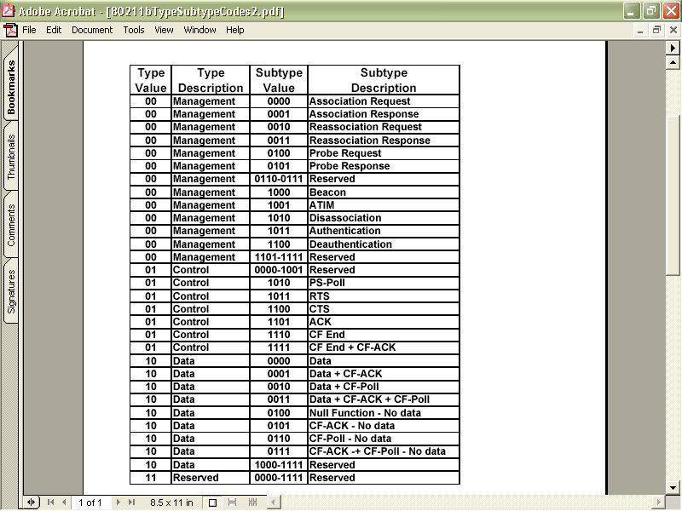
Type and Subtype Codes

Slide 48
To DS Subfield
1 bit
This is set to 1 when the frame is going to a distribution system
Recall that a distribution system is a wired connection among access points
This is set also whenever the frame is being sent to or as indicated by the next field being sent from a device that is connected to the network using a wire

Slide 49
From DS Subfield
1 bit
This is set to 1 when the frame is from a distribution system or wired device

Slide 50
More Fragments Subfield
1 bit
This is set to 1 when there are more fragments to come

Slide 51
Retry Subfield
1 bit
This says that the frame is a retransmission of a fragmented frame so that a frame is not duplicated

Slide 52
Power Management Subfield
1 bit
This field indicates whether the station is in
  Power Save Mode
  or
  Active Mode
The access point uses this field so that it will know which stations are in sleep mode

Slide 53
Power Management Subfield
Such a station requires the access point to hold transmissions for that station until it awakens

Slide 54
More Data Subfield
1 bit
This is to let the receiver know that more frames will follow this frame for a station that has been in sleep mode

Slide 55
WEP Subfield
1 bit
This is set when WEP – Wireless Equivalent Privacy is used

Slide 56
Order Subfield
1 bit
This field indicates that the DEC LAT protocol is in use
This is a protocol designed to allow LAN devices to connect to a DEC VAX minicomputer
For the most part, no one uses this protocol anymore

Slide 57
Duration or ID Field
16 bits
The meaning of this field depends on the type of frame this is
It can be used to
  Set the NAV value, which is the number of microseconds the medium is expected to be busy for a transmission

Slide 58
Duration or ID Field
  Set the NAV for stations that missed the beacon that announced the NAV value as just described
  Transmit a PS - Poll frame by stations awakening from power saving mode

Slide 59
Address Field 1
48 bits
A frame can have up to four addresses in it
This is the first of the four
This is the recipient address
The actual value of this field depends on the values in the To DS and From DS fields

Slide 60
Address Field 1
This recipient can be
  Broadcast address
  Access point address
  Station address

Slide 61
Address Field 2
48 bits
This is the second of the four address fields
This address is the unit transmitting the frame, either the access point or whichever station it might be
If the original transmitter of this frame is a wired device, then the address here is the access point that is retransmitting the data

Slide 62
Address Field 3
48 bits
This is the third of the four addresses
Depending again on the To DS and From DS this can be either the original source address or the destination address

Slide 63
Sequence Control Field
16 bits
This field is used to reorder the fragments back into a complete and correct frame and to discard duplicate frames

Slide 64
Address Field 4
48 bits
This is the fourth of the four addresses
This field is used when a frame is going from one AP – Access Point to another AP

Slide 65
Initialization Vector Header
This is an extension to the normal header
It exists only if WEP is being used
It is 4 bytes long
This header along with the Integrity Value Check shown below constitute the WEP information that is added

Slide 66
Initialization Vector Subfields
If the initialization vector header is used, there are three subfields in this header
  Initialization Vector
    This subfield carries the 24 bit initialization vector
  Pad
    This is to adjust the size, if required
  Key ID
    This identifies the default key that was used to encrypt the frame

Slide 67
Frame Body Field
Finally the important stuff, the data
This is the point to all of this discussed here
To get data from one place to another
Up to 2304 bytes of data is provided for
  Out of this 2304 bytes 8 bytes are used for the 802.2 LLC headers
  So the actual maximum real data that can be passed up to the next layer is 2296 bytes

Slide 68
Frame Body Field
  However a maximum payload of up to 2312 bytes must be supported to accommodate WEP overhead if WEP is used

Slide 69
Integrity Value Check
This addition to the trailer exists only if WEP is being used
It is 4 bytes long
This trailer along with the IV header shown above constitutes the information that is added if WEP is used

Slide 70
CRC Field
32 bits
The checksum
This is used as always to be sure the frame got to its destination intact

Slide 71
Management Frame Format
Let’s switch from the data frame to the format of a management frame
This frame has fewer fields
For example

Slide 72
Management Frame Format
Frame Control
Duration
DA
SA
BSSID
Sequence Control
Frame Body
CRC

Slide 73
Management Frame Format
Frame Control
  This is the same as the data frame
Duration
  The time period required for the frame
  The exact time specified depends on the type of management frame being sent
  For example if this is an ACK the duration is set to 0, for others it is set to several microseconds

Slide 74
Management Frame Format
DA
  The destination address
SA
  The source address
BSSID
  The MAC address of the access point
Sequence Control
  Used to place the frames in the correct order

Slide 75
Management Frame Format
Frame Body
  This field carries whatever management information is being sent by the management frame
  This will vary depending on the function of the management frame
CRC
  Error checking

Slide 76
Control Frame Format
The format of control frames differ slightly depending on what type of control frame it is
We will look at the common ones

Slide 77
Control Frame Format – RTS
Frame Control
Duration
RA
DA
CRC

Slide 78
Control Frame Format – RTS
Frame Control
  This is the same as the data frame
Duration
  This is the time in microseconds to transmit the frame, plus one CTS frame, one ACK frame, and three SIFS intervals
RA
  The destination station address

Slide 79
Control Frame Format – RTS
DA
  The address of the station transmitting the frame
CRC
  Error checking

Slide 80
Control Frame Format – CTS
Frame Control
Duration
RA
CRC

Slide 81
Control Frame Format – CTS
Frame Control
  This is the same as the data frame
Duration
  This is the time in microseconds required to transmit the frame
  This value is copied from the previous RTS frame, minus the time in microseconds required to transmit the CTS frame and its SIFS interval

Slide 82
Control Frame Format – CTS
RA
  This is the destination station address, which is copied from the previous RTS frame to which this frame is a response
CRC
  Error checking

Slide 83
Control Frame Format – ACK
Frame Control
Duration
RA
CRC

Slide 84
Control Frame Format – ACK
Frame Control
  This is the same as the data frame
Duration
  If the fragment field of the data frame to which this is a response is set to 0, this field is 0
  Otherwise the value is obtained from the duration field of the previous frame, minus the time in microseconds required to transmit the ACK and the SIFS interval

Slide 85
Control Frame Format – ACK
RA
  This is the destination station address, which is copied from the previous data frame this CTS frame is a response to
CRC
  Error checking

Slide 86
Control Frame Format – PS Poll
Frame Control
AID
BSSID
TA
CRC

Slide 87
Control Frame Format – PS Poll
Frame Control
  This is the same as the data frame
AID
  This is the Association ID
  This is how the AP knows which station it is talking to
BSSID
  The name of the access point

Slide 88
Control Frame Format – PS Poll
  The MAC address of the station sending the frame
CRC
  Error checking

Slide 89
Typical Frames
Now let’s look at some typical frames as seen on an 802.11b network
In this view the entire frame is shown
Later the use of the individual fields will be illustrated
We will look at
  Management Frames
    Beacon Frame
    Probe Request Frame
    Probe Reply Frame

Slide 90
Typical Frames
  Control Frames
    Acknowledgement
  Data Frames
    Ping
    Windows Browser Search

Slide 91
Beacon Frame
Beacons, beacon management frames, are frames sent by an access point when in infrastructure mode to synchronize a wireless network
How often these are sent can usually be adjusted
These are also sent out by stations when they are operating in ad hoc mode

Slide 92
Beacon Frame Functions
The beacon performs several functions such as
  Time synchronization
    This synchronizes the clock in all devices
  FH or DS Parameter Sets
    This is the type of spread spectrum technology being used
    FH for FHSS where it specifies a hop and dwell time

Slide 93
Beacon Frame Functions
    DS for DSSS where it specifies the channel information
  SSID Information
    The SSID of the device
  TIM - Traffic Indication Map
    To let sleeping stations know that they have traffic waiting
  Supported Rates
    To indicate the speeds at which the access point can talk

Slide 94
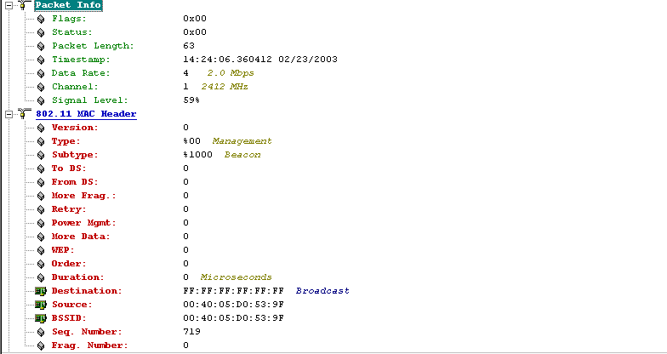
Typical Beacon Frame

Slide 95
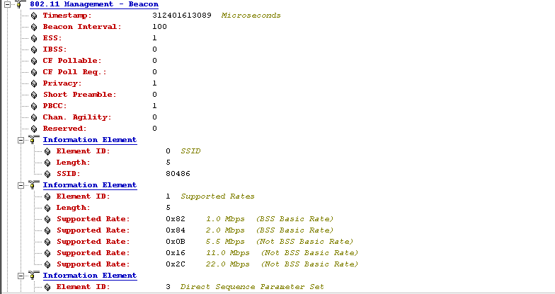
Typical Beacon Frame

Slide 96
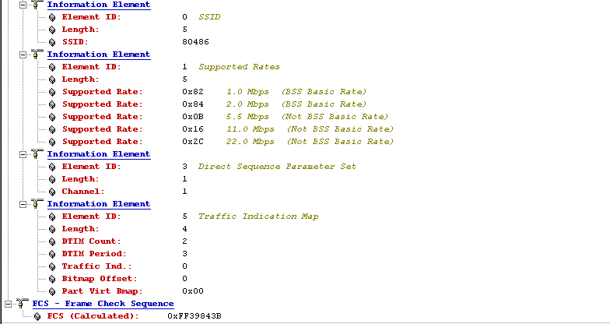
Typical Beacon Frame

Slide 97
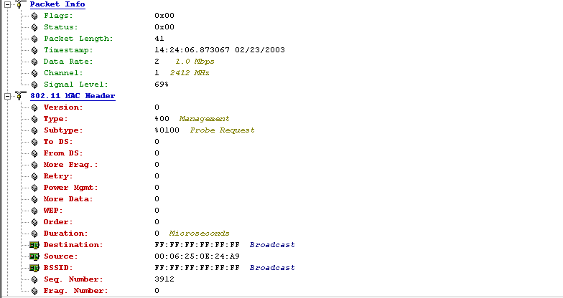
Typical Probe Request Frame

Slide 98
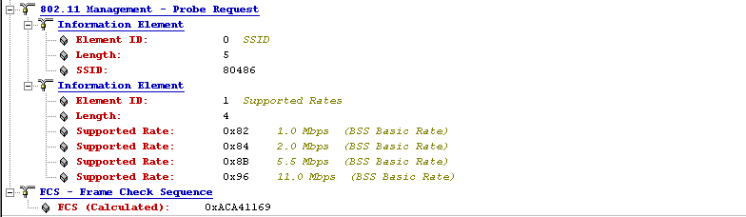
Typical Probe Request Frame

Slide 99
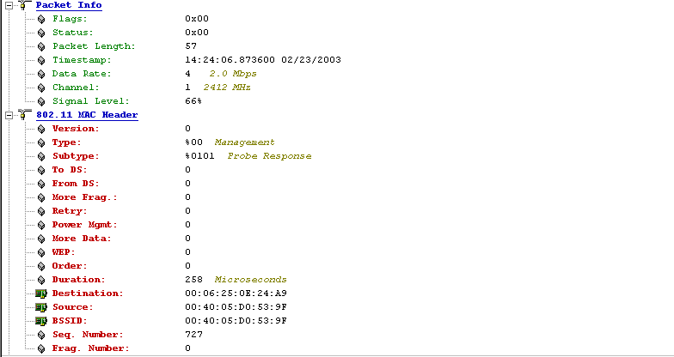
Typical Probe Response Frame

Slide 100
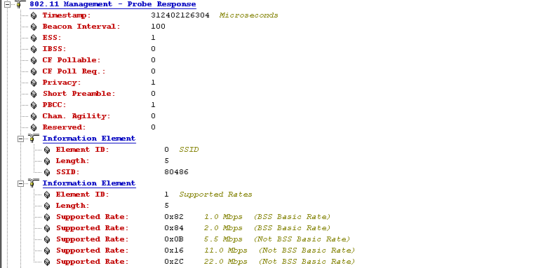
Typical Probe Response Frame

Slide 101
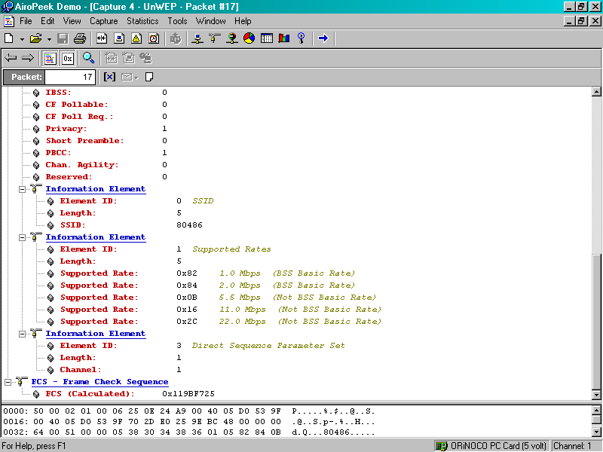
Typical Probe Response Frame

Slide 102
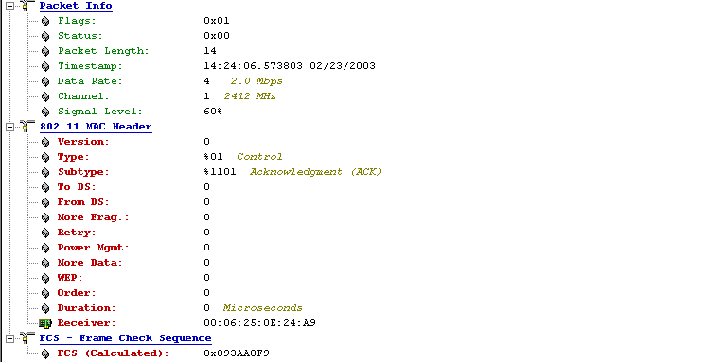
Typical ACK Frame

Slide 103
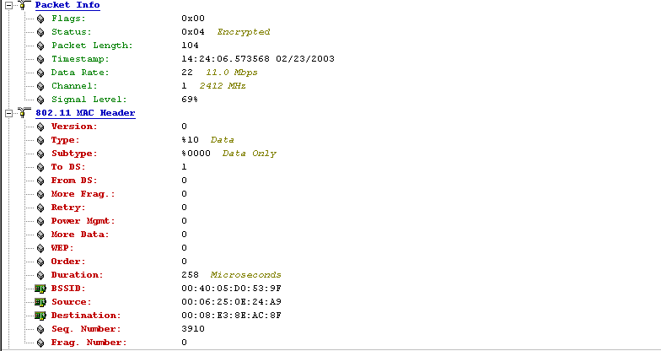
Typical Ping Request Frame

Slide 104
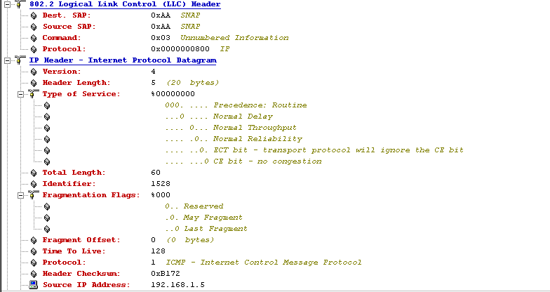
Typical Ping Request Frame

Slide 105
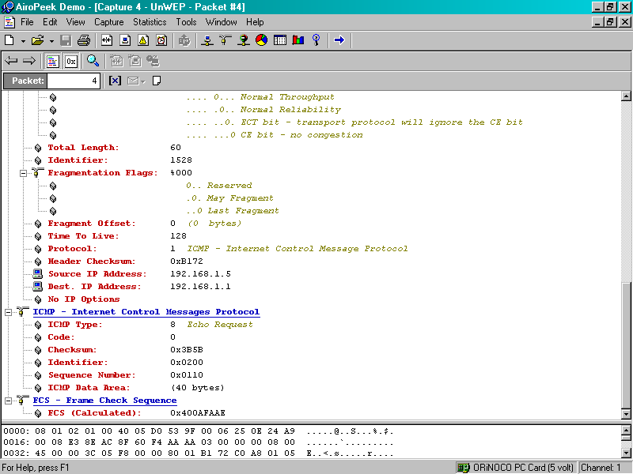
Typical Ping Request Frame

Slide 106
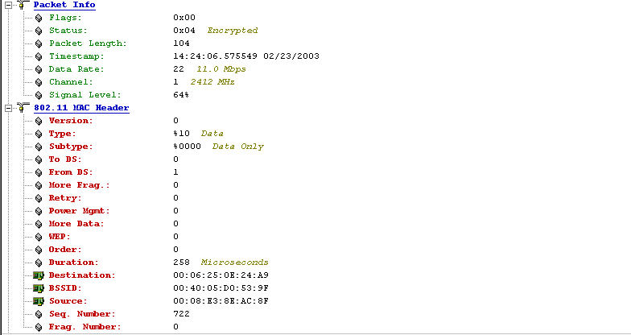
Typical Ping Response Frame

Slide 107

Typical Ping Response Frame

Slide 108

Typical Ping Response Frame

Slide 109
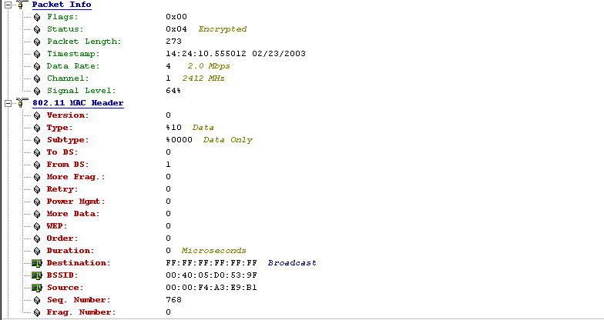
Typical Windows Browser

Slide 110
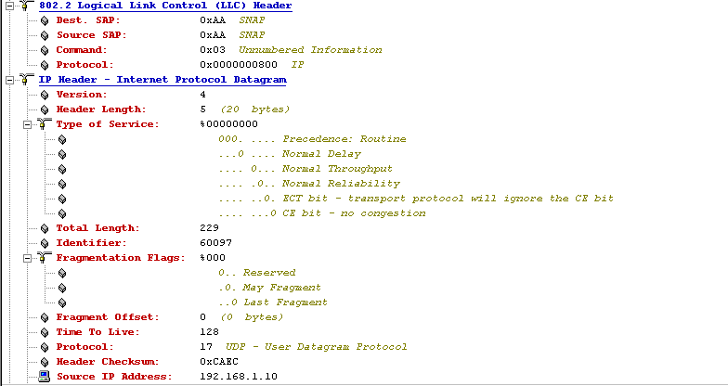
Typical Windows Browser

Slide 111
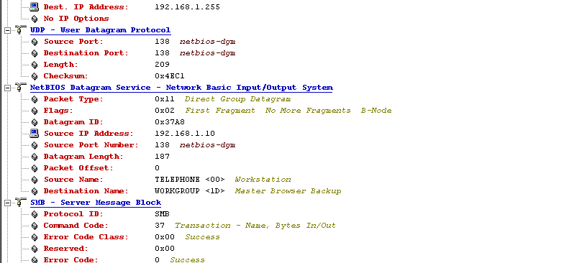
Typical Windows Browser

Slide 112
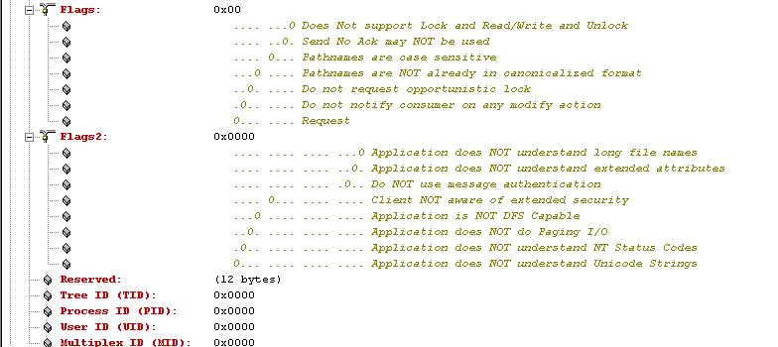
Typical Windows Browser

Slide 113
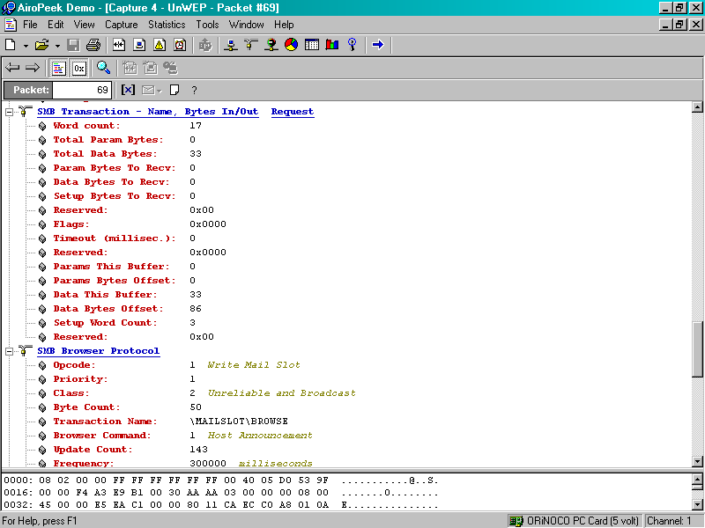
Typical Windows Browser

Slide 114
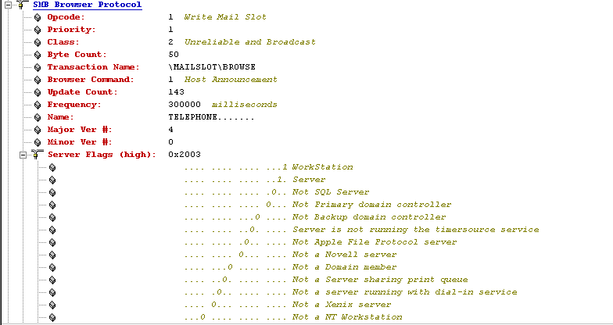
Typical Windows Browser

Slide 115
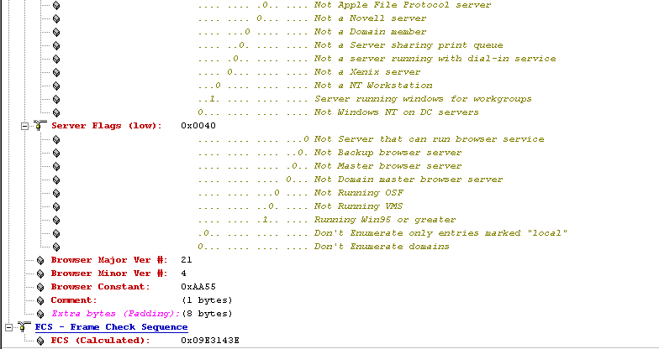
Typical Windows Browser

Slide 116
Access Point and Station
The general station authentication sequence is
  Client broadcasts a probe request frame on every channel
  Access points within range respond with a probe response frame
  The client decides which access point to connect to based on signal strength and data rate

Slide 117
Access Point and Station
  The client sends an authentication request
  The access points answers with an authentication reply
  Once authenticated, the client must associate by sending an association request frame to the access point
  The access point will reply with an association request
  The client can now send and receive traffic

Slide 118
Typical Startup Sequence
In this section we will look at a running system where the access point is sending out beacons
This is the normal function of an AP
It is basically saying
  I am here, can I help you
  I am here, can I help you

Slide 119
Typical Startup Sequence
While the AP is sending out beacons, a computer with a wireless NIC is turned on
In this example of passive scanning the computer sees the beacon frames and starts a conversation with the AP in order to associate and authenticate
Let’s look at a summary and then frame by frame

Slide 120
Beacons Being Sent
Look at the Absolute Time timestamp
Notice how often the beacon frame is sent
This is a lot of traffic, although each of these frames is quite small
These are also sent out at a low data rate, 2 Mbps, so that any device can connect

Slide 121
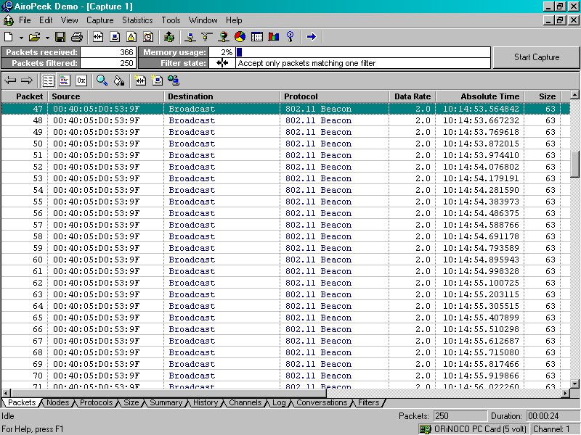
Beacons Being Sent

Slide 122
Wireless NIC is Turned On
In this section the computer with the wireless NIC is booted
First it authenticates with the access point
Then it associates with the access point
The last frame in the sequence, the EAPOL-Start frame, is due to the computer with the wireless NIC running Windows XP

Slide 123
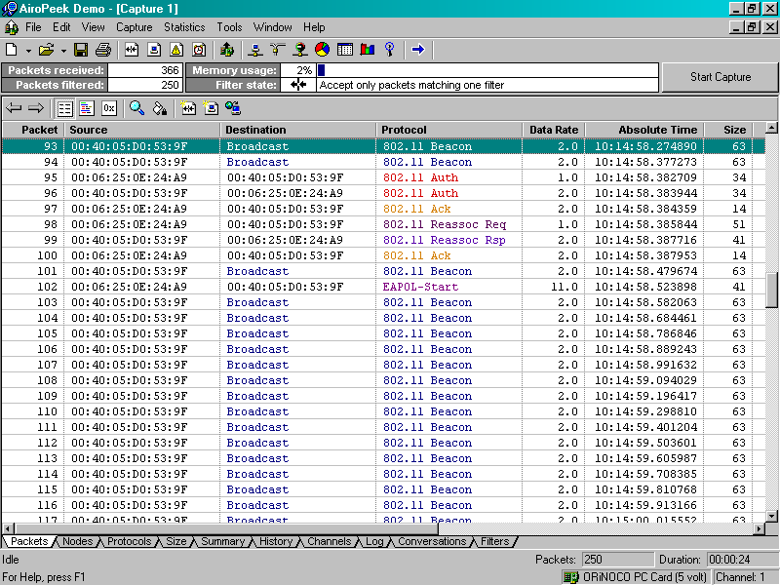
Wireless NIC is Turned On

Slide 124
Startup Sequence
Now we will look at the interesting fields in each of these frames

Slide 125
Beacon Frame
The beacon frame is used by the AP to announce its presence to anyone within range
Notice that the SSID is sent in clear text as pointed out below

Slide 126
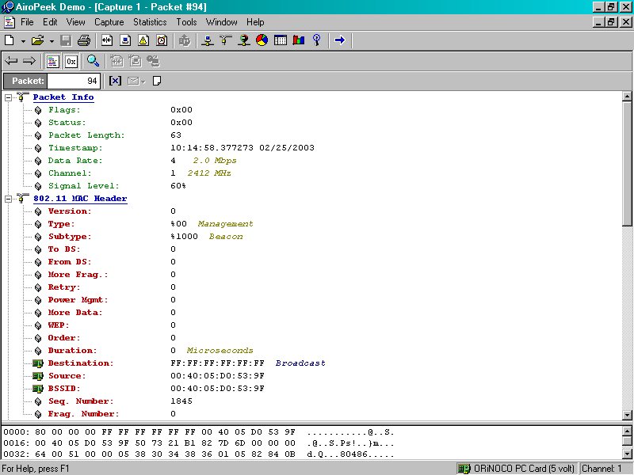
Beacon Frame
Beacons are sent at a slow data rate so every device can be sure to receive them
These are sent as Ethernet broadcasts

Slide 127

Beacon Frame
The SSID of the AP is sent
The AP’s data rates are sent
Notice the 22 Mbps rate, which is nonstandard

Slide 128
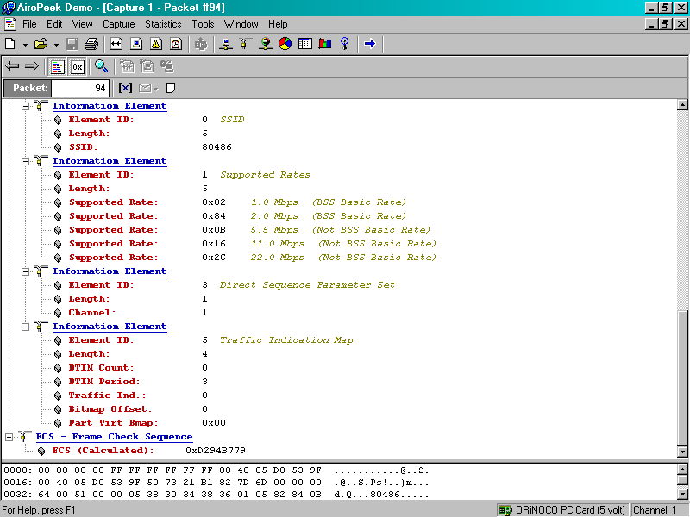
Beacon Frame
The SSID is sent in the clear

Slide 129
Authentication Frame
In this frame the wireless NIC tells the AP it wants to talk to it using Open System authentication

Slide 130
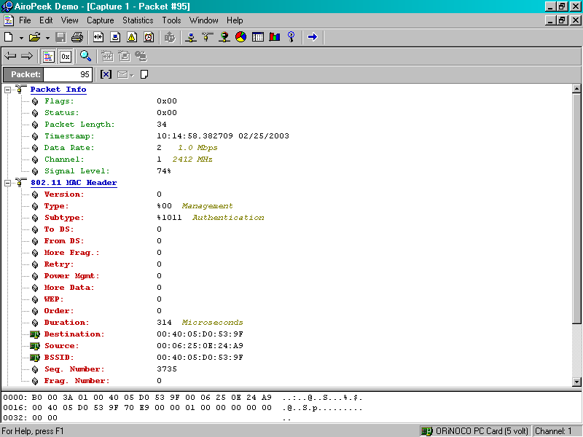
Authentication Frame
Still a slow data rate
The two devices are talking directly to each other

Slide 131
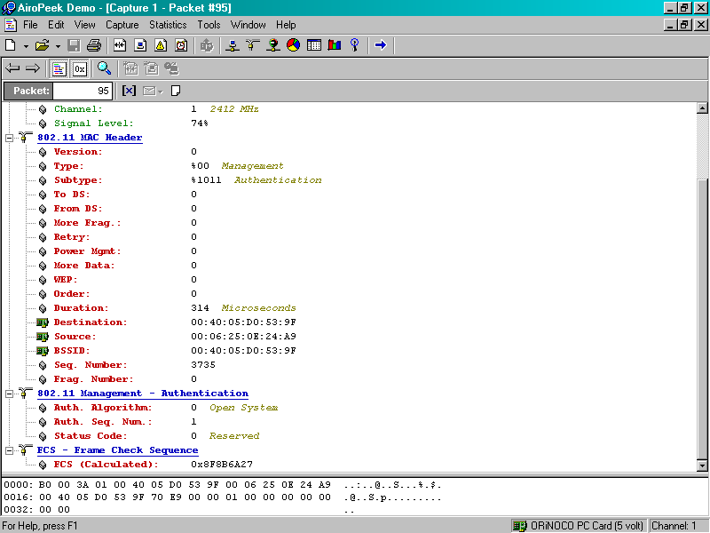
Authentication Frame
Open System
authentication
is proposed

Slide 132
Authentication Frame
Here the AP answers the wireless NIC telling it what part of the authentication proposal it agrees to

Slide 133

Authentication Frame

Slide 134
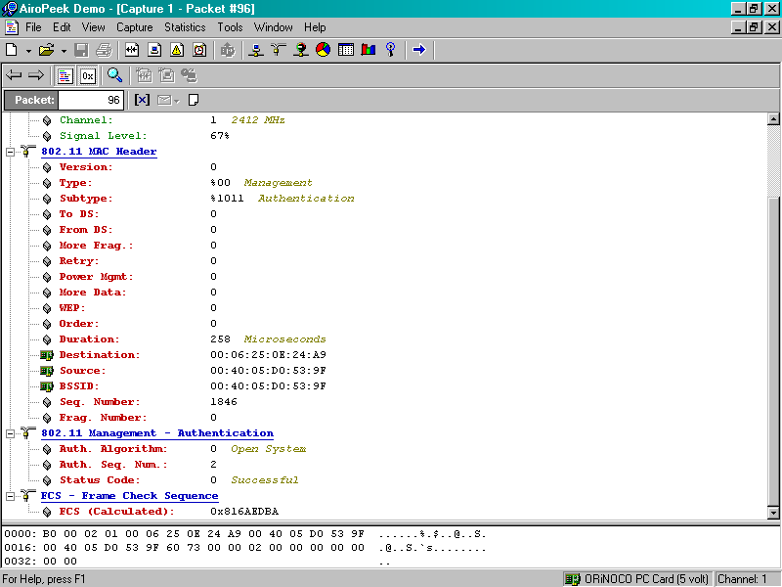
Authentication Frame
The AP says
Open System
is ok

Slide 135
Acknowledgement Frame
The wireless NIC tells the AP that it received the response to its authentication proposal

Slide 136
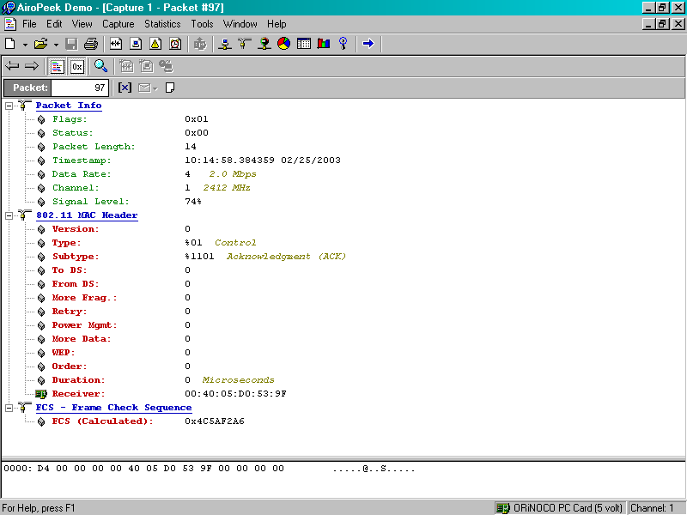
Acknowledgement Frame
The AP is the
receiver

Slide 137
Association Frame
Once authentication is complete, the next step is association
In this frame the wireless NIC asks the AP if it can associate with it

Slide 138
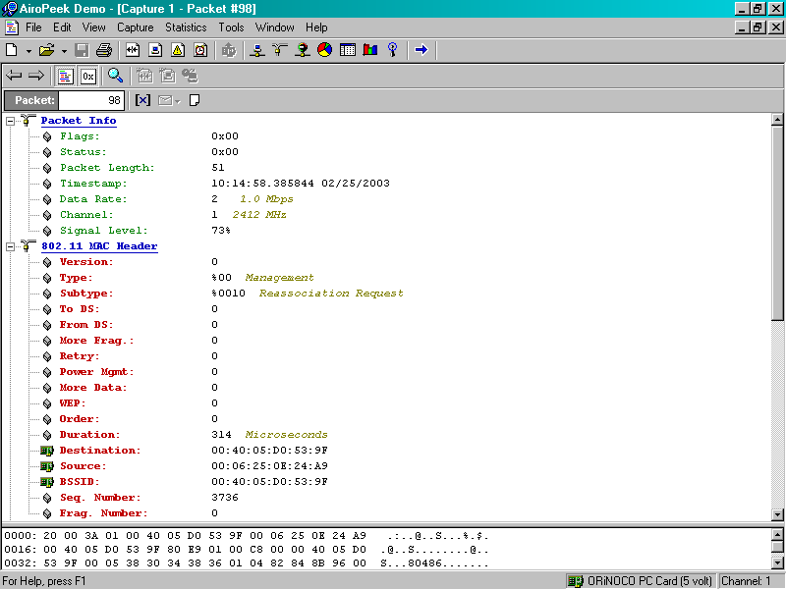
Association Frame
Data rate still slow
Indicates type of frame
From the wireless NIC to the AP

Slide 139
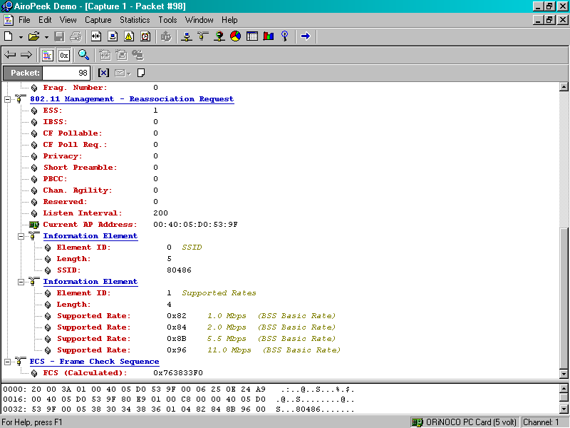
Association Frame
The wireless NIC’s data rates

Slide 140
Association Frame
The AP answers back saying ok

Slide 141
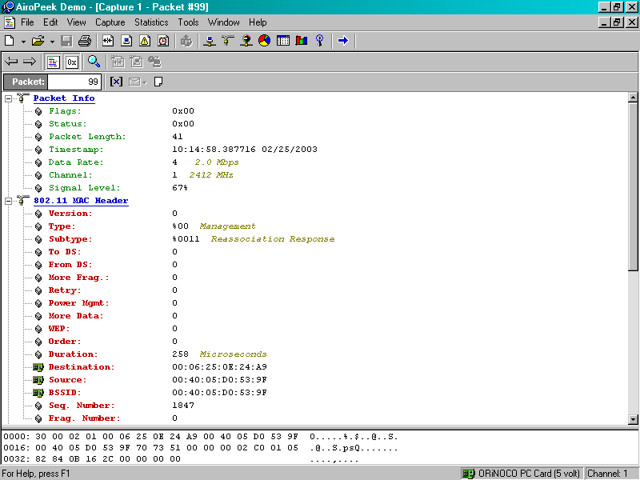
Association Frame

Slide 142
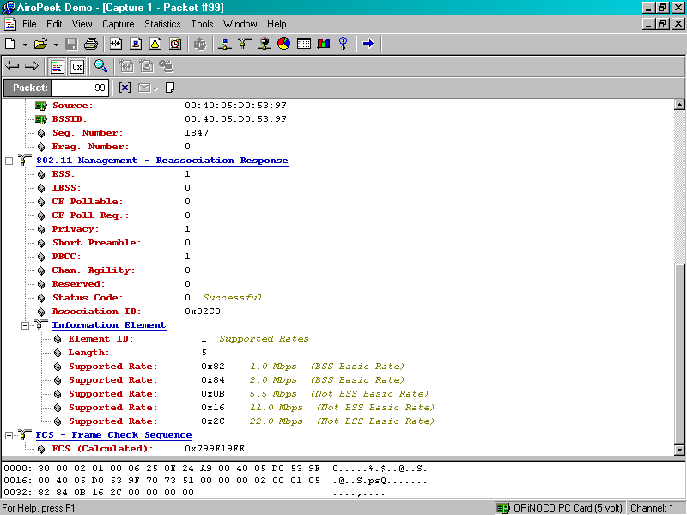
Association Frame
The AP says ok we can associate

Slide 143
Acknowledgement Frame
The wireless NIC tells the AP it received the AP’s answer to the association request

Slide 144

Acknowledgement Frame

Slide 145
Beacon Frame
A beacon frame sneaks in here

Slide 146

Beacon Frame

Slide 147

Beacon Frame

Slide 148

Beacon Frame

Slide 149
EAPOL – Start Frame
As this is a Windows XP box the wireless NIC asks the AP if it can talk EAPOL
Since the AP cannot, it just ignores the request as it has no idea what the wireless NIC is talking about

Slide 150
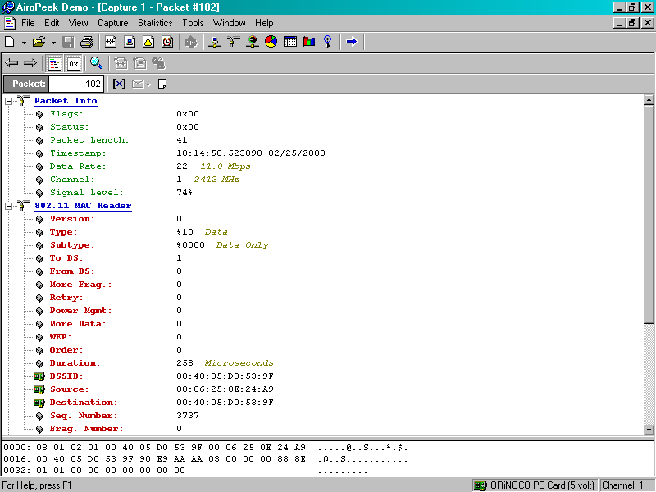
EAPOL – Start Frame

Slide 151
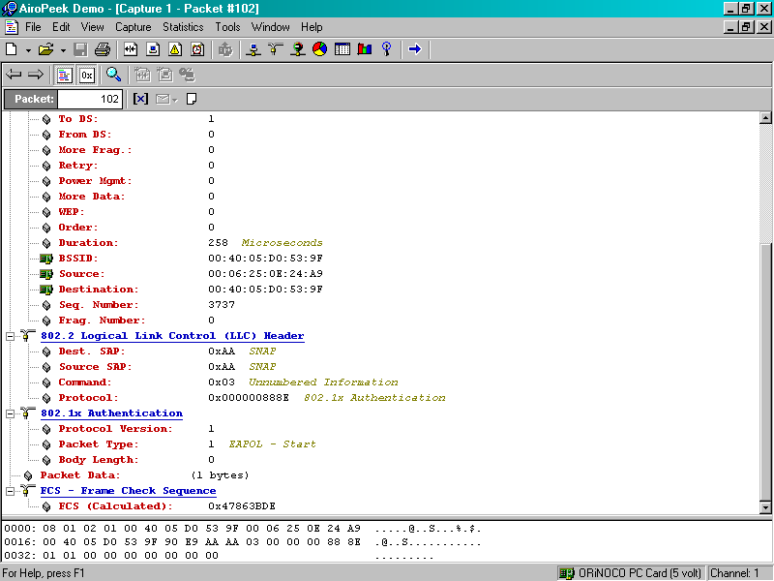
EAPOL – Start Frame

Slide 152
The End of the Sequence
This is the end of the sequence of frames used when a wireless NIC starts up and finds an AP already turned on

Slide 153
Typical Startup Sequence
Next we will look at a set of frames that shows another typical startup sequence
Again a computer with a wireless NIC was booted, but here the NIC is seen using Active Scanning by sending out a series of Probe Requests in order to find an AP
After that the sequence is the same as the one above

Slide 154
Typical Startup Sequence
This sequence also shows a couple of non wireless activities just to illustrate the complete startup process
The first non wireless related activity is a series of ARP conversations that resolve MAC to IP addresses
Finally, being a Windows box, the computer activates the NetBIOS name service

Slide 155
Typical Startup Sequence
As this goes on for a while, just the first few frames are shown
The next slide shows a listing of all of the frames involved
Then each set of related frames is discussed

Slide 156
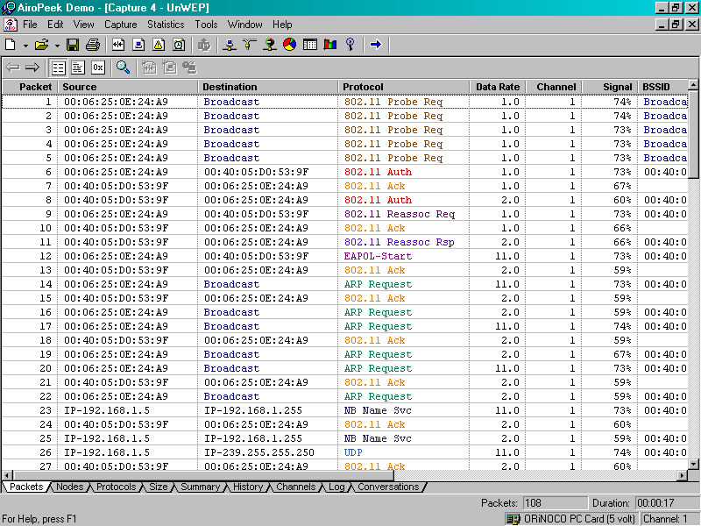
Typical Startup Sequence

Slide 157
Looking for an Access Point
In the first set of frames the computer is sending out a series of Probe Requests
In other words, it is saying is hello, hello, is anyone there, is anyone there

Slide 158
Looking for an Access Point

Slide 159
Looking for an Access Point
There are several interesting fields in the Probe Request frame that is used by the wireless NIC to find someone to talk to

Slide 160
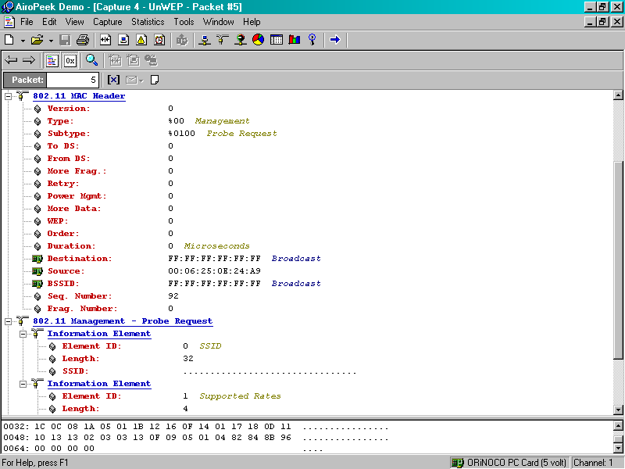
Looking for an Access Point
Indicates that this is a Probe Request frame
From the wireless NIC’s MAC address to the broadcast address
Notice that no SSID
is sent

Slide 161
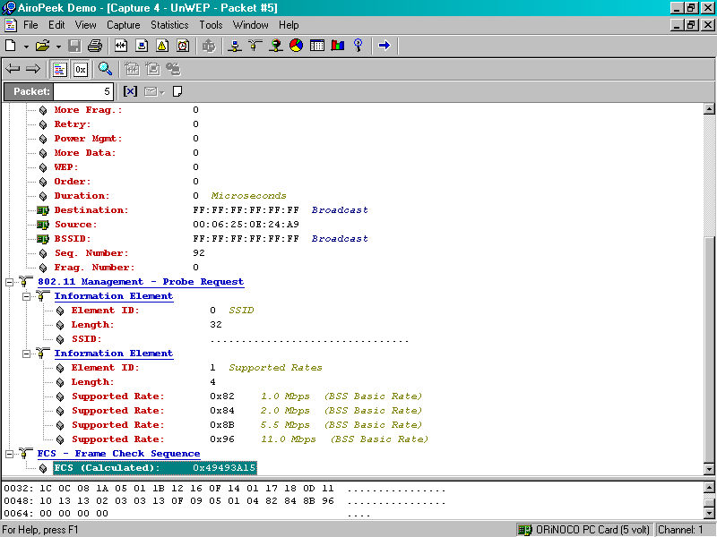
Looking for an Access Point
The wireless NIC announces the speeds at which it can connect

Slide 162
The Access Point Answers
After a while an access point answers by using a Probe Response
The Probe Response has some interesting fields

Slide 163
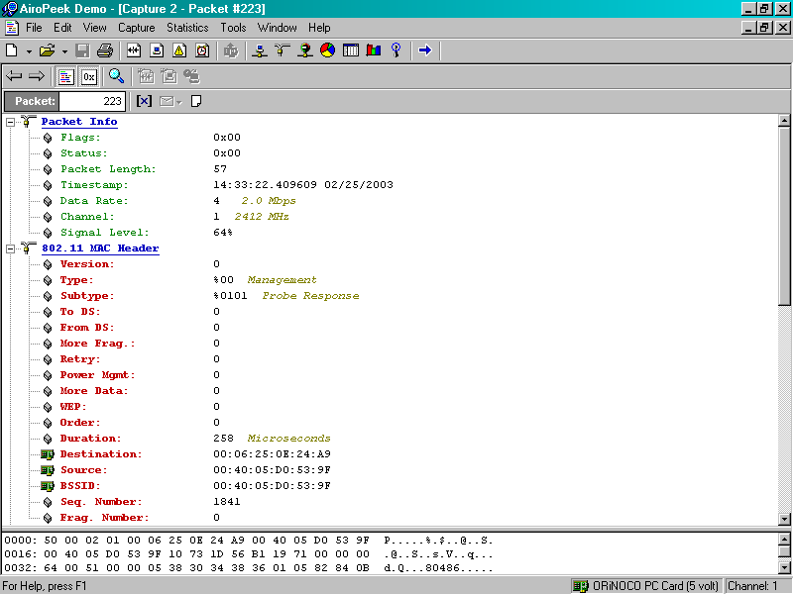
Finding an Access Point
Indicates that this is a Probe Response frame

Slide 164

Finding an Access Point
Notice the data rates, including the nonstandard rate supported by the AP

Slide 165

Finding an Access Point

Slide 166
Authentication
The computer then authenticates and associates with the access point as described in detail above
Recall that the first step in making a connection to an access point is to authenticate to it
In the next example the wireless NIC answers the AP’s probe response with a request to authenticate

Slide 167
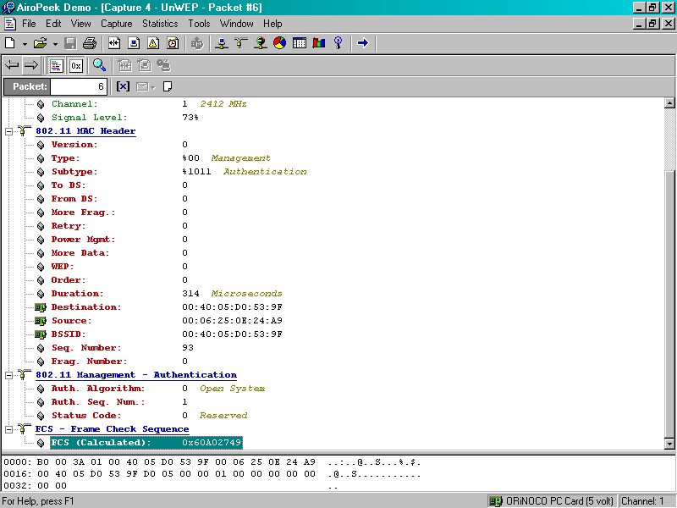
Authentication
Indicates that this is an Authentication related frame
From the wireless NIC’s MAC address to the AP’s MAC address
The wireless NIC proposes Open System authentication

Slide 168
Typical Acknowledgement
Shown next is a typical Acknowledgment frame as sent by the receiver back to the sender

Slide 169
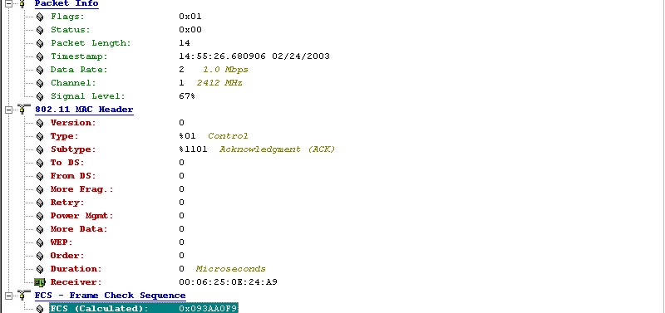
Typical Acknowledgement
Notice the slow speed at which this takes place as neither side is yet sure of what the other side is capable
Indicates this is an Acknowledgment
There is no source, just the receiver’s MAC address

Slide 170
Authentication
Now the AP answers the wireless NIC by saying it agrees to talk to the wireless NIC

Slide 171

Authentication
Indicates this is related to Authentication
From the AP to the wireless NIC
The AP says Open System is ok with it

Slide 172
Association
Next the wireless NIC asks the AP if it can associate with it

Slide 173
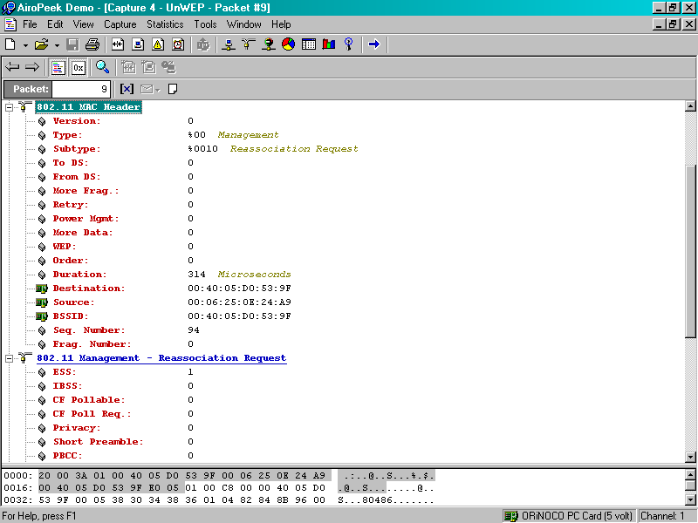
Association
Indicates this is an Association request
From the wireless NIC to the AP

Slide 174
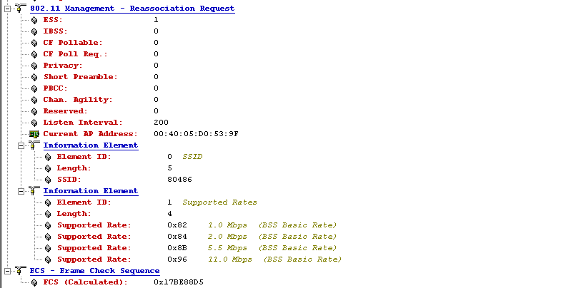
Association
The wireless NIC sends its SSID

Slide 175
Association
Next the AP answers the wireless NIC
In this case the AP says ok, let’s associate

Slide 176
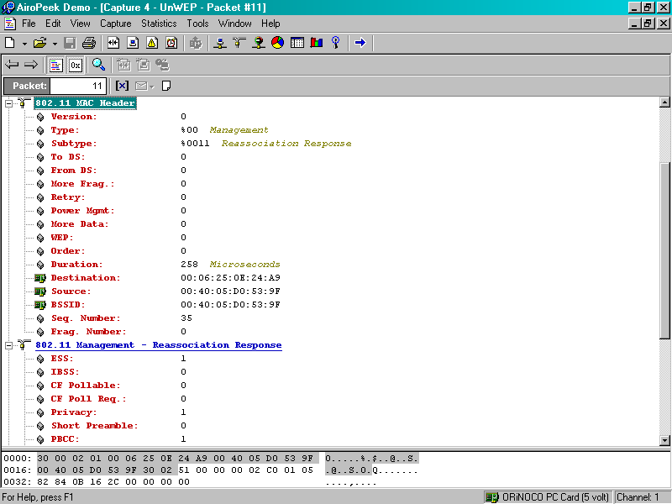
Association
Indicates this is an Association response
From the AP to the wireless NIC

Slide 177
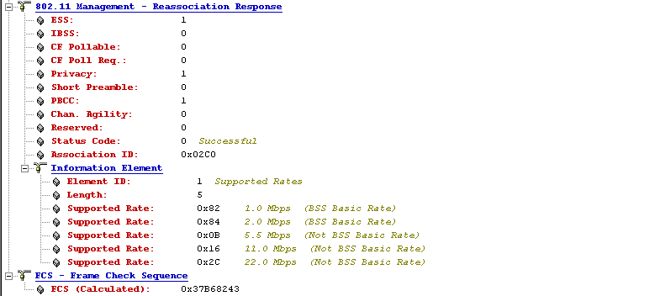
Association
The AP says ok, let’s associate
The AP announces the speeds at which it can talk.
Notice that in this case the AP supports a nonstandard speed

Slide 178
Summary of the Details
That’s all the details for this section
Now back to the discussion of the general listing of the frames

Slide 179
Checking for 802.1x Support
As the computer in this case is running Windows XP, it asks the AP if it supports the IEEE 802.1x authentication method
This is the EAPOL-Start message
EAPOL is the Extensible Authentication Protocol over LAN
As the AP in this case does not support this, it ignores the query by the wireless computer

Slide 180
Checking for 802.1x Support

Slide 181
Wireless is Finished Now
At this stage the purely wireless part of the startup procedure is over
As can be seen this is fairly short and straight forward
The remainder of the packets relate to resolving MAC addresses to IP addresses using ARP
Then resolving the NetBIOS name and other Windows browser related issues

Slide 182
ARP Conversations
In this section the computer is resolving physical layer MAC addresses and network layer IP addresses

Slide 183
ARP Conversations

Slide 184
NetBIOS Conversations
Shown next is part of the NetBIOS and Windows browser related conversations

Slide 185
NetBIOS Conversations

Slide 186
Conclusion
This sequence of 802.11 frames should have shown you what the fields in these frame headers actually do
It is vital to understand how something works in order to properly use it in a data network

