Slide 1
Service Providers
Last Update 2011.09.03
1.4.0

Slide 2
Objectives of This Section
Learn
What a service provider is
How to order a data line from one

Slide 3
What is a Service Provider
A service provider is an entity that provides you with something you cannot do or would rather not do for yourself
In this context a MAN or WAN related service, such as one of the data lines discussed earlier in the course
The various kinds of service providers are commonly categorized as follows

Slide 4
Categorizing Service Providers
ILEC - Incumbent Local Exchange Carrier
These are the old line RBOCs that have been around forever using one name or the other, such as
AT&T
Verizon

Slide 5
Categorizing Service Providers
CLEC - Competitive Local Exchange Carrier
Those in competition with the ILECs
IXC - Interexchange Carrier
These were originally long distance competitors to the RBOCs
Now they compete on data lines as well

Slide 6
Categorizing Service Providers
ISP – Internet Service Provider - Tier 1
These entities form the top level Internet
They run the backbone
ISP - Internet Service Provider Tier 2
A layer below the basic Internet backbone
ISP - Local
In other words, all the other ISPs

Slide 7
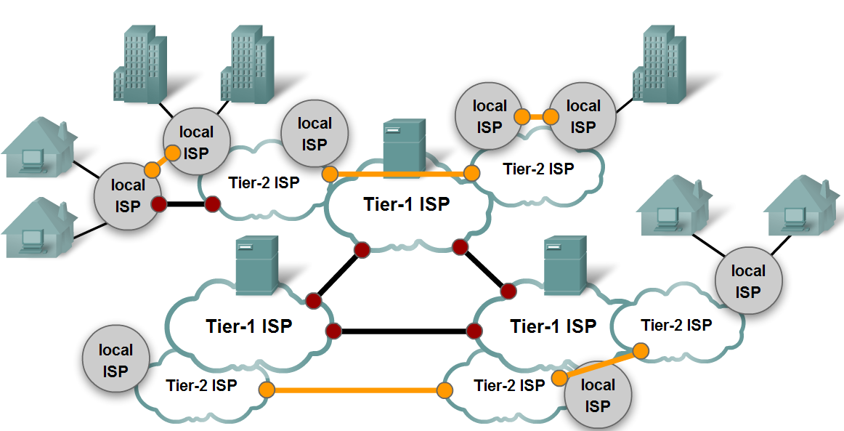
ISP Levels

Slide 8
Categorizing Service Providers
Cable Company
Also called MSOs for multisystem operator these are a growing alternative to the ISPs

Slide 9
Categorizing Service Providers
Greenfield IXC
These are the same as the IXCs, but without an old style network
They provide services like the original IXCs, but over new style networks
Level 3

Slide 10
Categorizing Service Providers
Utilities
Some traditional utility companies are beginning to get into the telecom business, since they have right of way all over their service area already
Some of these are targeted at end users, but more are in the wholesale and metropolitan service area

Slide 11
Categorizing Service Providers
Colo - Colocation Provider
These organizations provide space for equipment and WAN access

Slide 12
Provisioning
The actual process of calling up a service provider to order a line is called provisioning
A closely related part of this process is purchasing and installing the equipment required at each end of the data line being ordered
These are all of the parts after the demarc on each end of the circuit

Slide 13
Provisioning
You or another service provider you select, such as a reseller of WAN equipment, must select and install this equipment for the circuit to operate properly with the service the phone company installs at your request

Slide 14
Provisioning
Once that process has been completed it should be apparent what types of lines are needed from where to where
But what exactly is required before calling up the service provider
Let's look at a sample of a form used by a local company

Slide 15
Provisioning
They fill this form out before they call the service provider
It contains all of the information required to place the order, in this case for T Carrier lines

Slide 16
Sample Order Form

Slide 17
Sample Order Form

Slide 18
Provisioning
At the top it says this is a new circuit
Under the Data Services section the T1 box is checked
This indicates they want full T1 circuits
The only details required for a T1 circuit are the coding and framing types
B8ZS is the common coding type as they have selected here

Slide 19
Provisioning
ESF - Extended Superframe is the frame type use with B8ZS
Down at the bottom they have listed the contact information for both ends of the circuit
This includes
Street address, city, state, zip code
The exact location for the demarc, which may need to be extended

Slide 20
Provisioning
The local contact with several phone numbers
With this information the service provider will go to each end of the location and install the demarc at the requested location, on the first trip we hope

Slide 21
Provisioning
In many cases the ordering of the circuit is done online
For example, here for a MPLS line using a AT&T point-to-point circuit

Slide 22
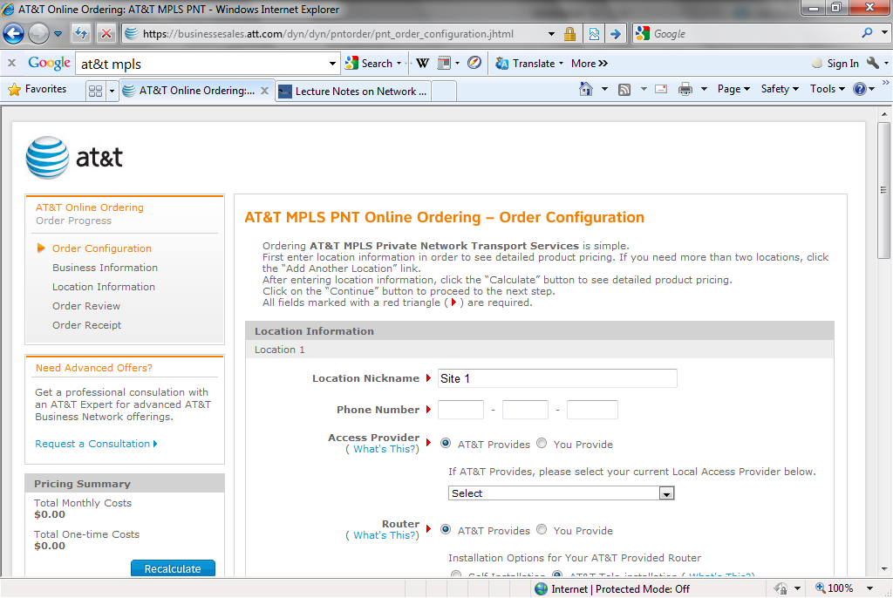
Provisioning

Slide 23
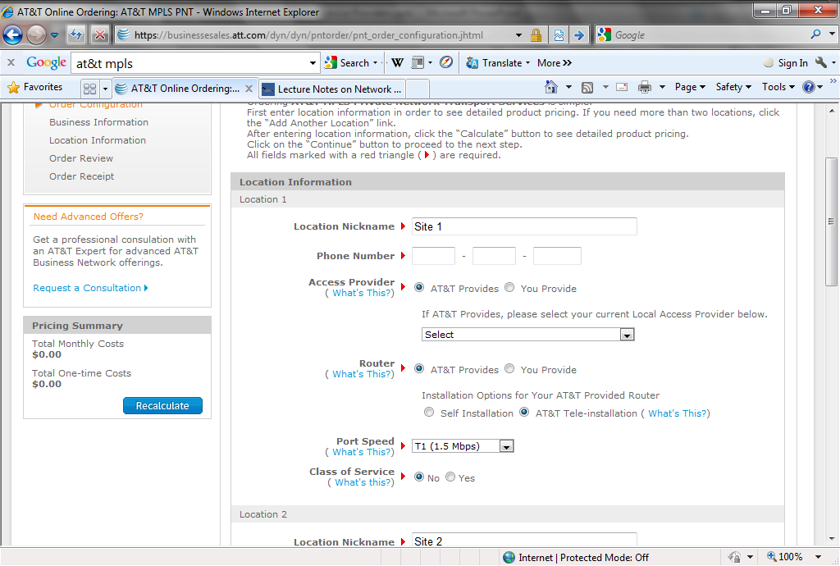
Provisioning

Slide 24
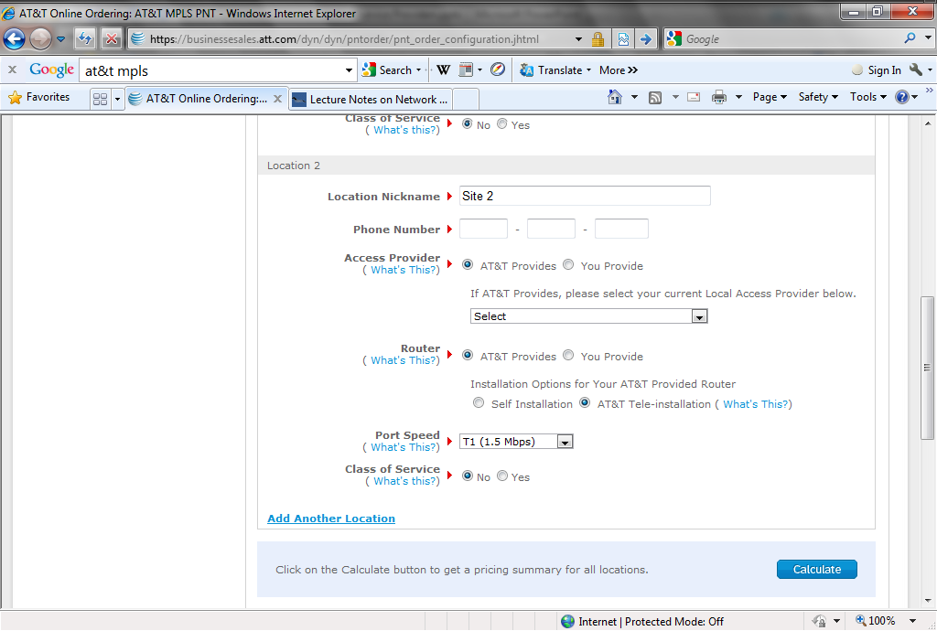
Provisioning

Slide 25
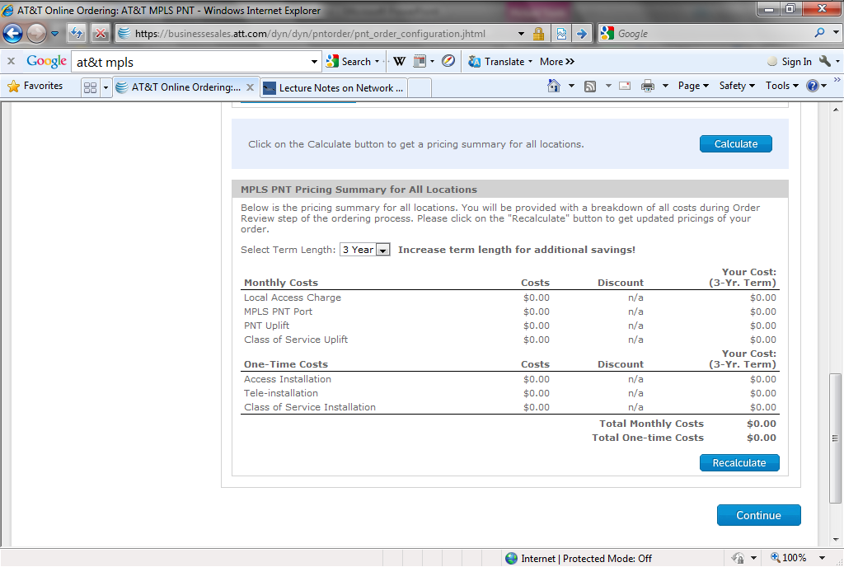
Provisioning

Slide 26
Provisioning
Once the circuit is up, according to the phone company, the equipment must be installed
You can do this yourself, someone else in the company may have the training to handle this, or you may hire a company that provides this type of service
When the equipment is in, the circuit must be checked to see if it is running clean

Slide 27
Provisioning
This can be done in one of two ways
First is to just assume the line installed by the phone company is working perfectly
If you assume this, you just start sending data down the line
This can be real data, test data, or diagnostic data such as pings

Slide 28
Provisioning
Then look to see if it arrived intact at the other end, using whatever diagnostic methods are provided by the equipment you are using
The second method is to call the phone company up after the equipment is up and running at each end of the circuit

Slide 29
Provisioning
Then you ask them to setup a loopback at the other end of the circuit, if that can be done for the circuit type
For example, for a T1 line the loopback can be at the demarc or the CSU side of the CSU/DSU
You then send out diagnostic packets like pings to see how the circuit performs

Slide 30
Provisioning
If there is a problem you have the phone company on the line with you as this test is being performed so they can work on the problem right then
Which is the best way
It depends on how many circuits and how pressed for time you are

Slide 31
Provisioning
I would say about 30% of circuits are
Not turned on at all
Have problems sending and receiving data
Are located in the wrong physical location
Here is what one network administrator saw as stated in an email message to one of the newsgroups I read

Slide 32
Provisioning
Here are some statistics from the last year of WAN implementations at my company
178 Unique circuit installs
- 123 FR
- 55 point-to-point circuits (T1 or greater)
46 Incomplete installations due to errors
- 13 Extended DEMARC
- 1 Bad serial port on router
- 12 Bad configuration by LEC
- 21 Bad configuration by CLEC
- 2 Operator error

Slide 33
Partner Programs
If you do not know how to install or configure the equipment required to talk to the data line you are going to use, then an organization associated with the equipment makers partner program can be hired to do this

Slide 34
Partner Programs
For example, in the Cisco Partner program there are various levels of partners from resellers of equipment to those that can design, install, and manage your network for you

Slide 35
Partner Program

