Slide 1
IPv6
Last Update 2012.10.29
1.9.0

Slide 2
Objectives of This Section
Learn about IPv6

Slide 3
IPv6
Soon we will move to IPv6
Why you might ask
Well because

Slide 4
Why 32 Bits
How did we get here
Why were 32 bits used in the first place
Why not 64 or 128 or some other number of bits for the address space
Let’s here from the person who decided on 32 bits in the first place
Here is an email message sent to the NANOG mailing list in 2010 on this

Slide 5
Why 32 Bits
Hi,
Vint Cerf kindly sent through some more explanation
Regards,
Mark

Slide 6
Why 32 Bits
Begin forwarded message:
Date: Sat, 3 Apr 2010 08:17:28 -0400
From: Vint Cerf vint at google.com
To: Mark Smith nanog at 5d5b20a518b8f6864949bd940457dc124746ddc.nosense.org
c: Andrew Gray <3356 at blargh.com
NANOG List nanog at nanog.org
Subject: Re: legacy /8

Slide 7
Why 32 Bits
When the Internet design work began, there were only a few fairly large networks around
ARPANET was one
The Packet Radio and Packet Satellite networks were still largely nascent
Ethernet had been implemented in one place: Xerox PARC
We had no way to know whether the Internet idea was going to work

Slide 8
Why 32 Bits
We knew that the NCP protocol was inadequate for lossy network operation (think: PRNET and Ethernet in particular)
This was a RESEARCH project
We assumed that national scale networks were expensive so there would not be too many of them
And we certainly did not think there would be many built for a proof of concept

Slide 9
Why 32 Bits
So 8 bits seemed reasonable
Later, with local networks becoming popular, we shifted to the class A-D address structure and when class B was near exhaustion, the NSFNET team (I think specifically Hans-Werner Braun but perhaps others also) came up with CIDR and the use of masks to indicate the size of the "network" part of the 32 bit address structure

Slide 10
Why 32 Bits
By 1990 (7 years after the operational start of the Internet and 17 years since its basic design), it seemed clear that the 32 bit space would be exhausted and the long debate about IPng that became IPv6 began
CIDR slowed the rate of consumption through more efficient allocation of network addresses but now, in 2010, we face imminent exhaustion of the 32 bit structure and must move to IPv6

Slide 11
Why 32 Bits
Part of the reason for not changing to a larger address space sooner had to do with the fact that there were a fairly large number of operating systems in use and every one of them would have had to be modified to run a new TCP and IP protocol
So the "hacks" seemed the more convenient alternative

Slide 12
Why 32 Bits
There had been debates during the 1976 year about address size and proposals ranged from 32 to 128 bit to variable length address structures
No convergence appeared and, as the program manager at DARPA, I felt it necessary to simply declare a choice

Slide 13
Why 32 Bits
At the time (1977), it seemed to me wasteful to select 128 bits and variable length address structures led to a lot of processing overhead per packet to find the various fields of the IP packet format
So I chose 32 bits
vint

Slide 14
IPv6
Larger address space
IPv6 addresses are 128 bits, compared to IPv4's 32 bits
It has been said that if each IPv6 address was represented by a grain of sand, then the entire address space would generate enough sand to build 300 million earth size planets
However, not all of these individual grains of sand will be able to be used as single addresses

Slide 15
IPv6
So like IPv4, the useable number of addresses is less at about the number of grains of sand in the world
The exact total number being
340,282,366,920,938,463,374,607,431,768,211,456
That’s about
56,713,727,820,156,300,000,000,00
addresses for each person on the planet

Slide 16
IPv6
This larger addressing space allows more support for addressing hierarchy levels, a much greater number of addressable nodes, and simpler autoconfiguration of addresses
Globally unique IP addresses
Every node can have a unique global IPv6 address, which eliminates the need for NAT
However, I expect everyone will still use NAT

Slide 17
IPv5
Now if we are currently using IPv4 and moving to IPv6, what happened to IPv5
Let’s let Geoff Huston in an article from the Internet Protocol Journal for March 2011 Volume 14 Number 1 explain
He writes

Slide 18
IPv5
It would be reasonable to expect the successor protocol of IP Version 4 to be called IP Version 5, but as it turned out Version 5 of the Internet Protocol Family was already taken
In the late 1980s the Internet Protocol itself was the topic of a considerable level of research, as researchers experimented with different forms of network behavior

Slide 19
IPv5
Version 5 of the Internet Protocol was reserved for use with an experimental IP protocol, the Internet Stream Protocol, Version 2 (ST-II), written up as RFC 1190 in 1990
When it came time to assign a protocol number of the “next generation” of IPv4, the next available version number was 6, hence IPv6

Slide 20
IPv5
Since this is the same story I have heard before, I assume this is definitive

Slide 21
IPv7
There is no IPv7 or any other reasonable replacement for IPv6 at least not yet
So how long will IPv6 be useful
In the same issue of the Internet Protocol Journal Geoff Huston offers this view

Slide 22
IPv7
The design intent of IPv6 is a usable lifetime of more than 50 years, as compared with a “mainstream” deployment lifetime of IPv4 of 15 years, assuming that you are prepared to draw a line at around 1995 and claim that at that time the protocol moved from an interesting academic and research project to a mainstream pillar of the global communications industry

Slide 23
IPv6 Address Types
There are three main types of IPv6 addresses
They are

Slide 24
IPv6

Slide 25
IPv6

Slide 26
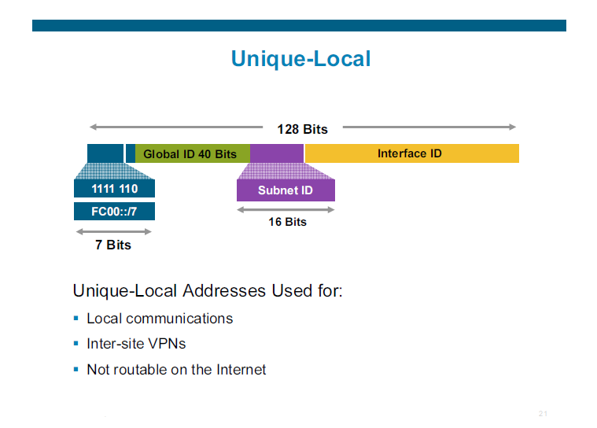
IPv6

Slide 27
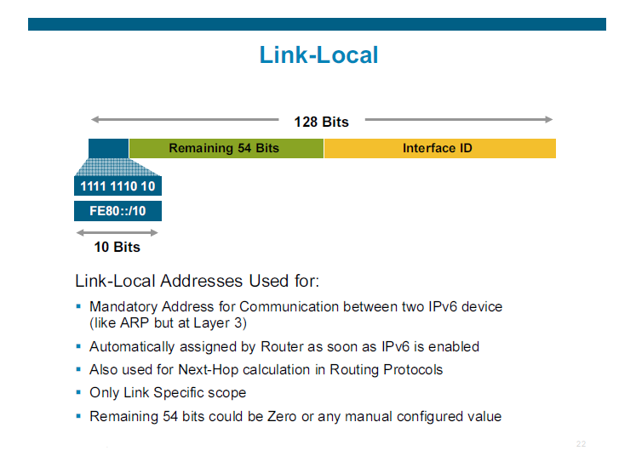
IPv6

Slide 28
IPv6 Address Parts
Each IPv6 address is 128 bits
In practice these 128 bits are divided into two 64 bit parts
The first 64 bits from the left are for the networks of various sorts
The last 64 bits are for the host’s interface
As in

Slide 29
IPv6 Address Parts

Slide 30
IPv6 Address Parts
The last 64 bits are straight forward, they belong to the end device’s NIC
As the first 64 bits are designated for networks these bits are further subdivided
Since most distribution plans assume that each end user will be given a /48 address this means the remaining 16 bits of the first 64 are available to the end user for networks at their premises

Slide 31
IPv6 Address Parts
The first 48 bits are then used by those networks above the end user premises
The first three are reserved by the IANA
The next 45 are for use by various Regional Registries and upstream ISPs
As in

Slide 32
IPv6 Address Parts

Slide 33
IPv6 Distribution From IANA
The hierarchy of address distribution will be as follows
Each RIR receives a /12 to /23
Large ISPs each receive a /32
They are expected to give each customer a /48 although some are thinking a /56 may work as well
Each network a customer has regardless of size or type will use a /64

Slide 34
IPv6

Slide 35
IPv6

Slide 36
IPv6

Slide 37
IPv6 Address Types
There are two basic types of IPv6 addresses
Global Unicast Address or GUA
Unique Local Address or ULA
In each case the form is eight groups, always eight groups
So if you see a set of :: where the zeros have been replaced just expand this section so that there are eight altogether

Slide 38
GUA
For a GUA the first four groups will come from an ISP
It constitutes the network and subnet they use
The last four groups are yours to use as you wish
For example 2001:0db8:1234:1234::

Slide 39
GUA Address Planning
Lets examine the most commonly suggested IPv6 addressing plan
Recall that a IPv6 address is 128 bits long
Each digit in the hexadecimal numbering system is a nibble or half a byte
This is equivalent to four bits so an IPv6 address can be represented by 32 hexadecimal numbers

Slide 40
GUA Address Planning
These 32 hex numbers are the ones we will use for the addressing plan
Prefixes in a slash number form are used to group IPv6 addresses
These prefixes define all of the addresses that start with the same series of bits from the leftmost

Slide 41
GUA Address Planning
For example
2001:0db8::/32
This would indicate all of the addresses from
2001:0db8:0000:0000:0000:0000:0000:0000
to
2001:0db8:ffff:ffff:ffff:ffff:ffff:ffff
You will often see the 0db8 part of the address written as just db8 as the rules allow prepended zeros to be omitted

Slide 42
GUA Address Planning
Why did they do this, just to confuse you
They love to do these sorts of things to students
Back to the point
To see why this is so lets see how the 128 bits fit into this
Consider that each group of hex numbers separated by a colon represents 4 binary places

Slide 43
GUA Address Planning
As there are 32 of these hex numbers, 32 times 4 equals 128 bits
Likewise each group of four hex numbers represents 16 bits
So if the first two groups of hex numbers are already set for you, then you have a prefix of /32 as 16 plus 16 equals 32

Slide 44
GUA Address Planning
Doing all of this by groups of four makes deciphering the address easier
Therefore, common prefixes seen are /48, /52, /56, /60, /64, and so on
Using this by fours division address blocks are typically assigned this way
Here is a table from RIPE NCC the European regional Internet registry in a December 2010 white paper

Slide 45
GUA Address Planning

Slide 46
GUA Address Planning
As seen in the table a large ISP will receive a /32 from their regional registry, such as ARIN for the US
They will then assign smaller blocks of addresses to their customers
The general assumption is that all organizations will receive a very large address space from their upstream provider

Slide 47
GUA Address Planning
In this example it is a /48
Now giving everyone a /48 may seem like a waste of address space, and it is, but this is where we are today
In no case should a home user be provided with only a single address as would be the case with a /128 as was common with IPv4

Slide 48
GUA Address Planning
It is further expected that each network – LAN, CAN, MAN, and WAN link will be assigned a /64
So we have 16 bits to use to create these /64 networks from the /48 address space provided to us since the difference between 48 and 64 is 16

Slide 49
GUA Address Planning
This means we can create 65,536 networks with 18,446,744,073,709,551,616 hosts on each one of these networks
This is eighteen quintillion, four hundred forty-six quadrillion, seven hundred forty-four trillion, seventy-three billion, seven hundred nine million, five hundred fifty one thousand, six hundred and 16 or just 18,446 quintillion hosts

Slide 50
GUA Address Planning
These 65,536 network names would range from
2001:0db8:1234:1234:0000/64
to
2001:0db8:1234:1234:ffff/64
If a /56 is provided, then 256 networks can be created instead of 65,536

Slide 51
GUA Address Planning
What you do with these addresses is up to you
You may just assign these 65,536 one by one
The RIPE white paper suggests three ways to do this in a more organized way based on location, use type, or both
There are advantages and disadvantages to each approach

Slide 52
GUA Address Planning
The white paper suggests this layout
2001:0db8:1234:1234:LLLL:GGGG:BBBB:BBBB
16 bits are assigned to a location L and 16 bits are assigned to a use type G
As a result, there are 32 bits remaining Bs
Following this addressing plan, 65,536 locations can be addressed, with each location having 65,536 use types
Each of these networks could have 4,294,967,296 end devices

Slide 53
GUA Address Planning
The location and use types could be reversed to provide
2001:0db8:1234:1234:GGGG:LLLL:BBBB:BBBB
16 bits are assigned to a use type G and 16 bites to locations L yielding 65,536 use types with each one in 65,536 possible locations
Placing use types first can make it easier to apply security policies such as ACLs

Slide 54
ULA
The ULA is similar to the RFC1918 private address space
These addresses begin with fd
This address is in three parts
Network Address
Subnet Address
Device Address

Slide 55
ULA Network Address
After the fd the next ten hex numbers – the first 48 of the 128 bits - define the network address
This is the first three hex number groups
This can be anything after the fd

Slide 56
ULA
For simplicity this form can be used
fd00:0000:0000
or any of the 72 trillion network and subnet possibilities

Slide 57
IPv6
Site multihoming
IPv6 allows hosts to have multiple IPv6 addresses and allows networks to have multiple IPv6 prefixes
Consequently, sites can have connections to multiple ISPs without breaking the global routing table

Slide 58
IPv6
Header format efficiency
A simplified header with a fixed header size makes processing more efficient

Slide 59
IPv6
Improved privacy and security
IPsec is the IETF standard for IP network security, available for both IPv4 and IPv6
Although the functions are essentially identical in both environments, IPsec is mandatory in IPv6
IPv6 also has optional security headers

Slide 60
IPv6
Flow labeling capability
A new capability enables the labeling of packets belonging to particular traffic flows for which the sender requests special handling, such as nondefault quality of service (QoS) or real-time service

Slide 61
IPv6
Increased mobility and multicast capabilities
Mobile IPv6 allows an IPv6 node to change its location on an IPv6 network and still maintain its existing connections
With Mobile IPv6, the mobile node is always reachable through one permanent address

Slide 62
IPv6 Traffic Types
In IPv6 there are still three types of traffic
However the functions are somewhat different
Unicast
One to one
Anycast
One to nearest
Examples of when anycast addresses could be used are load balancing, content delivery services, and service location

Slide 63
IPv6 Traffic Types
For example, an anycast address could be assigned to a set of replicated FTP servers
A user in China who wants to retrieve a file would be directed to the Chinese server, whereas a user in the Europe would be directed to the European server
Multicast
One to many
This is also the broadcast format

Slide 64
IPv6 Host Address
The host address in IPv6 is referred to as an interface identifier
Its form is
OUI – FFFE – Serial Number
In other words the hex numbers FFFE are placed between the two parts of the MAC address
This makes it a 64 bit address

Slide 65
IPv6

Slide 66
Implementing IPv6
The question now is how best to make the move from 4 to 6
Transition ideas include
Dual stacks
Tunneling
Translation
The suggested approach is to dual stack where possible, otherwise tunnel

Slide 67
Implementing IPv6
Consult the Internet Protocol Journal for March 2011 Volume 14 Number 1 for a detailed discussion of the possible ways to implement this transition
In particular consult Transitioning Protocols by Geoff Huston

Slide 68
Implementing IPv6
Dual stacking is basically what occurred when the move from other routed protocols such as IPX, Decnet, and so forth to TCP/IP occurred
I ran multiple routed protocols on each end device, then tunneled the non TCP/IP traffic across the WAN

Slide 69
Implementing IPv6
Keep in mind that all the devices out there will have to be upgraded or replaced during this implementation process
Many devices cannot and will not ever support IPv6 in any form
Various models suggest anywhere from 80 years to 2 years to make this transition
Huston in the article above guesses 5 years

Slide 70
Implementing IPv6
Why not just NAT forever
Huston says this
But address sharing has its limitations
When a single household shares a single address, nothing unusual happens
But If I were to try to do the same address-sharing trick of using a single IP address to share across, say 2,000 customers, I would cross over into a world of pain

Slide 71
Implementing IPv6
Many applications today gain speed through parallelism, and they support parallelism through consuming port addresses
Each IP address can support the parallel operation of 65,535 sessions, using a 16-bit port identifier as the distinguishing identifier
But when address sharing is used, these ports are shared across the number of devices that are all sharing this common address

Slide 72
Implementing IPv6
When 2,000 customers are sharing a single address and each customer has some 20 or so devices, then the average number of port addresses per device is 1.5
Common applications that exploit parallel operation include such favorites as Gmail, Google Maps, and iTunes

Slide 73
Implementing IPv6
With a sufficiently constrained number of available ports to use, these applications would cease to work
Indeed, many network applications would fail, and at a level of a single address shared across 2,000 households, I would guess that up to half of these 2,000 customers would not have a working Internet at any single point in time

Slide 74
Dual Stacks
A dual stack is just what it says
Both IPv4 and IPv6 are run at the same time
For example

Slide 75
Dual Stacks

Slide 76
Dual Stacks

Slide 77
Tunneling
There are several tunneling methods
Manual 6 over 4 tunneling
Dynamic 6 over 4 tunneling
Intrasite Automatic Tunnel Addressing Protocol
Teredo Tunneling
At this point which one to use is undecided

Slide 78
Translation
A form of NAT can be used on some Cisco routers to translate 6 to 4 and back
Translation is not a preferred method

Slide 79
Sources
The slides with the blue line on top are from a presentation by Byju Pularikkal to the Nanog meeting 51 in January 2011

