Slide 1
Oracle Virtualization Last Update 2012.03.23 1.0.0

Slide 2
Objectives of This Section
Learn
About Oracle’s approach to virtualization

Slide 3
What is Oracle Virtualization
Oracle has a comprehensive virtualization approach
Here is a graphic from their web site showing what they offer

Slide 4
Oracle Virtualization

Slide 5
Virtual Box
Here we will concentrate on Oracle’s free desktop virtualization method called Virtual Box
This is a hosted virtualization method
Once downloaded and installed a virtual machine is setup this way

Slide 6
Virtual Box
Click New
Then Next

Slide 7
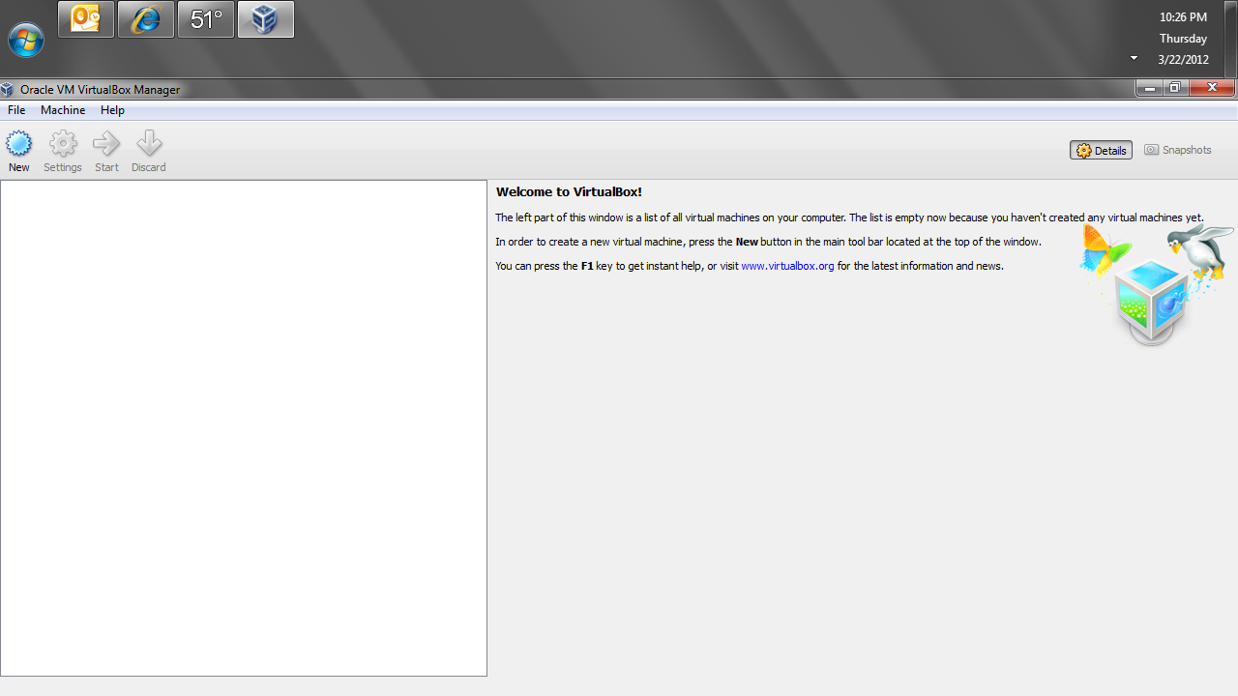
Virtual Box

Slide 8
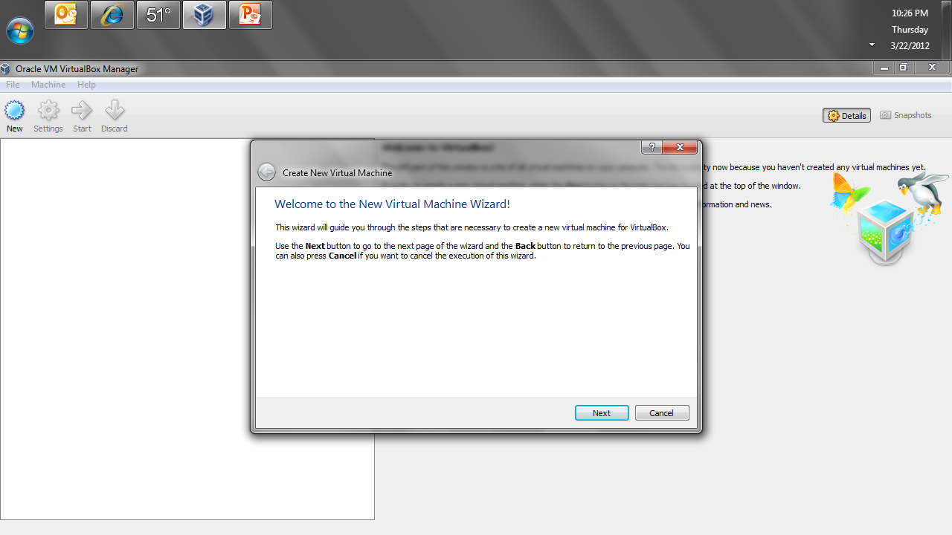
Virtual Box

Slide 9
Virtual Box
Give the virtual machine a name
Select the type of OS that will run inside the virtual machine

Slide 10
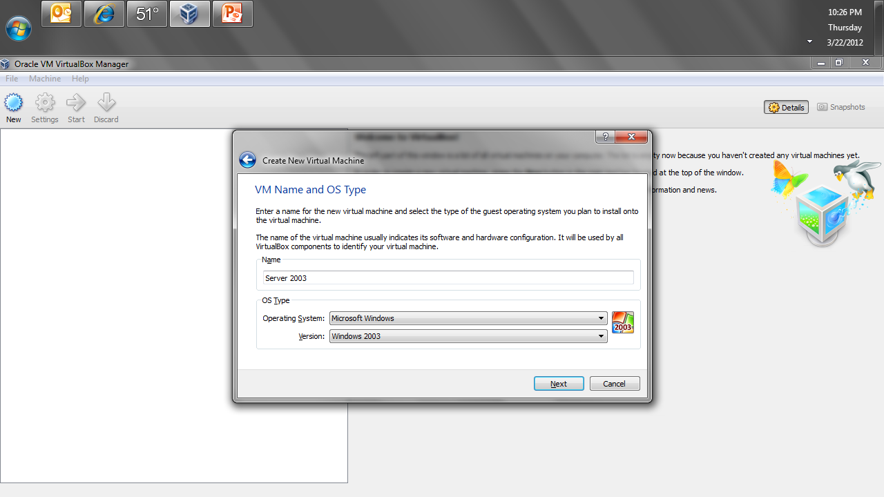
Virtual Box

Slide 11
Virtual Box
Select the amount of memory
Be sure this is an amount sufficient for the virtualized OS, otherwise the installation will fail with a strange set of errors in the log
This is true of the disk size selected later as well

Slide 12
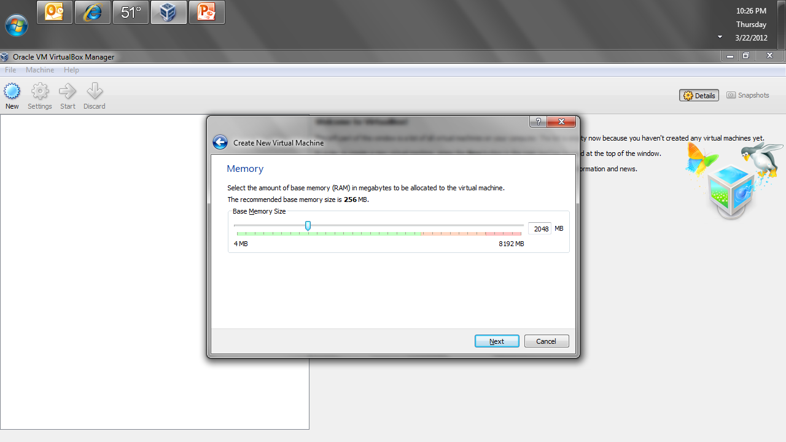
Virtual Box

Slide 13
Virtual Box
Next is the setup of the virtual disk drive
The default is fine for the Virtual Hard Disk
I find a VHD Virtual Hard Disk works best for most operating systems
Dynamically allocated is fine as well

Slide 14
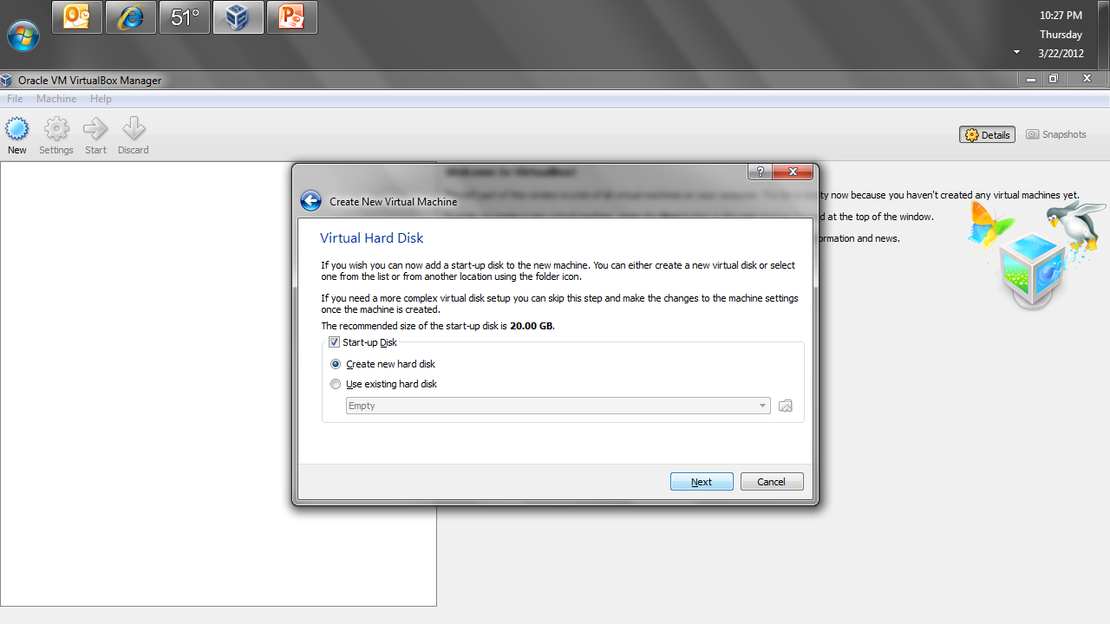
Virtual Box

Slide 15
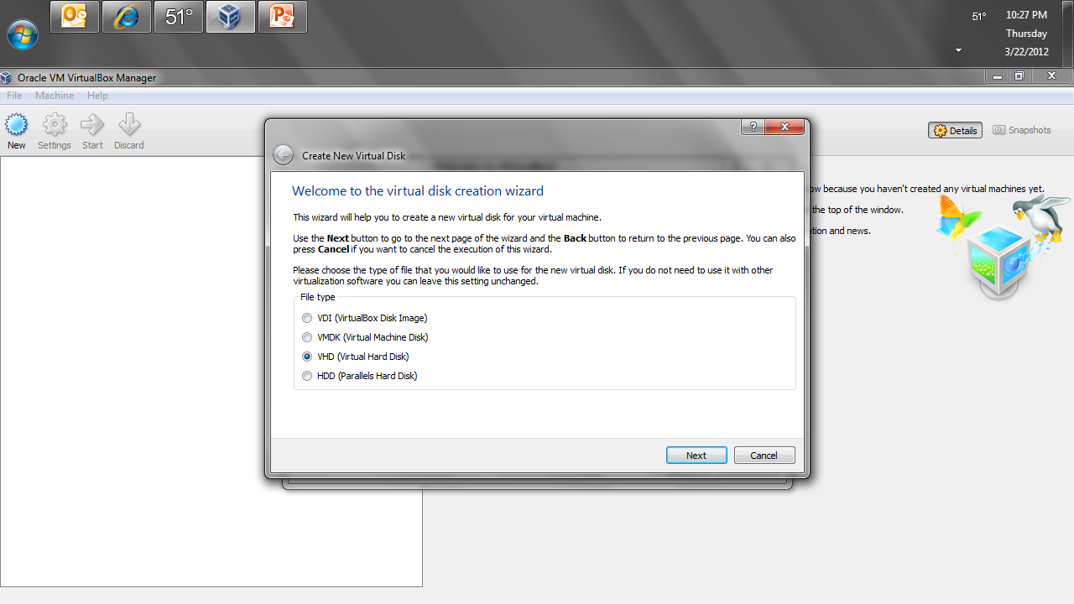
Virtual Box

Slide 16
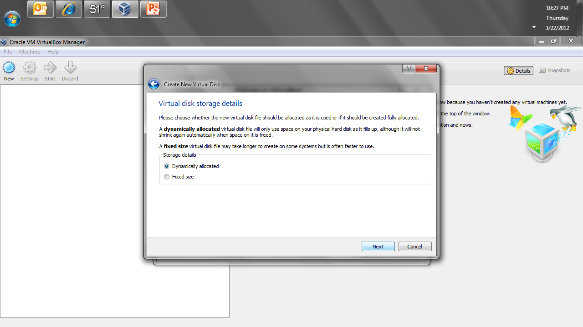
Virtual Box

Slide 17
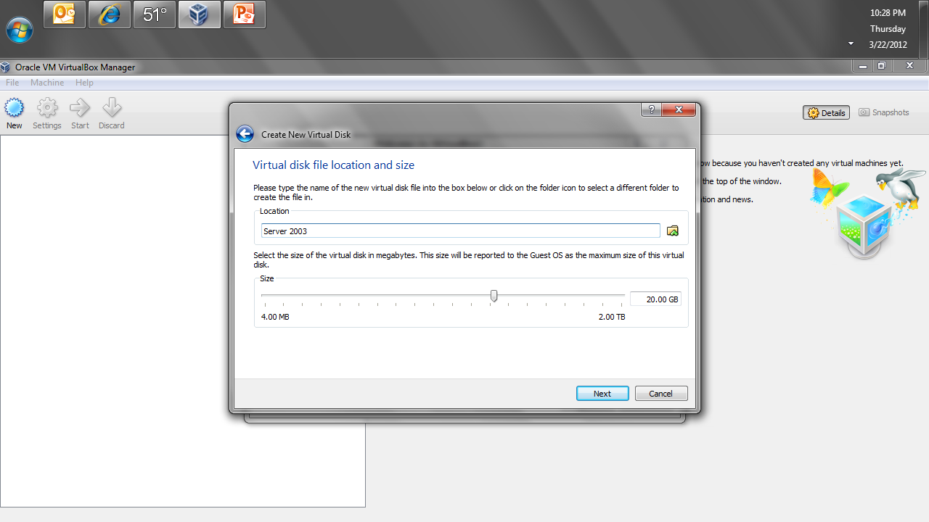
Virtual Box

Slide 18
Virtual Box
Click Create

Slide 19
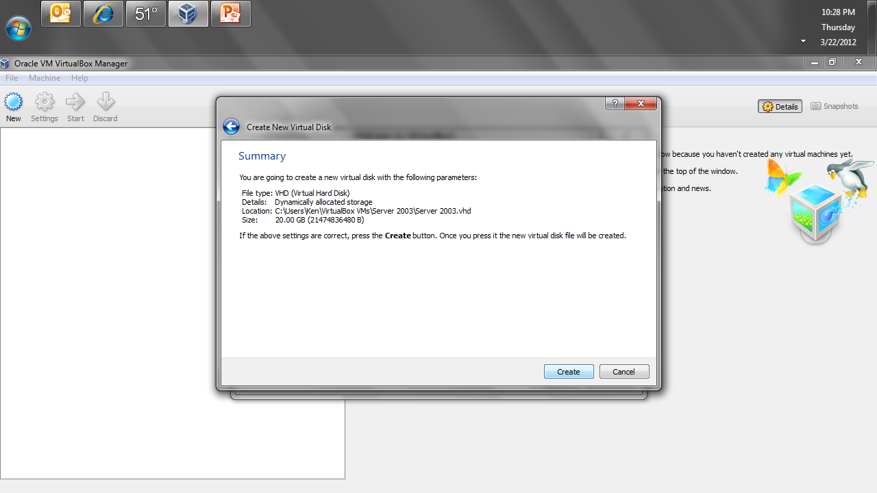
Virtual Box

Slide 20
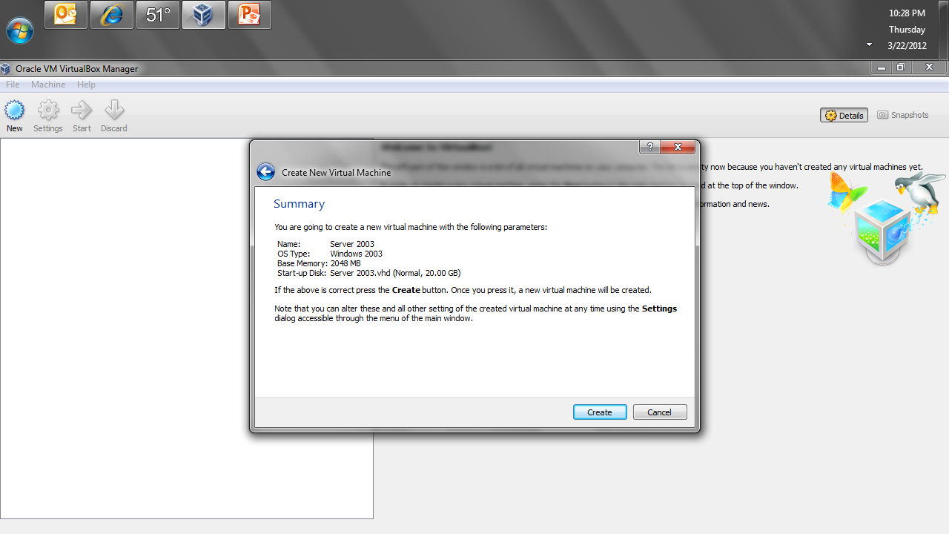
Virtual Box

Slide 21
Virtual Box
Now you have a VM with no OS
Click Start, OK, and Next

Slide 22
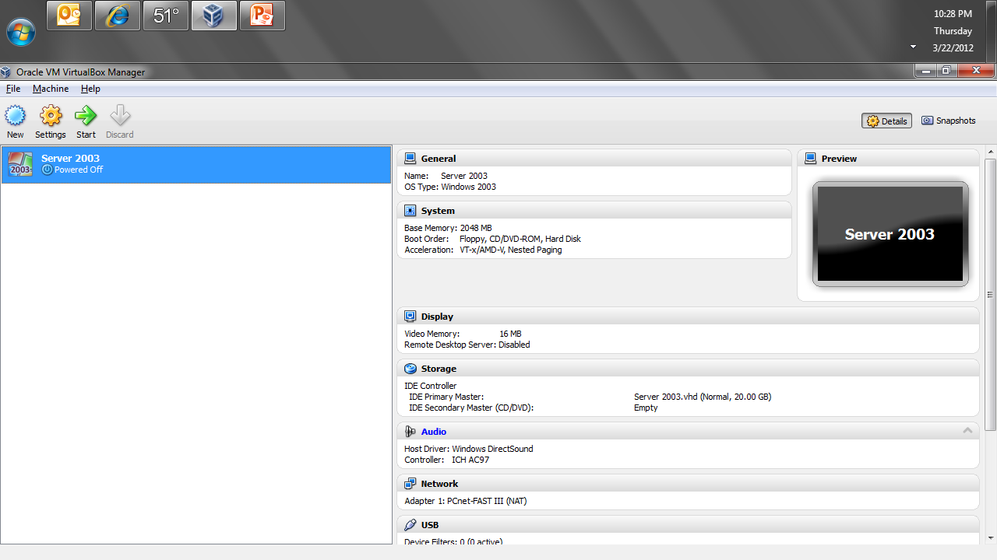
Virtual Box

Slide 23
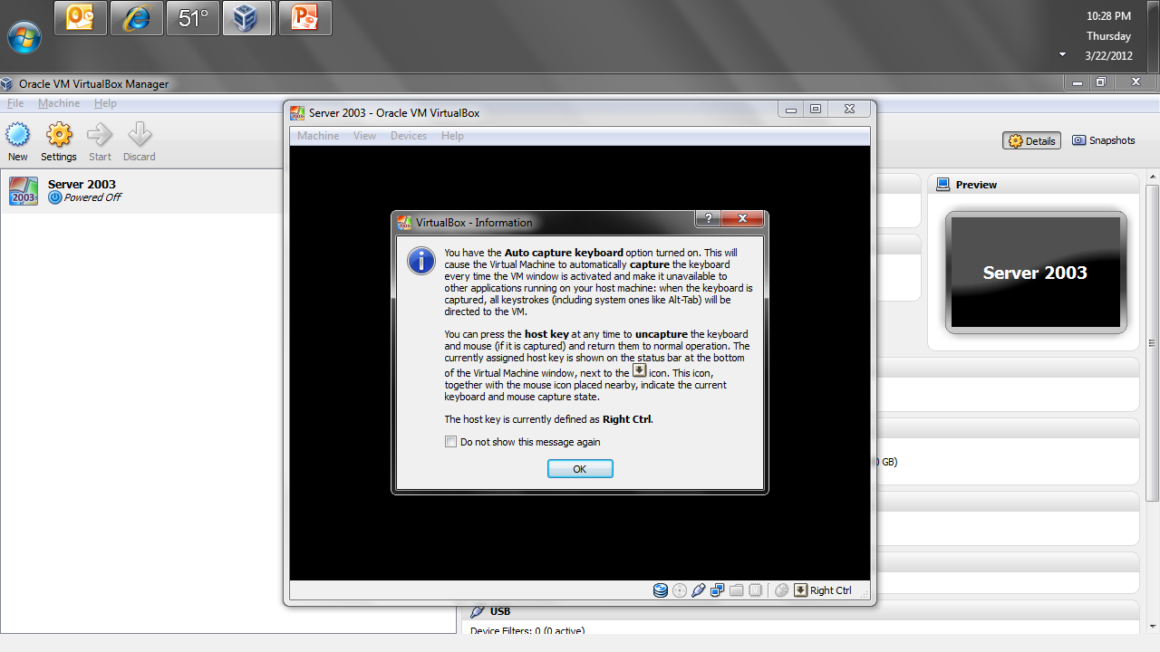
Virtual Box

Slide 24
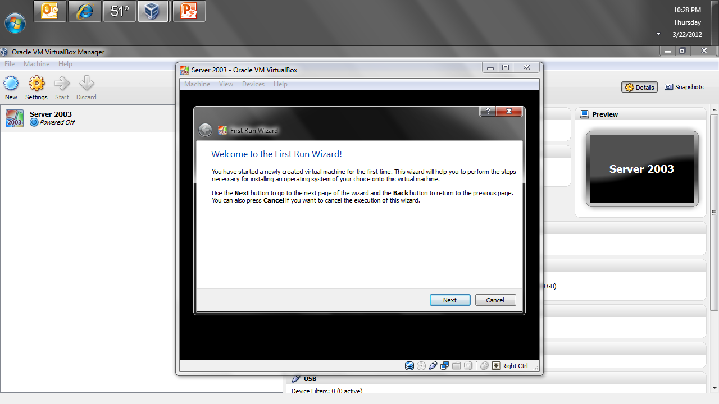
Virtual Box

Slide 25
Virtual Box
Now tell it where to find the OS
In most cases a ISO file on the hard drive of the host machine is best
Click Start
In the window the usual OS installation steps will appear

Slide 26
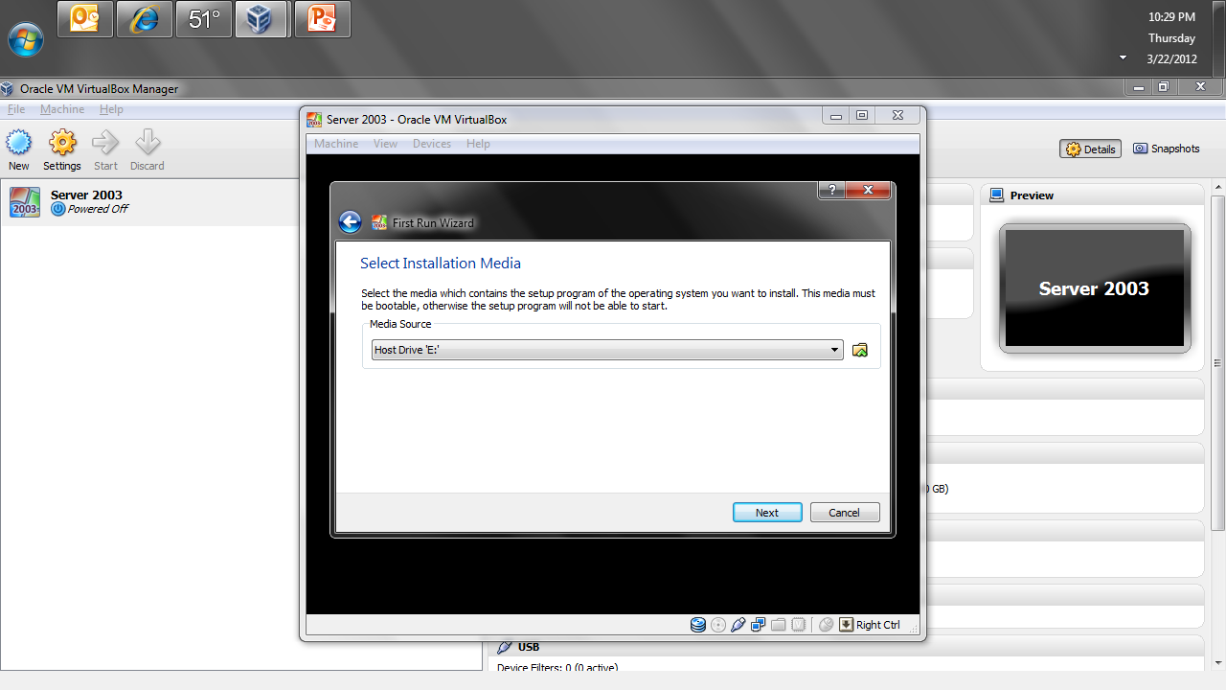
Virtual Box

Slide 27
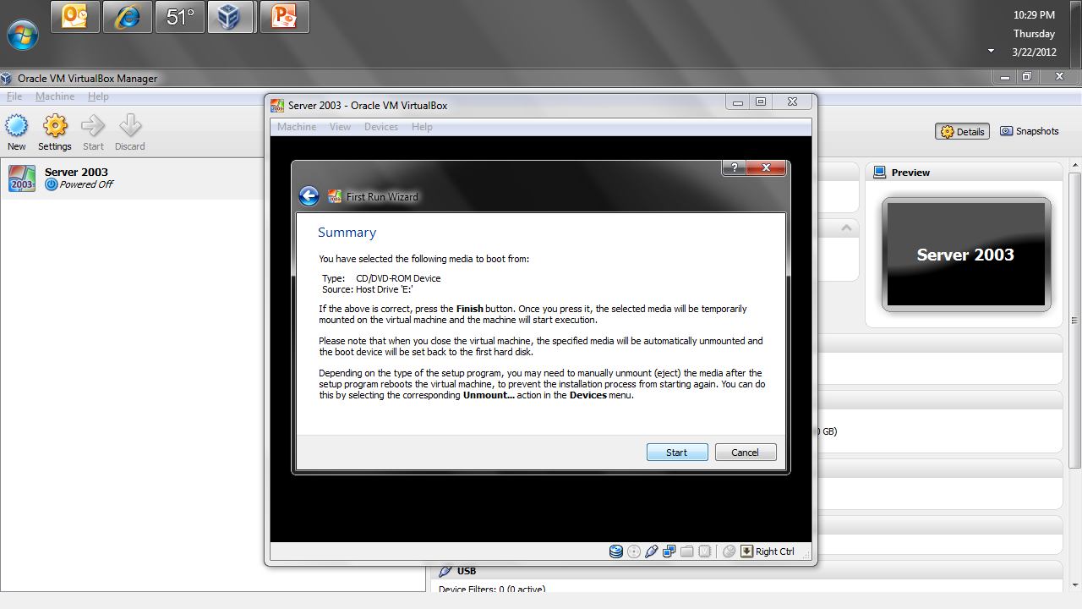
Virtual Box

Slide 28
Virtual Box

Slide 29
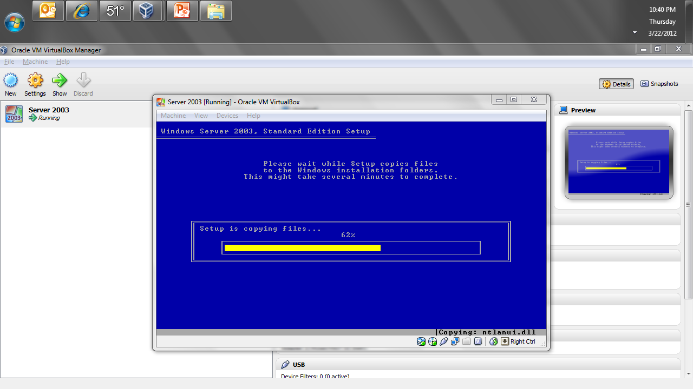
Virtual Box

Slide 30
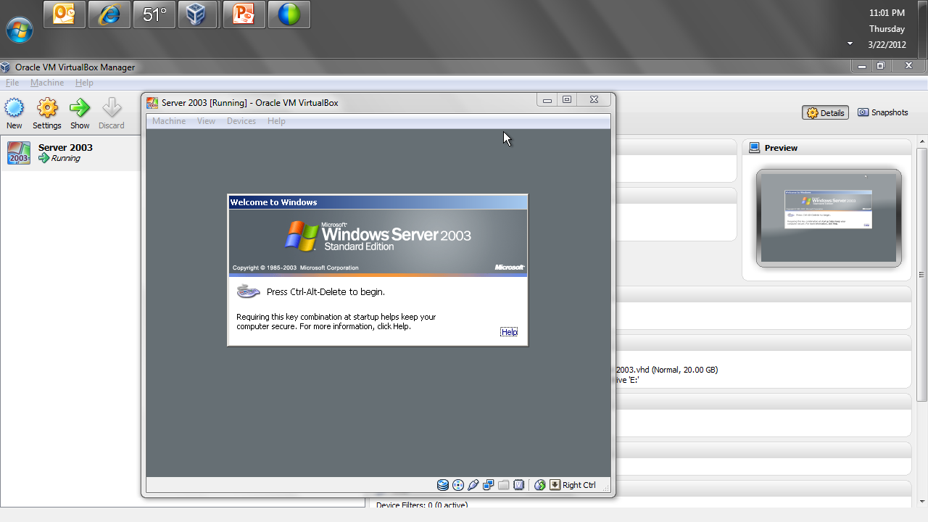
Virtual Box

Slide 31
Virtual Box
At this point the VM is created and the OS is installed in it

