Slide 1
Disk Interfaces Last Update 2011.04.14
1.9.0

Slide 2
Objectives of This Section
Learn
What disk interfaces are used in servers now and will be used in the future

Slide 3
Types of Disk Interfaces
There are three types of disk interfaces that may be encountered in servers
Currently in wide use
IDE ATA
SCSI
Fibre Channel

Slide 4
IDE ATA
IDE – Integrated Drive Electronics also called ATA – Advanced Technology Attachment is the most widely used disk interface
It was designed to be offered in workstations so as to lower their cost
Over the last few years it is seeing more and more use in servers

Slide 5
IDE ATA
The correct name for this interface is ATA, but everyone calls it IDE
This standard was developed in the late 1980s by the SFF – Small Form Factor Committee, a group made up of engineers from major drive manufacturers
At its basic level this is a 16-bit parallel path method

Slide 6
IDE ATA
It connects the devices using a 40 pin unshielded ribbon cable
The cable length is limited to 18 inches
This interface is designed for data storage devices only
This is used in workstations and small servers

Slide 7
IDE ATA
The current IDE standards include
Ultra DMA/33, which transfers data at 33 MBps
Ultra DMA/66 at 66 MBps
It uses an 80-pin shielded cable
So the old and new will diverge
ATA/100 at 100 MBps also uses the 80-pin cable
ATA/133 at 133 MBps

Slide 8
IDE ATA
Serial ATA with speeds from 150 to 600 MBps is the latest version

Slide 9
Serial ATA
Interest in SATA - Serial ATA arose as the standard parallel ATA schemes run out of speed
Besides the speed increase another nice aspect is the cable used
It is smaller, as well as allowing for a longer distance of 1 meter

Slide 10
Serial ATA
In this scheme all devices are seen as masters, this simplifies configuration
Serial ATA allows for hot swapping of drives, which means the computer does not have to be turned off first

Slide 11
SCSI
SCSI – Small Computer Systems Interface is the dominate disk interface seen in servers
This is another parallel path interface
It uses unshielded ribbon cables with a varying number of pins depending on the type of SCSI it is

Slide 12
SCSI
Maximum cable length is 3 meters for normal SCSI and 25 meters for Differential SCSI
The SCSI chain must be terminated at each end
Termination in this case is a resistor
Many newer devices figure out they are on the end and self terminate

Slide 13
SCSI
This is particularly true of controller boards
But you must be sure the chain is properly terminated or errors in data will occur
Each device in the SCSI chain has a number to identify it
This is the device number
For 8 bit SCSI it ranges from 0 to 7
For 16 bit SCSI it ranges from 0 to 15

Slide 14
SCSI
SCSI naming is quite confused
In general it proceeds this way
There are three major parameters that define a SCSI connection and distinguish the various versions
Bus width
Bus speed
Type of electrical signaling

Slide 15
SCSI-1
SCSI-1 is the original version of SCSI
It uses an 8-bit-wide data bus running at 5 MHz
The transfer rate of up to 5 MBps

Slide 16
SCSI-2
SCSI-2 introduced two major changes
The first, called Fast SCSI, doubled the bus speed to 10 MHz, which doubled the maximum transfer rate of the 8-bit bus to 10 MBps
It also introduced a 16-bit bus, known as Wide SCSI, which again doubled throughput

Slide 17
SCSI-2
Combine the two new features and you get Fast/Wide SCSI, capable of up to 20-MBps throughput

Slide 18
SCSI-3
SCSI-3, also known as UltraSCSI, doubled the bus speed to 20 MHz
This gave 8-bit UltraSCSI a 20 MBps transfer rate and Wide UltraSCSI a 40 MBps rate

Slide 19
SCSI Signaling
The original SCSI specification called for single-ended signaling
That is each bit is sent as a signal over an individual wire
With this system, SCSI-1 cables could stretch up to 6 meters
SCSI-2 was limited to just 3 meters

Slide 20
SCSI Signaling
UltraSCSI and Wide UltraSCSI could handle 3-meter runs, but not with more than four devices
Eight devices limited the cable to 1.5 meters
Differential signaling, which uses two wires for each bit, changed this

Slide 21
SCSI Signaling
The extra circuitry used for differential signaling is more expensive and requires more power
The big advantage is that differential SCSI buses can be as long as 25 meters

Slide 22
SCSI
The LUN is the Logical Unit Number from 1 to 7
This number only applies to multifunction devices
Of which I have never seen an example
So in most cases the SCSI device has a device number and a LUN of 0

Slide 23
SCSI
Type | MBps | Cable Single | Cable Differential | Devices
SCSI-1 | 5 | 6 | 25 | 8
Fast SCSI | 10 | 3 | 25 | 8
Fast/WideSCSI | 20 | 3 | 25 | 16
UltraSCSI | 20 | 1.5 |  | 8
Wide Ultra SCSI | 40 | 1.5 | 25 | 8 or 16
Ultra2 SCSI | 40 |  | 25 | 8
Wide Ultra 2 SCSI | 80 |  | 25 | 16
Ultra 160 SCSI | 160 |  |  | 16
Ultra 320 SCSI | 320 |  |  | 16
Ultra 640 SCSI | 640 |  |  | 16

Slide 24
Serial Attached SCSI
A new version of SCSI that abandons the parallel interface for a serial interface is Serially Attached SCSI
This solution is being positioned as faster than SATA and less costly than Fibre Channel

Slide 25
Serially Attached SCSI

Slide 26
Fibre Channel
Fibre Channel is called Fibre Channel instead of Fiber Channel because it was first designed for fiber optic cable, but later copper was used as well
So to remove the association with fiber cable the spelling was changed to fibre
Seems a little silly to me

Slide 27
Fibre Channel
Fibre Channel takes the best part of SCSI the command set and adds higher data transfer rates and longer distances
In contrast to the other two types of disk interfaces this is a serial interface
It uses copper or fiber in half and full duplex modes

Slide 28
Fibre Channel
When used to connect storage devices it uses an arbitrated loop called FC-AL implemented as a hub; similar in function to an Ethernet hub or a switched fabric; similar to an Ethernet switch
In the arbitrated loop approach bandwidth is shared among all the devices on the network

Slide 29
Fibre Channel
In the switched fabric a port is dedicated to each device
Fibre Channel functions like a group of networked devices
The basic setup is a loop of media with connections for up to 126 devices
In practice only 30 devices are practical at present, but this is quite a few more than the typical fifteen drives in SCSI

Slide 30
Fibre Channel
A second controller can be used to create a second connection to each device
One path can be dedicated to reads and the other to writes to reduce losses in speed due the overhead produced by the arbitration activity
In its original form Fibre Channel was used to connect the LAN to the SAN

Slide 31
Fibre Channel
The SAN still used SCSI for the storage devices themselves
Manufacturers are now starting to use Fibre Channel for all of the connections including the drives
Why not use SCSI for SANs
SCSI does have the required high transfer rate

Slide 32
Fibre Channel
It is also limited to a 25-meter cable length at best
SCSI has higher overhead in that it requires a handshake and an acknowledgement for each byte transferred
Fibre Channel uses a 2048 byte packet to transfer data

Slide 33
Fibre Channel
This larger packet is more efficient in that it sends more data before an acknowledgement is required
Fibre Channel is not a standard, therefore Interconnection can be a problem
The cost of Fibre Channel is higher compared to SCSI

Slide 34
Fibre Channel
Some vendors think Ethernet will overtake both SCSI and Fibre Channel as Fibre Channel can also be carried over Ethernet links

Slide 35
iSCSI
With iSCSI native SCSI commands are carried using TCP/IP protocols
This approach is gaining in popularity as it runs over normal cabling rather than the special purpose Fibre Channel cables

Slide 36
Who Use What
Here is a graph from the April 2011 issue of Storage magazine showing what is most commonly used

Slide 37
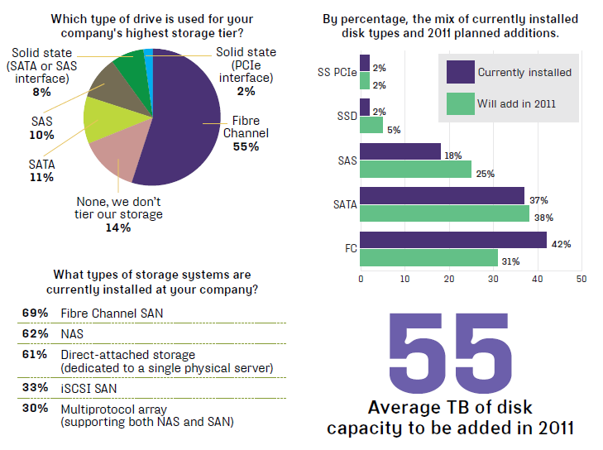
Who Use What

