Slide 1
Using Wacom Tablets For Class
Last Update 2013.08.26
1.3.0

Slide 2
Wacom Tablets
Wacom tablets come in two basic forms
Single Screen
Separate Screen

Slide 3
Single Screen
Wacom has a line of tablets that include their own screen
This creates a more intuitive environment than the more common separate screen and tablet approach
The problem with these is the high cost
Here is an example

Slide 4
Cintiq Single Screen Tablets

Slide 5
Separate Screen
The less expensive line of Wacom tablets uses an existing monitor to display the underlying information and that added through the tablet

Slide 6
Intuos Separate Screen Tablets

Slide 7
Installing the Tablet
Installation of the tablet consists of connecting it to the computer and installing the drivers

Slide 8
Connecting to the Computer
The connection to the computer is made using a USB cable or a wireless module

Slide 9
Installing the Drivers
The drivers are available on the included disc or downloaded from Wacom

Slide 10
Using the Tablet
The tablet is just another input device
It can be used as a substitute for or in addition to other input devices

Slide 11
Uses of the Tablet
Uses of the tablet for class include
Drawing diagrams
Annotating slides
Annotating videos
Annotating live displays
Correcting documents

Slide 12
Drawing Diagrams
Any suitable program can be used to draw freehand illustrations
An example is Sketchbook Express that can be downloaded from Wacom after registering the Intuos tablet
It is easy to use and provides a full screen sheet of paper to work on

Slide 13
Drawing Diagrams
Pressing the T or Tab button toggles all of the extra windows on or off so you can draw and then let the students clearly see what was drawn

Slide 14
Annotating Slides in PowerPoint
It is not at all obvious as to how to annotate slides when they are running in full screen mode in PowerPoint
The procedure I discovered by consulting the source of all knowledge is this
Start the slide show in PowerPoint
Hover the pen just to the right of the bottom left corner until a small slanted pen appears
It looks like this

Slide 15
Annotating Slides in PowerPoint

Slide 16
Annotating Slides in PowerPoint
Click on this pen with the tablet’s pen
A popup menu will appear

Slide 17
Annotating Slides in PowerPoint

Slide 18
Annotating Slides in PowerPoint
Select the pen
Begin writing

Slide 19
Annotating Videos
To write on a video while it is running or stopped an overlay program is required
The only one I have found so far is Ink2Go
To use it you must move back and forth between the mouse and the pen or program the pen’s slide switch to do the navigation functions such as starting and stopping the video

Slide 20
Annotating Live Displays
The only way I have found to write on a web page or other running program that does not directly support the tablet is to use an overlay program
In this case Ink2Go as well

Slide 21
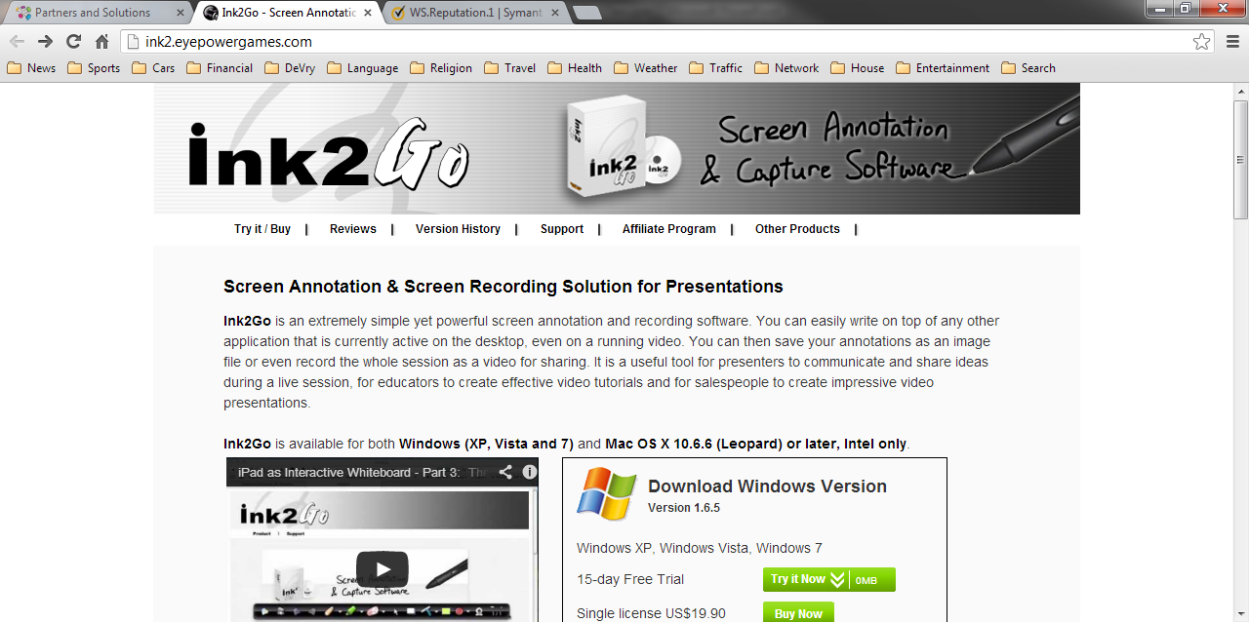
Ink2Go

Slide 22
Ink2Go
This does not appear to be an entirely stable program as it functions fine, but reports an app crash each time it is exited

Slide 23
Annotating Word Documents
To write directly on a Word document
Open the document
The pen will not work at this point
Touch the document with the pen tip
The Ink Tools Pen menu will appear in the Ribbon
Click on the Pen menu in the Ribbon
Now you can write on the document

Slide 24
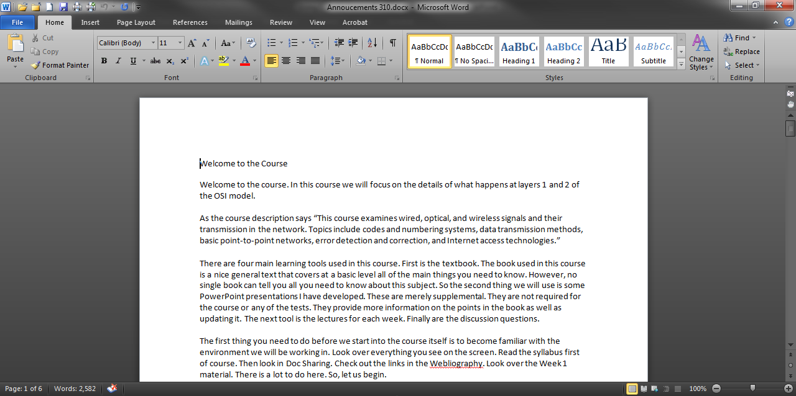
Annotating Word Documents

Slide 25
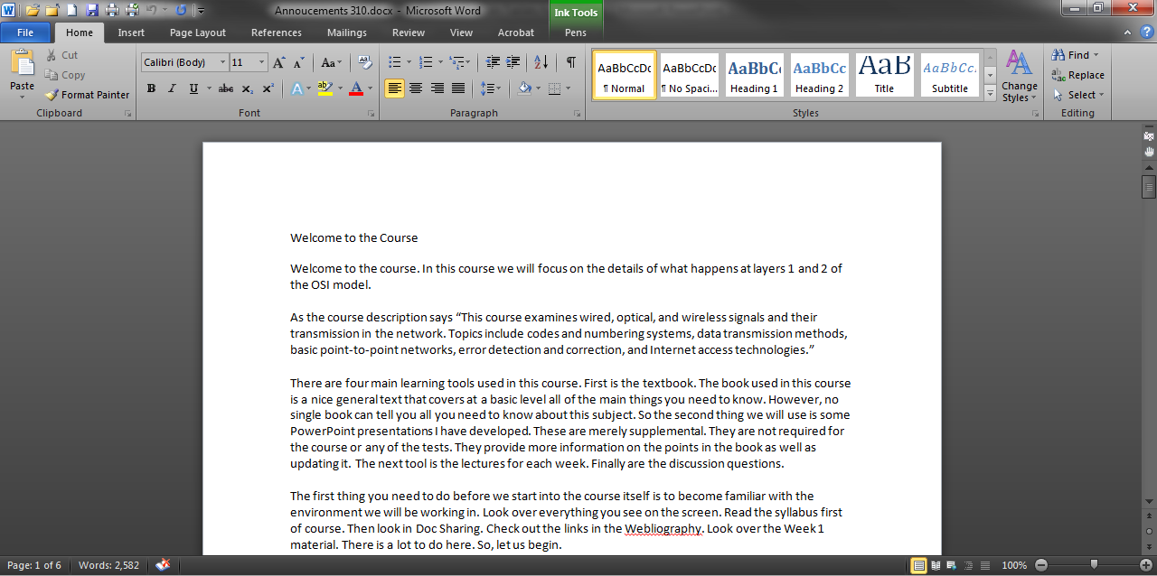
Annotating Word Documents

Slide 26
Annotating Word Documents

Slide 27
Annotating Word Documents
The pen tool is used to write notes
The different color highlighters can be used to mark common problems without having to write a separate note each time the problem occurs, such as yellow marks poorly phrased words, green marks missing information, and so on

Slide 28
Annotating Word Documents
This function of the Wacom tablet can be used to grade lab reports and papers submitted electronically
To do this
Download the papers to a local device as this will save each one with the student’s name as the file name
Open each file
Write the comments directly on the pages

Slide 29
Annotating Word Documents
Save the file
After all of the files have been graded return these to the students by selecting them one at a time in the Inbox of the LMS, and then attaching their corrected file
If the Ink tab appears but the inking tools are grayed out, resave the file in docx format

Slide 30
Annotating PDF Documents
PDF documents can be directly annotated in Adobe Acrobat using the Pen tool in the Comments section
This procedure is not very useful as the response is quite slow

Slide 31
Annotating PDF Documents
A plugin maker for Acrobat says the reason is this
The Acrobat's standard "Pencil" tool is designed for a mouse input and does not utilize a pen support that comes with latest operating systems
As the result, AutoInk provides a much better user experience

Slide 32
Annotating PDF Documents
To set this up in Acrobat using their built-in tool select
View
Comment
Annotations

Slide 33
Annotating PDF Documents

Slide 34
Annotating PDF Documents
In the window that appears on the right side of the screen right click on the pen and the eraser
For each select Add to Quick Tools

Slide 35
Annotating PDF Documents

Slide 36
Annotating PDF Documents
With the PDF opened click on the Pen tool and begin writing
The better method is to install the AutoInk plug-in for Acrobat
It works much better than the Adobe tools
Once installed it appears in the standard Acrobat tool bar
Expand the menu and select the tool

Slide 37
Annotating PDF Documents

Slide 38
Using the Mouse and Pen
The pen by itself with some practice can take the place of the mouse
Or the pen and mouse can both be used, but not at the same time
To enable the mouse move the pen more than 10mm off the tablet surface

Slide 39
Windows 7 Tablet Driver Issues
The support for tablets and pens that Windows 7 has built in to the operating system does not always play well with others
To work around this problem you can do one of two things
Remove the Windows 7 tablet support
Adjust the Windows 7 tablet settings to remove the annoyances as best you can

Slide 40
Removing Tablet Support
The problem with just removing the tablet support is that some functions disappear from one program while they remain in another program
For example, the pen erase tool that is part of the inking tool in Office 2010 remains available in PowerPoint but disappears in Word

Slide 41
Adjust Tablet Support
The second option is to adjust the tablet support that is part of Windows 7
The common annoyances include
A small input box on the edge of the screen
Ripples when the pen is pressed to the screen

Slide 42
Removing the Small Input Box
Windows tablet support places a small rectangular box on the left edge of the screen

Slide 43
Removing the Small Input Box
To turn this off
Click Tools, and then click Exit, if it's available
The Exit option might not appear if you have an external digitizer or a touchscreen connected to a laptop or desktop PC, and never appears if you have a Tablet PC

Slide 44
Removing the Small Input Box
If you don't see the Exit option, do the following
Tap Tools, and then tap Options
Tap the Opening tab, clear the For tablet pen input, show the icon next to the text box and Use the Input Panel tab check boxes, and then tap Ok

Slide 45
Removing the Ripples
As described in a posting on the source of all knowledge
If you draw or paint with a Wacom tablet, you know what I'm talking about those horrible little circles that hound your cursor and hamper your ability to draw smoothly
From what I gather, they're actually designed for touch-screen monitors, so it's frustrating that Microsoft forces them onto Wacom users where they don't belong

Slide 46
Ripple One
The author says I found it surprisingly hard to find the solution to this issue online
Part of the problem is that there are two separate circles, each with a separate solution
Another part is that one of the solutions I frequently came across doesn't work on Windows 7 Home Premium Edition

Slide 47
Ripple One
First is the circle that appears not when you click but when you hold or drag your pen
it momentarily pauses your cursor, making smooth brushstrokes all but impossible
This is the circle that quickly forms itself in a clockwise motion as you hold the pen down, and sometimes goes bright blue when you release it

Slide 48
Ripple One
To get rid of it
Press the windows key
Type "pen and touch" and press enter
In the window that appears, left-click the entry "Press and hold" and click "settings“
Uncheck "Enable press and hold for right-clicking"
Click OK on both windows to close them

Slide 49
Ripple Two
Second is the little ripple-like circle that appears whenever you click your pen
It doesn't hinder your drawing/painting as severely as the other circle does, but it's still distracting
To get rid of it
Press the windows key
Type "computer management" and press enter

Slide 50
Ripple Two
In the window that opens, Double click "Services and Applications" in the center column
Double click "Services" in the center column
Scroll down and double click "Tablet PC Input Service"
Find the "Startup type:" dropdown box and change it to "Disabled"
Click OK, then close the Computer Management window

Slide 51
Ripple Two
Restart your PC
After your PC loads up again, one of two things should happen: either your tablet works happily and circle-free, or it doesn't work at all
If it doesn't work at all, you now need to download and install the proper driver for it to replace the Microsoft one that you just disabled
Of course doing this will cause the no eraser problem in Word discussed above

Slide 52
However
The author then says if either of these methods didn't work for you possibly due to a different edition of Windows try this
Click Start, type in gpedit.msc and hit enter
Click through User Configuration - Administrative Templates - Windows Components -Tablet PC - Cursors
Double click on "Turn off pen feedback" and select Enabled to enable the filter that turns off the ripple

