Slide 1
How to Use a
Network Analyzer
Last Update 2007.06.08
1.4.0

Slide 2
What Will Be Learned
How to use the most basic troubleshooting and analysis tool
The network analyzer

Slide 3
Equipment
This lab is best with both of these
  PC with promiscuous mode NIC, a driver for the NIC as specified by the network analyzer manufacturer, and an operating system installed
  Access to a hub based network

Slide 4
Equipment
This lab only can work with either of these instead
  PC with any NIC, any driver, and an operating system installed
  Access to a switch based network through a spanned port

Slide 5
Connect to the Network
Drivers for Ethernet NICs are designed to see all traffic
However they ignore all unicast traffic that is not addressed to them by MAC address
To overcome this the driver for the NIC must be set to promiscuous mode
In such a mode it sees all traffic

Slide 6
Connect to the Network
A NIC with a card that can be set to promiscuous mode is required for this lab, otherwise the card will see only traffic addressed to itself
In general most NICs can be set this way by the network analyzer program

Slide 7
Connect to the Network
A connection issue related to the NIC is whether the driver will capture all of the errors on the network
This does not relate to promiscuous mode, but rather to the way the driver is written
In general these drivers are only available from the manufacturer of the network analyzer software

Slide 8
Connect to the Network
Be sure that you have a NIC that the supplier of the analyzer has a driver for
If such a driver is not available the analyzer will still work, but it will miss the error packets

Slide 9
Connect to the Network
Once the NIC in the computer is set to promiscuous mode it will read in all traffic sent across the network as long as it is connected to a hub
As in

Slide 10
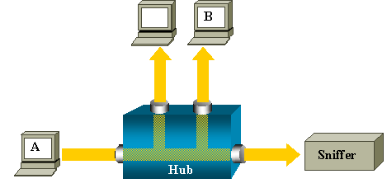
Connect to the Network

Slide 11
Connect to the Network
To analyze the local traffic of a switch based network is more difficult because after a switch learns a MAC address on a port, it forwards traffic for this MAC address directly to the corresponding port
On a switch, after host B's MAC address is learned, unicast traffic from A to B is only forwarded to B's port, and therefore not seen by the sniffer

Slide 12
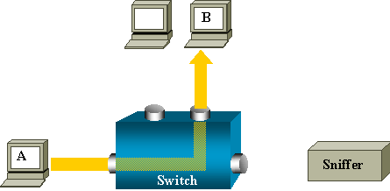
Connect to the Network

Slide 13
Connect to the Network
To watch traffic on a switch based network, plug the cable from the computer running the analyzer software into any standard port on the switch
Then set the switch port to span or monitor mode

Slide 14
Connect to the Network
In such a mode instead of the port just seeing the traffic directed to the MAC address of the computer on that port, the broadcast traffic, and the multicast traffic; by spanning the port, this port will see all traffic on the local network
As in

Slide 15
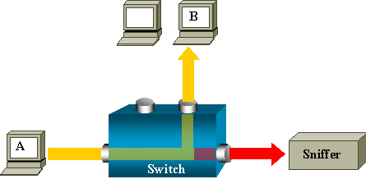
Connect to the Network

Slide 16
Connect to the Network
For example on the Cisco Catalyst 2950 switch the Switched Port Analyzer or SPAN feature, also called port mirroring or port monitoring, selects network traffic for analysis by a network analyzer
This is called creating a Span port

Slide 17
Connect to the Network
The Catalyst 2950 Switches can have only one SPAN session active at a time and can monitor only source ports, it can not monitor VLANs

Slide 18
Connect to the Network
To create such a port, access the command line interface for the operating system then enter
  C2950#config t
  C2950(config)#monitor session 1 source interface fastEthernet 0/2
  !-- Interface fa 0/2 is configured as source port

Slide 19
Connect to the Network
  C2950(config)#monitor session 1 destination interface fastEthernet 0/3
  !-- Interface fa0/3 is configured as destination port
  C2950(config)#Ctrl Z
To check this enter
  C2950#show monitor session 1
  Session 1
  ---------

Slide 20
Connect to the Network
  Source Ports:
  RX Only: None
  TX Only: None
  Both: Fa0/2
  Destination Ports: Fa0/3
To clear this
  C2950#config t
  C2950#no monitor session session 1

Slide 21
Connect to the Network
Catalyst 2950 Switches are able to SPAN source port traffic in the
  Receive direction only - Rx span or ingress span
  Transmit direction only - Tx span or egress span
  Both directions

Slide 22
Connect to the Network
Keep in mind the way most switches work these days in that if the switch receives a corrupted packet, the ingress port usually drops it, so you won't see it on the egress port
It is then true that a switch is not completely transparent when it is a matter of capturing traffic

Slide 23
Connect to the Network
So when you see a corrupted packet, the errors where generated on the egress segment

Slide 24
What is a Network Analyzer
As Laura Chappell, a very well known writer and trainer on network analysis says
  A network analyzer is a device (desktop, laptop or portable computer) that can 'capture' all the packets seen on the network and display them in the order they appeared on the cable
  A good analyzer should have some alerts/alarms that notify you of unusual or faulty traffic patterns

Slide 25
What is a Network Analyzer
  The analyzer should also be able to build trend graphs to illustrate the current and long-term traffic patterns (such as utilization and packets per second)
  In order to make the communications information useful to you, the analyzer decodes, or interprets, the actual packet information received

Slide 26
What to Call These Things
Network analyzers go by many different names
Such as
  Network Analyzer
  Protocol Analyzer
  Sniffer

Slide 27
A Network Analyzer
Next we will go through the basics of what a network analyzer can do using screenshots and an explanation of each task
This example uses Sniffer Pro Version 4.5
We will begin by looking at each button on the toolbar

Slide 28
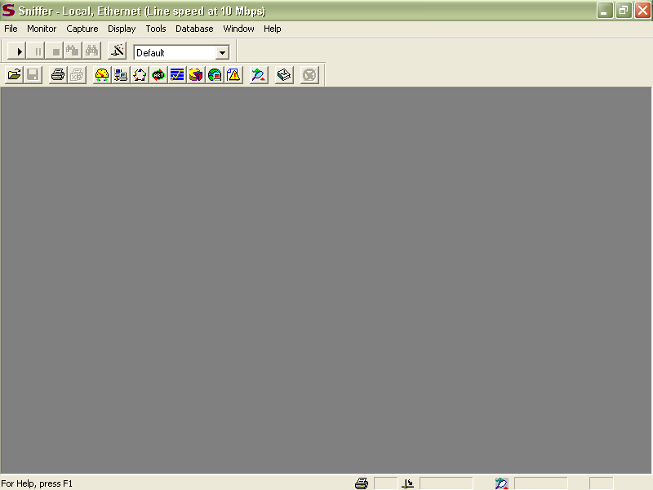
Opening Display

Slide 29
Toolbar Buttons

Slide 30
Toolbar Buttons

Slide 31
Gauge Dashboard View
The normal opening view shows the dashboard
To make the dashboard appear click on the dashboard button on the toolbar

Slide 32
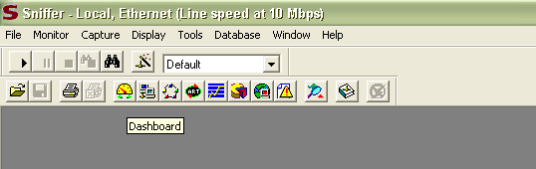
Gauge Dashboard View

Slide 33
Gauge Dashboard View
The dashboard is a set of gauges showing
  Utilization
  Packets per Second
  Errors per Second
Below this is a line chart
  Utilization is selected by default
  Other lines can be added by checking the boxes

Slide 34
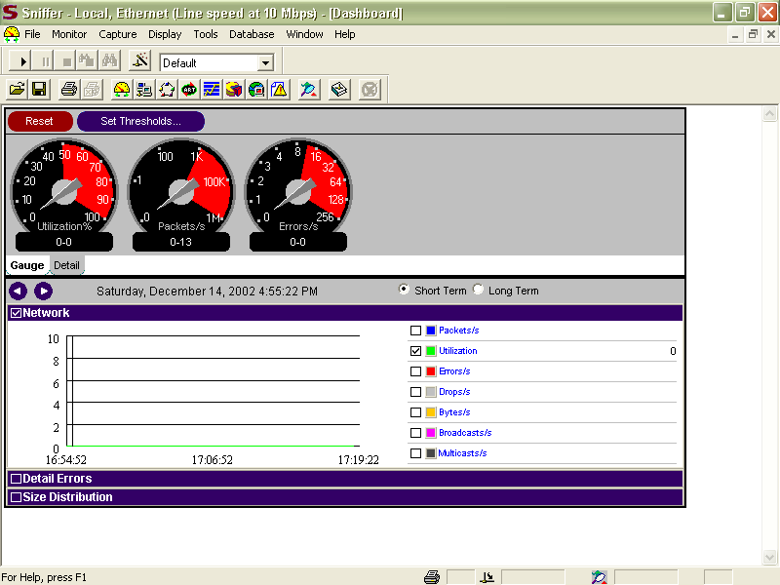
Gauge Dashboard View

Slide 35
Detail Dashboard View
The information seen in the gauges can be expanded to show more detail by clicking the Detail tab

Slide 36
Detail Dashboard View

Slide 37
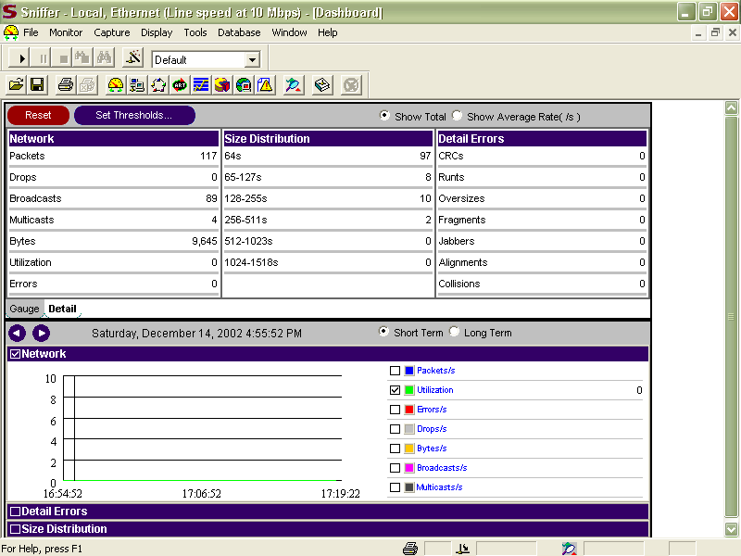
Detail Dashboard View

Slide 38
Gauge Threshold Settings
The two colors on the gauges represent the normal range – in black and the problem range – in red
These can be set to any level desired by clicking on the Set Thresholds button
And adjusting the values shown

Slide 39
Gauge Threshold Settings

Slide 40
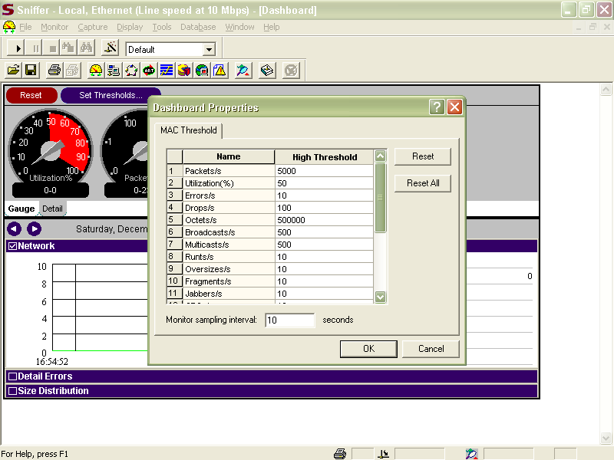
Gauge Threshold Settings

Slide 41
See All Devices on the Network
The network analyzer can be used to show all devices that are sending traffic over the network
This is done by clicking the Host Table button

Slide 42
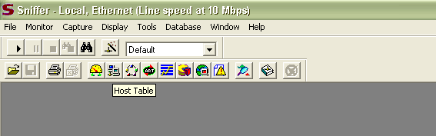
See All Devices on the Network

Slide 43
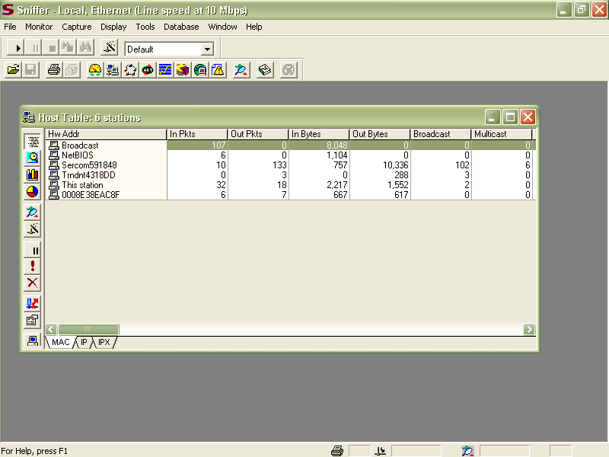
See All Devices on the Network

Slide 44
See All Devices on the Network
The devices can be listed by
  MAC address
  IP address

Slide 45
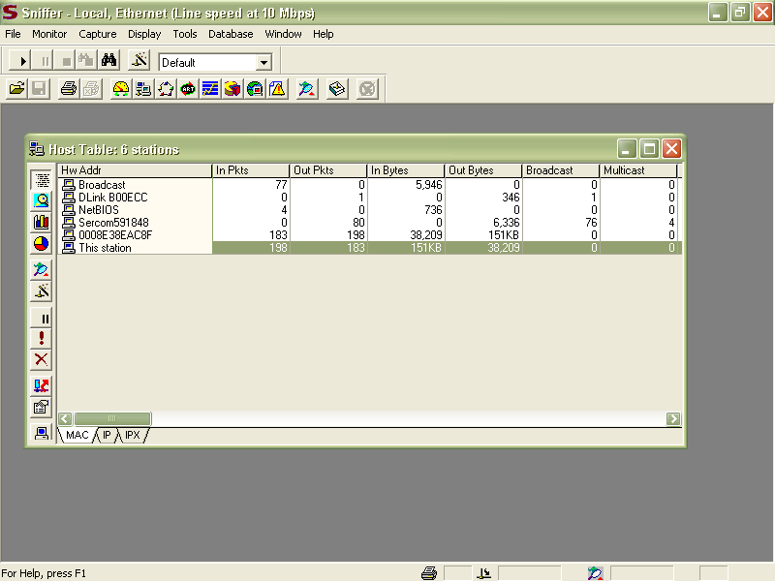
See All Devices on the Network

Slide 46
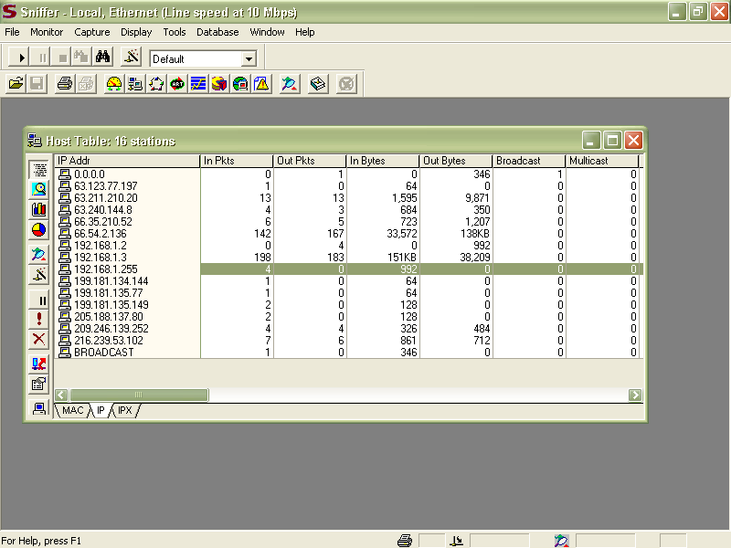
See All Devices on the Network

Slide 47
See All Devices on the Network
The IP list shows local and remote devices, such as web sites viewed
This window has several other views that can be selected by clicking on the buttons on the left of the window

Slide 48
See All Devices on the Network

Slide 49
Traffic Map
The Traffic Map is an odd display
It is meant to show who is talking to who

Slide 50
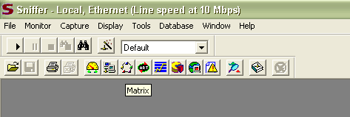
Traffic Map

Slide 51
Traffic Map
There are two basic views
  Graphic view
  Table view
As in

Slide 52
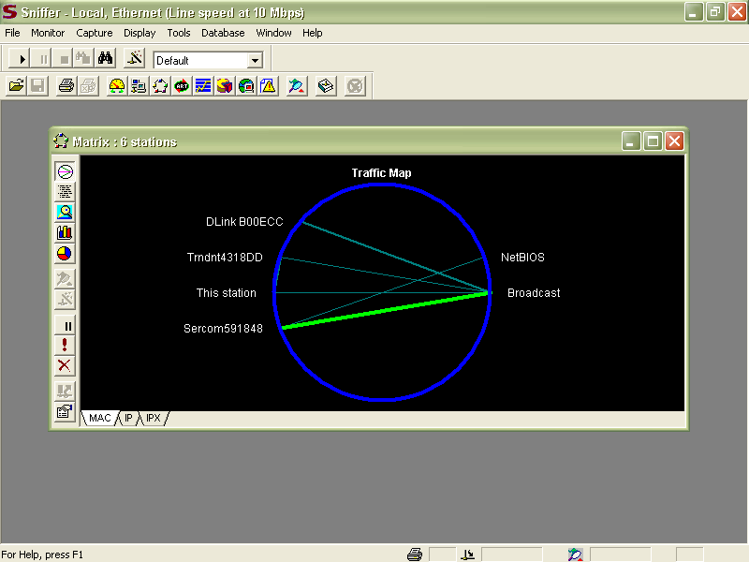
Traffic Map

Slide 53
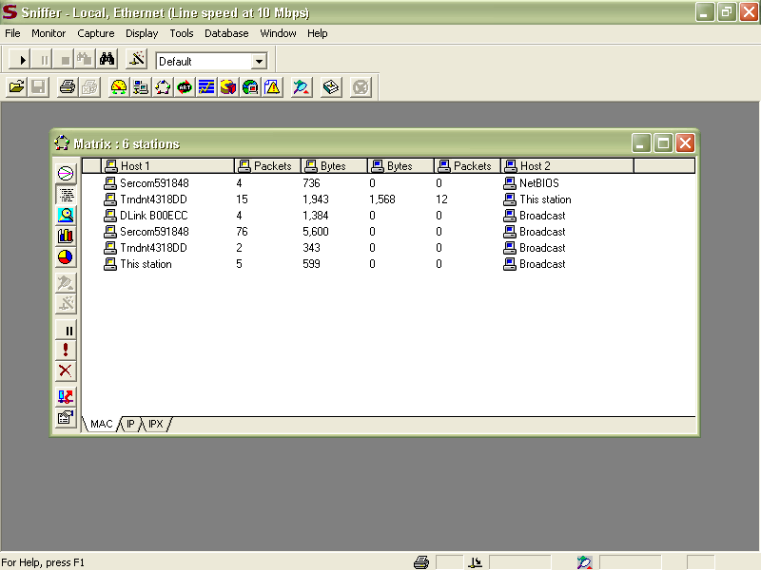
Traffic Map

Slide 54
Application Response Time
Next is the Application Response Chart
This is a useful tool for baselining as it shows how long it takes for a station to talk to a server

Slide 55
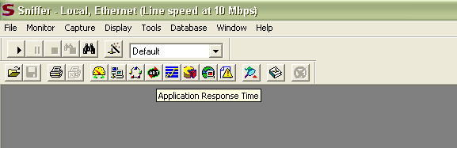
Application Response Time

Slide 56
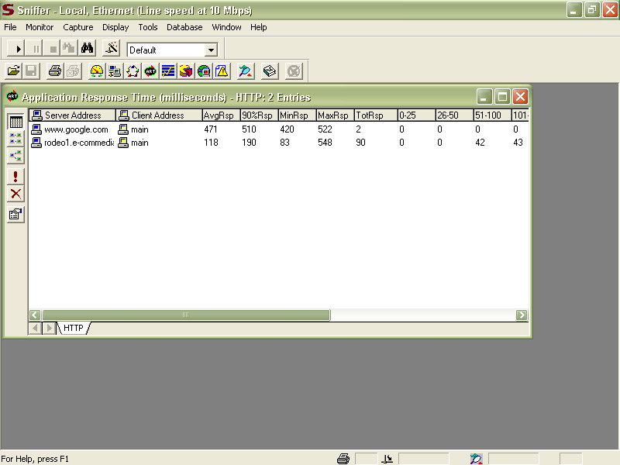
Application Response Time

Slide 57
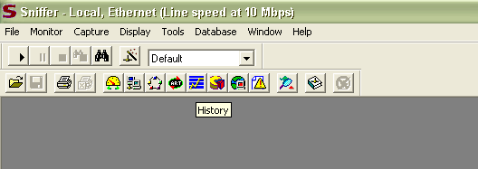
History

Slide 58
History
History shows a bunch of stuff
As in

Slide 59
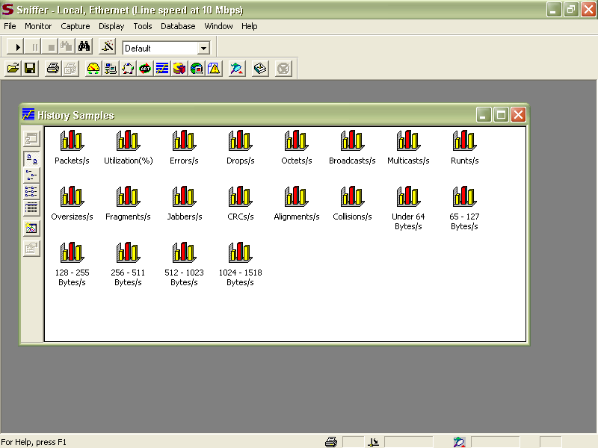
History

Slide 60
History
Packets per Second
Utilization
Errors per Second
And so on
Lets look at a few of these by double clicking the icon

Slide 61
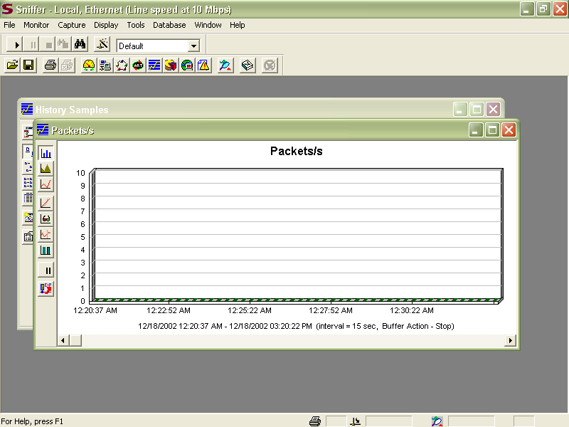
History

Slide 62

History

Slide 63

History

Slide 64
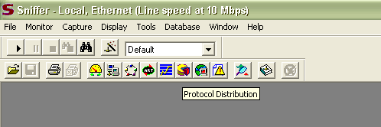
Protocol Distribution

Slide 65
Protocol Distribution
The Protocol Distribution display is very useful
It shows what protocols are running on the network
For example, you may think there is no NetBEUI traffic on the network
Yet this sample display shows NetBEUI traffic

Slide 66
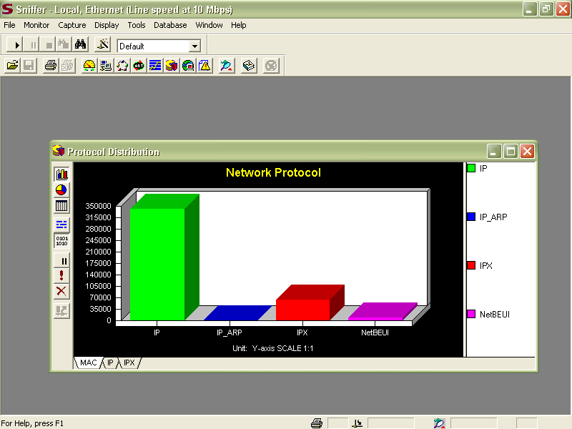
Protocol Distribution

Slide 67
Protocol Distribution
This has a
  Histogram
  Pie Chart
  Table
view

Slide 68
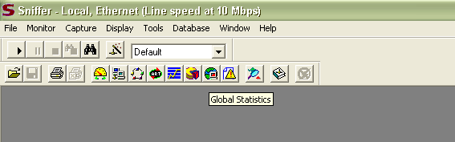
Global Statistics

Slide 69
Global Statistics
The Global Statistics shows the packet sizes seen on the network

Slide 70
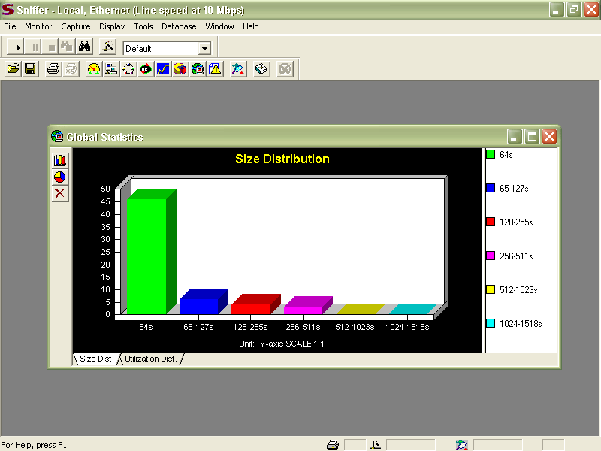
Global Statistics

Slide 71
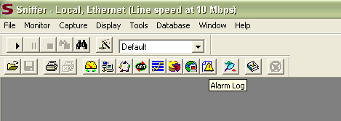
Alarm Log

Slide 72
Alarm Log
The Alarm Log shows just that, any alarms that have been issued based on the settings for alarms
This is set on the Dashboard view using the Set Threshold button

Slide 73
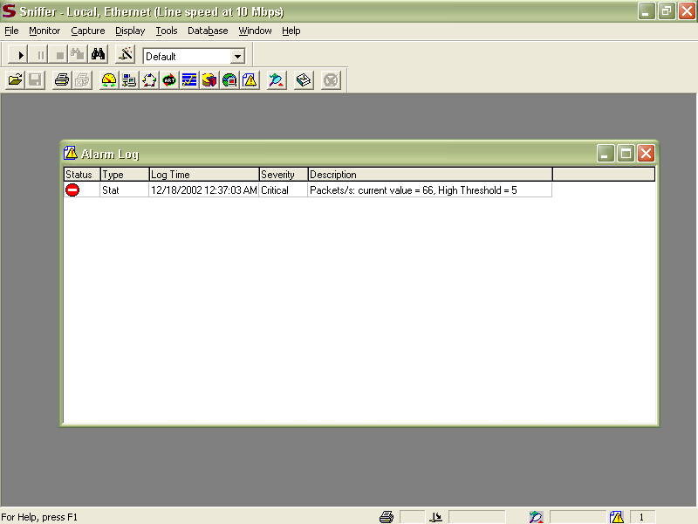
Alarm Log

Slide 74
Capture and Decode Packets
To examine the traffic packets must be captured and presented in a form humans can comprehend
This is what capture does

Slide 75
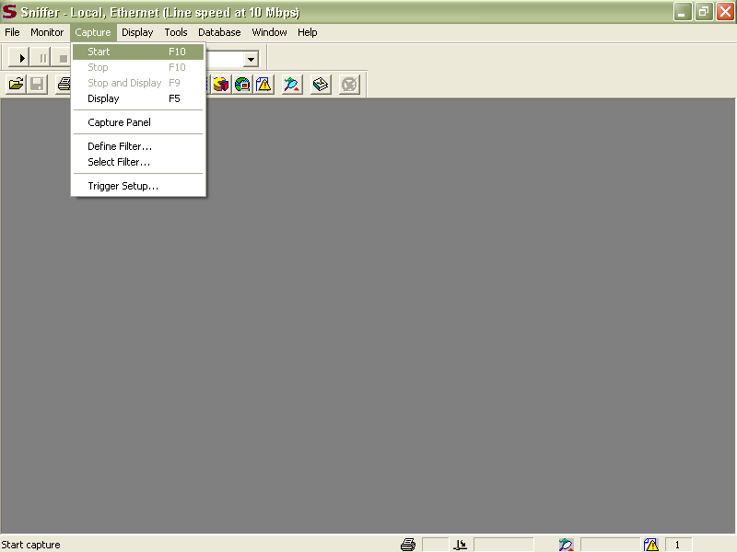
Capture and Decode Packets

Slide 76
Capture and Decode Packets
When
  Capture
  Start
is selected frames going over the wire are placed in a buffer
To look at this go back to the same place and select
  Stop and Display

Slide 77
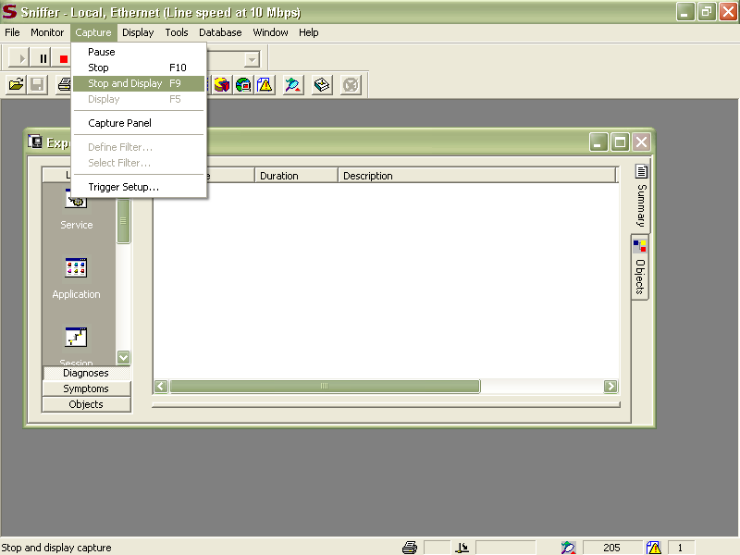
Capture and Decode Packets

Slide 78
Capture and Decode Packets
In Sniffer Pro the initial decode display has the Expert tab selected
For this example click on the Decode tab

Slide 79
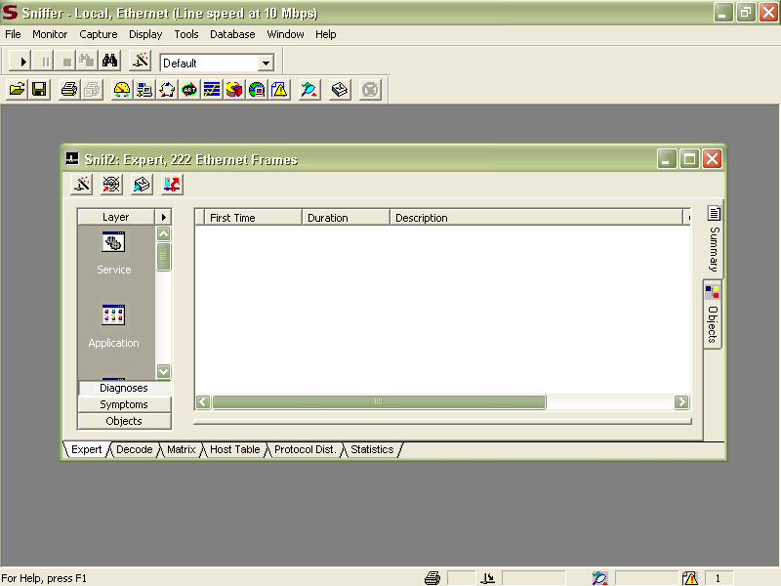
Capture and Decode Packets

Slide 80
Capture and Decode Packets
Now the display shows each packet listed in the top pane
The decoded information in the middle pane
The raw data in hex and ASCII in the bottom pane

Slide 81
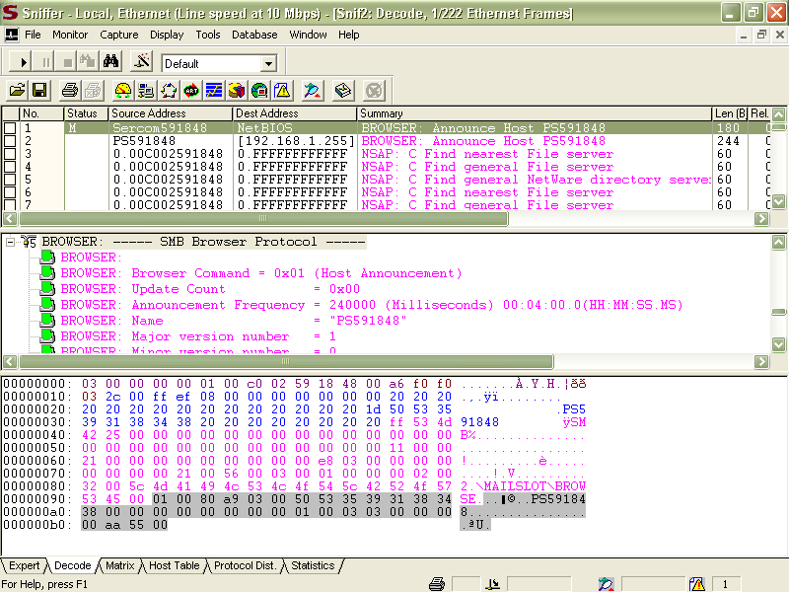
Capture and Decode Packets

Slide 82
Capture and Decode Packets
The middle pane is the most useful
It presents the information layer by layer in a form simple humans can deal with
The example shown next is a decode showing a conversation with a web server
Notice that it shows several layers from bottom to top of the TCP/IP model

Slide 83
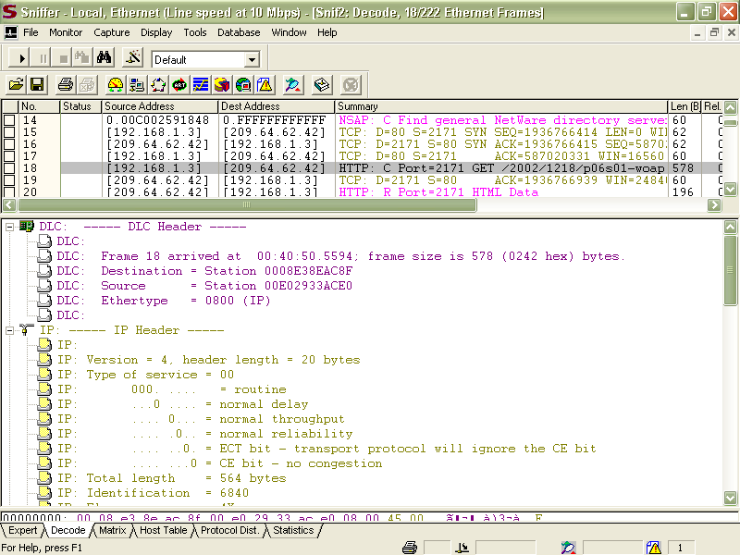
Capture and Decode Packets

Slide 84
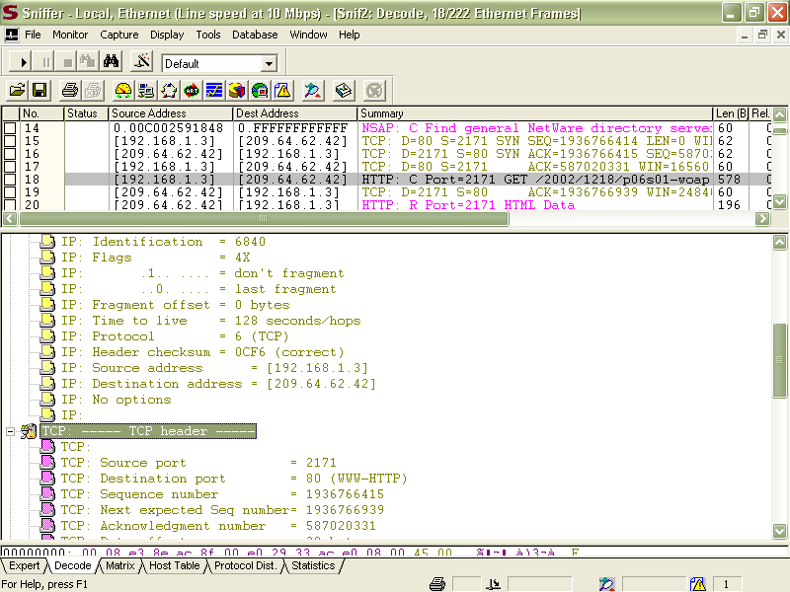
Capture and Decode Packets

Slide 85
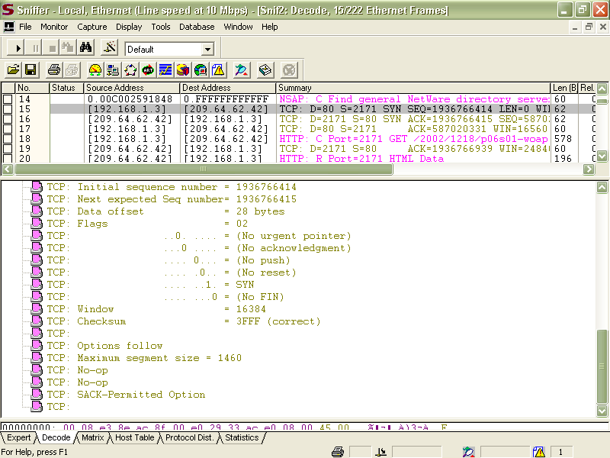
Capture and Decode Packets

Slide 86
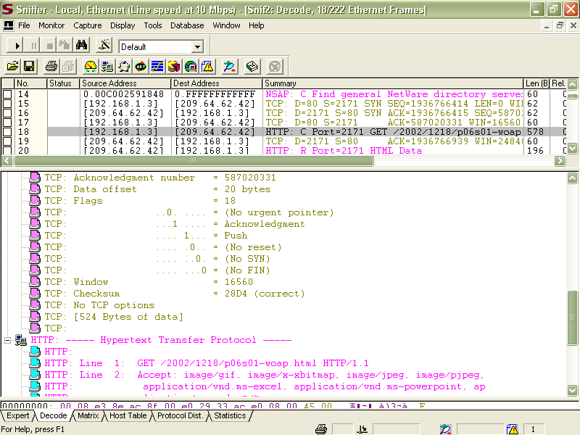
Capture and Decode Packets

Slide 87
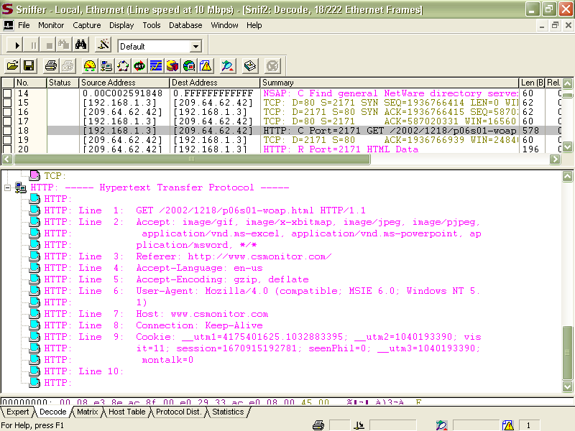
Capture and Decode Packets

Slide 88
Basic Packet Filtering
Doing it the way just shown captures everything
It is more useful to limit the packets captured to just those of interest
This is done by specifying a filter such as
  Address Filters
  Protocol Filters
  Dataset Filters

Slide 89
Basic Packet Filtering
Address filters look for particular source or destination addresses at the MAC address, IP address, or IPX address level
Protocol filters look for a particular activity as revealed by the protocol number the activity uses, such as 53 for DNS

Slide 90
Basic Packet Filtering
Dataset filters define traffic to watch based on a specific value at a specific offset within a packet
  These are considered advanced filters and difficult to construct
But this is a topic for another lab

Slide 91
Typical Things to Watch
What types of trends are most interesting
Common things to watch include
  Protocol distribution
  Top 10 most active devices
  Packet size distribution
  Utilization trends
  Packets per second trends
  Error packets
  Broadcast and multicast traffic

Slide 92
Common Problems to Look For
The network is experiencing excessive broadcasts
  Filter on all traffic to the broadcast address and find the most active device - the one that is broadcasting most often
  Then classify the broadcast types to determine its purpose

Slide 93
Common Problems to Look For
  Typically broadcast storms are caused either by a device performing an unsuccessful lookup or by a device blasting information out to all devices on the network
There is a large amount of unnecessary traffic on the network
  For example, unanswered routing queries, excessive watchdog or connection keep-alive sequences are just wasteful on the network

Slide 94
Common Problems to Look For
A client appears to have numerous failure replies
  Filter on packets to and from that client device to create a packet-by-packet view of what the client has been doing
  Perhaps the client mapped a resource to an incorrect location and it cannot find what it is looking for there

Slide 95
Common Problems to Look For
An unusual amount of unknown or undecoded traffic is found on the network
  Consider filtering on some unique field value, such as the type field or the port field value
  You might find some proprietary communication going on

Slide 96
Common Problems to Look For
The network is slow
    General Traffic
      Does anything stick out as strange
    Broadcasts
      Do periodic broadcast storms occur
    Multicasts
      Does the network have a multicast storm problem
    ICMP Packets
      Do any ICMP - Internet Control Message Protocol packets indicate misconfigurations, loops, or services that are available only sporadically

Slide 97
Common Problems to Look For
    Protocol Distribution
      Is anything unexpected happening with the network protocols
    Client Boot-Up Sequences
      What happens when the client simply boots up
      Do any severe slowdowns occur during the boot-up sequence
    Client Login Sequences
      What happens during the login process
      Can I identify any slowdowns during the login sequence
      How does the client get configured during this process
      Do any errors occur

Slide 98
Common Problems to Look For
    Network File Transfer Times
      How much time does it take to copy a big file - at least 40 MB - across the network
    Internet Access Times
      What is the roundtrip time when users access the Internet

Slide 99
Troubleshooting Procedure
The general procedure to follow is
  Look at the typical latency between a client and a server to see if packets have a problem getting from one place to anotherIf the roundtrip LAN times are just a few microseconds or milliseconds no problem, but if a slowness is seen with every request and reply set or there are retransmissions or timeouts, then look at the infrastructure as a possible problem

Slide 100
Troubleshooting Procedure
  If most request and reply sets are quick, however, look for anomalies - sudden moments when the response time climbs unusually
  To do this, scroll through the summary of the boot-up and login sequence, looking at the delta time column to see if any sudden increases in response time can be seen

Slide 101
More Than This
There is much more to network analysis
But this is a start
There are several issues that must be dealt with when using a network analyzer
Such as

Slide 102
Problems
In the wrong hands these little guys are dangerous
Let’s say a member of the cleaning crew plugs one in one night, then sets it to capture all of the traffic for the next day or two

Slide 103
Problems
Or just lets it run while they are there
With all of the broadcasts – even on a network with no active users – much can be discovered
In general network analyzers cannot be detected as they are passive devices

Slide 104
Detecting Network Analyzers
To detect these you can run a program that scans for NICs set to promiscuous mode
The average NIC should not be set this way.

Slide 105
Sources
Several articles and books by Laura Chappell

Slide 106
For More Information
Introduction to Network Analysis, 2nd Edition
  Laura Chappell
  ISBN 1-893939-36-7

