Slide 1
How To Do VLSM Last Update 2009.07.17 1.2.0

Slide 2
What is VLSM
VLSM – Variable Length Subnet Masking is an improvement on the original method of subnetting called FLSM – Fixed Length Subnet Masking
In FLSM the same subnet mask is used for all of the subnetworks inside of a network, regardless of the number of hosts on any of the networks

Slide 3
The Problem With FLSM
There are two problems with using FLSM
It wastes addresses if the number of hosts on the subnets vary in size
It forces the routers that talk to these subnets to process too much information
For example
Notice on the diagram on the next slide that there are six networks

Slide 4
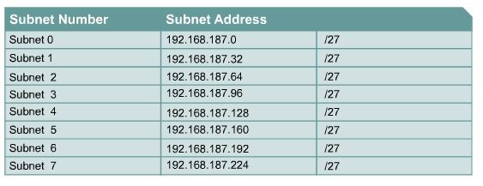
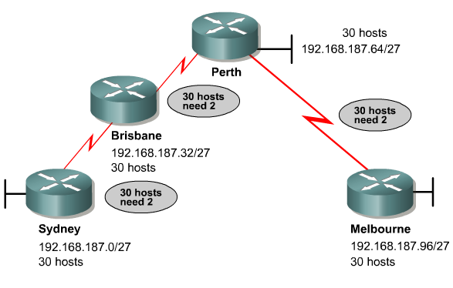
A Waste of Space

Slide 5
The Problem With FLSM
The number of interfaces on these networks are
30
30
30
2
2
2

Slide 6
The Problem With FLSM
If we use a subnet mask that provides enough interface addresses for the three networks with 30 hosts, then we waste 28 addresses on all three of the 2 interface networks
Further, the upstream router must maintain six separate network addresses in its routing table

Slide 7
The Problem With FLSM
All of this can certainly be done, but it is wasteful of addresses and inefficient in route processing

Slide 8
VLSM
The alternative is to use VLSM
In this method an existing subnetwork is further subnetted
The resulting subnets of the subnet are all of a size that best fits the networks in question

Slide 9
VLSM
For example
If the router on the far left of the diagram on the slide that follows has been assigned the 172.16.32.0/20 network, this network can be further subdivided so as to introduce better IP address utilization and fewer routes in the far left router’s routing table
Notice that the /30 is formed from the space left after the /20 has been formed
In other words if we count over from the far left of the available 32 bits, 20 bits, this is where the far left router’s network stops

Slide 10
VLSM
The remaining 12 bits are meant to be used for interface addresses
Instead we can use part of this 12 bit space to create new subnets
In this example we first subnet at the /26 line, then take one of these /26 networks and subnet it at the /30 line

Slide 11
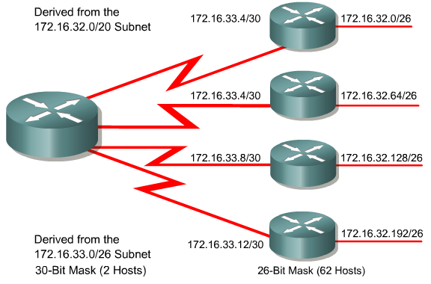
VLSM Example

Slide 12
All Very Confusing
All of this is very confusing
Let’s work through an example to lessen the confusion
We will use the example from the CCNA Command Reference from Cisco Press
Here is the network

Slide 13
VLSM Example

Slide 14
VLSM Example
In this example there are 8 networks
A
B
C
D
E
F
G
H

Slide 15
VLSM Example
In this example the 192.168.100.0/24 is assigned
The assigned network bits cannot be used for the inside networks
Only the hosts bits can
In this case of the 32 bits the 24 bits indicated by the /24 cannot be used
Only the remaining 8 host bits

Slide 16
The Solution
Doing VLSM masking by hand is a simple two step process that is repeated on each network beginning with the largest network, then the next largest, the next largest, until the point-to-point links are done as the last thing

Slide 17
The Solution Steps
Step 1
Determine how many host bits will be needed to satisfy the largest network
Step 2
Pick a subnet for the largest network to use
Repeat Step 1 and 2
Pick the next largest network to work with
Repeat Step 1 and 2
Pick the third largest network to work with
Repeat Step 1 and 2
Determine the networks for the point-to-point connections

Slide 18
Step 1
Determine how many host bits will be needed to satisfy the largest network
Find the largest network in terms of the number of hosts or other interfaces
If there are two of the same size, it does not matter which one you start with
In this case the largest network has 50 hosts

Slide 19
Step 1
How many of the available host bits, 8 in this case, need to be turned into subnet bits to provide at least 50 useable host addresses
The formula for this is
2^{H}-2
Where the H is the number of host bits
In this case we need at least 6 because 2⁶-2 is 62

Slide 20
Step 1
Beginning with the 8 available bits being used this way
HHHHHHHH
We now have this arrangement
NNHHHHHH
The subnetting that begins in Step 2 is limited by this arrangement of bits
In other words we can do whatever can be done with 2 bits for subnets

Slide 21
Step 2
Pick a subnet for the largest network to use
In this case with 6 bits already being used, this leaves 2 bits for subnets
The formula for this is
2^{N}
Where the N is the number of host bits left for subnetworks
The result, when using ip-subnet zero, is 2² or 4

Slide 22
Step 2
This yields these 4 subnetworks
00HHHHHH
01HHHHHH
10HHHHHH
11HHHHHH
Or in decimal
.0
.64
.128
.192

Slide 23
Step 2
This is a /26 or 255.255.255.192 subnet mask
Select one of these 4 subnets for the Network A, which is the largest network, the one we started with
Set this network number aside as it has been used
In this case we will use the .64 network number

Slide 24
Step 2
So .64 is done, finished, not to be used for any other purpose

Slide 25
Repeat for Next Largest
Pick the next largest network to work with
In this example it is Network B with 27 hosts
How many hosts bits will be needed for this network
The formula for this is
2^{H}-2
Where the H is the number of host bits

Slide 26
Repeat for Next Largest
In this case we need at least 5 because 2⁵-2 is 30
The original network and host bits pattern cannot be altered
That pattern was
NNHHHHHH
Select one of the available network numbers
We began with 4 subnetworks

Slide 27
Repeat for Next Largest
We now have 3, since one was used for Network A
For this example we will use the .128 network
This pattern is
10000000
Since the 10 cannot be changed and 5 host bits are needed, the result is
10NHHHHH

Slide 28
Repeat for Next Largest
With this single N bit we can create 2 subnets
The formula for this is
2^{N}
Where the N is the number of host bits left for subnetworks
In this case it is 2¹ or 2
The pattern for these two is
10000000
10100000
In decimal
.128
.160

Slide 29
Repeat for Next Largest
Subnet mask
11111111.11111111.11111111.11100000
or
255.255.255.224

Slide 30
Summary So Far
What has happened so far is a /24 network has been broken into a /26 network which has been broken into a /27 network
How do we know this
We were given the /24
The /26 was created by taking the first 2 bits of the 8 that remained after the /24 was created
Then the next bit, the 27th, was taken to create the /27

Slide 31
Summary So Far
Think of this as a series of boxes
In Step 2 we created 4 boxes
One of these, the .64 box, was assigned to Network A
Another one, the .128 box, was cut in half
Half was assigned to Network B
The other half can be used for
Another network of similar size
A future network
Or it can be further subnetted

Slide 32
Summary So Far
Look at this diagram
It shows what we have done and what else will be done
If the diagram does not show up clearly there is a Microsoft Word version as well

Slide 33
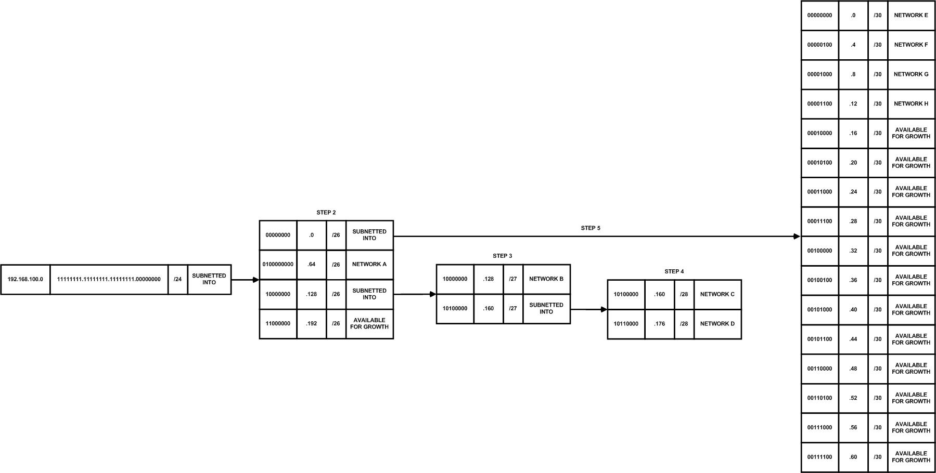
Summary So Far

Slide 34
Repeat for Next Largest
Pick the third largest network to work with
In this example Network C has 12 hosts as does Network D
Just as in Step 1
How many hosts bits will be needed for this network
The formula for this is
2^{H}-2
Where the H is the number of host bits

Slide 35
Repeat for Next Largest
In this case we need at least 4 because 2⁴-2 is 14
A decision must be made
You can use one of the remaining subnets from above
In this example
.0
.192
Or the left over /27 network from just above can be used, the .160 network

Slide 36
Repeat for Next Largest
For this example the remaining .160 network will be divided into two more smaller boxes
With 1 bit we can create
2^{N}
Where the N is the number of bits used for this purpose
This yields 2¹ or 2 networks
In this case these will reside in the fourth from the left of the 8 available bits position

Slide 37
Repeat for Next Largest
Such as this
101 0 0000
101 1 0000
In decimal the subnet numbers are
.160
.176
Based on
1010
1011

Slide 38
Repeat for Next Largest
This is a /28
With a subnet mask of
255.255.255.240

Slide 39
Summary So Far
We began with one network the /24
Using a /26 we created 4 subnetworks
We assigned one of these 4 to Network A
Then we took a second one of the 4 and subnetted it as a /27 into two additional subnets
One of these two subnets of subnets was used for Network B

Slide 40
Summary So Far
The second one was further subnetted into a /28
Of the two .28 networks created one was assigned to Network C and the other one to Network D
We have know accounted for all of the networks with hosts on them
The last step is to create network addresses for the serial links

Slide 41
Repeat for PtP
Determine the networks for the point-to-point connections
Each of these point-to-point networks only need two interface addresses as there are no hosts on these types of networks
In this case we need 4 networks like this
These should be /30 networks as this will yield only two interface addresses on each network

Slide 42
Repeat for Next PtP
The pattern looks like this
00 NNNN HH
The 00 is the original bits set aside above
NNNN are the bits we will use for the networks with hosts
HH are the bits that will be used for the router interfaces
With 4 bits we can create
2^{N}
Where the N is the number of bits used for this purpose
This yields 2⁴ or 16 networks
The network numbers are

Slide 43
Repeat for PtP
.0
.4
.8
.12
.16
.20
.24
.28

Slide 44
Repeat for PtP
.32
.36
.40
.44
.48
.52
.56
.60

Slide 45
Repeat for PtP
Four will be used, assigned as follows
Network E
.0
Network F
.4
Network G
.8
Network H
.12

Slide 46
Conclusion
That’s it
All of the networks have been accounted for
In this example as in all cases some inefficiency results at the last repeat of the process
Here it was many more point-to-point networks being created than were needed

Slide 47
Conclusion
In addition in this example little growth was built into the schemes
In essence all this is a simple two step procedure that is repeated over and over

