Slide 1
Device Problems
Last Update 2011.07.01
1.5.0

Slide 2
Objectives
Learn about the common problems seen on devices such as workstations, switches, and routers

Slide 3
Configuration Problems
Sometimes the problem is due to a device being configured incorrectly
Here is how to examine the devices for this type of problem

Slide 4
Show Commands
The most common command is the show command
There are several of these
Let’s look at some of the most useful ones

Slide 5
Show ip int brief
The show ip int brief command shows a summary of all three layers of a router

Slide 6
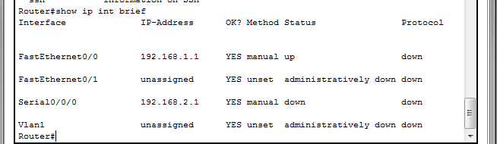
Show ip int brief

Slide 7
Show Interfaces Command
When using a Cisco device some common commands include the show interfaces command
It supplies a lot of important information about interfaces, such as the status of the interfaces, statistics about packets sent and received, and a wide variety of error counters and configuration settings

Slide 8
Show Interfaces Command
You can see the many variations of the show interfaces command by using the show interfaces ? command on a router CLI
The following three are the main variations
  show interfaces
  show interfaces type number
  show interfaces description

Slide 9
Lab
Start Packet Tracer
Create the network shown in the following slide using RIP as the routing protocol
Once this network is communicating we will use it to look at the output of several commands

Slide 10
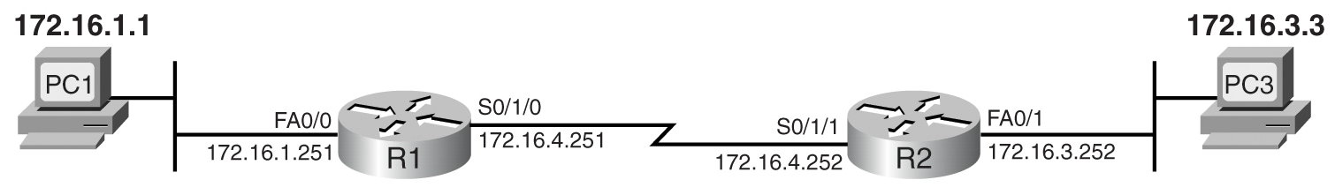
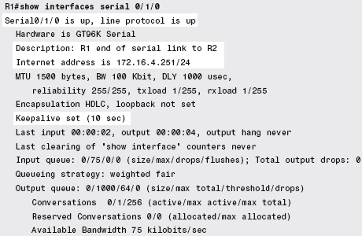
Show Interfaces
Small Internetwork with Two Routers Connected by a Serial Link

Slide 11
Show Interfaces
Cisco routers give two indications about whether each interface is working, as listed in the first line of output in the show interfaces command
Together, these two indicators are called the interface status, and individually, they are called the line status and line protocol status

Slide 12
Show Interfaces

Slide 13
Show Interfaces
An interface must have both a line status and a line protocol status of up to send and receive traffic
All other combinations of status mean that the interface cannot currently be used

Slide 14
Show Interfaces

Slide 15
Show Interfaces
The line status - the first of the two status values in the show interfaces command output - mainly relates to hardware or layer 1
As a result, many people refer to this first status value as either the hardware status or layer 1 status

Slide 16
Show Interfaces
A line status of down means that the interface has some physical problem
To troubleshoot such problems, you can follow some obvious steps, such as checking the cable or checking whether the device on the other end of the cable is powered off

Slide 17
Show Interfaces
Additionally, the show interfaces commands list some counters that can be helpful in determining why an interface has a line status of down

Slide 18
Show Interfaces
The input errors counter lists the number of frames that the router received but for which the FCS - Frame Check Sequence process determined that the frame experienced errors during transmission, meaning that the router had to discard the frame

Slide 19
Show Interfaces
A high value for the input errors counter could mean that the link has been experiencing a large number of bit errors, possibly due to poor but working cables, bad connectors, or too-long cable lengths

Slide 20
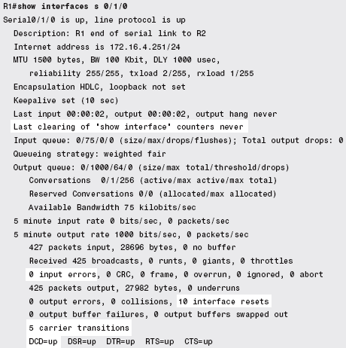
Show Interfaces

Slide 21
Show Interfaces
The other highlighted counter, the carrier transitions counter, relates to a pin lead on serial cables
The CSU/DSU signals the router serial interface that the link is working by raising the carrier detect - also called data carrier detect, or DCD - pin lead on the serial cable

Slide 22
Show Interfaces
The last two lines of the output show that the router has seen the DCD transition from up to down, or from down to up, a total of five times
The last line of output also lists the current state of the DCD pin
A link on which a large number of carrier transitions occur means that the link has been going up and down a lot

Slide 23
Show Interfaces
In most cases, when an interface’s line status is up but its line protocol status is down, the problem relates in some way to layer 2
Many times the problem relates to some configuration problem like
  Mismatched layer 2 protocols configured on the routers on the ends of a serial link

Slide 24
Show Interfaces
  On a serial link with a back-to-back serial connection in a lab, the absence of a clock rate command on the router with the DCE cable
  The failure to receive keepalive messages

Slide 25
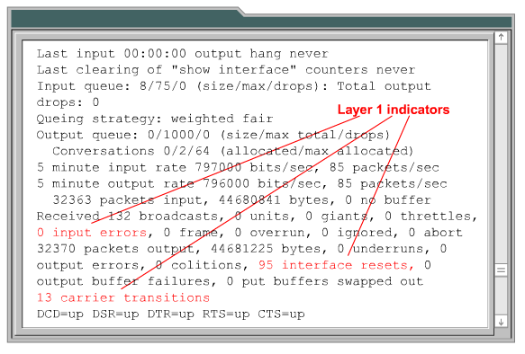
Show Interfaces for Layer 1

Slide 26
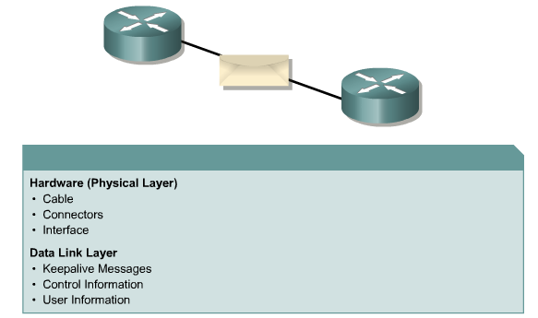
Show Interfaces for Layer 2

Slide 27
Examining the Routing Table
Several aspects of the routing table configuration may cause problems with connectivity
In this section we will discuss several considerations related to routing

Slide 28
Show IP Route
The show ip route command displays the contents of the IP routing table
This table contains entries for all known networks and subnetworks
It also shows a code that indicates how the route was learned
The table includes all the routes that the router can currently use when forwarding packets

Slide 29
Show IP Route
These routes include the following
  Connected routes
    Routes to subnets connected to this router’s interfaces
  Static routes
    Routes configured on this router using the ip route global configuration command
  Dynamically learned routes
    Routes learned by using a dynamic routing protocol

Slide 30
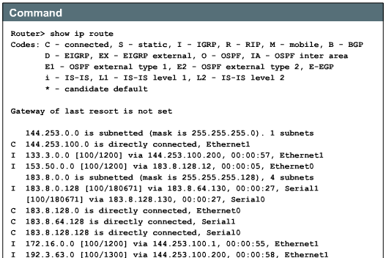
Show IP Route

Slide 31
Show IP Route

Slide 32
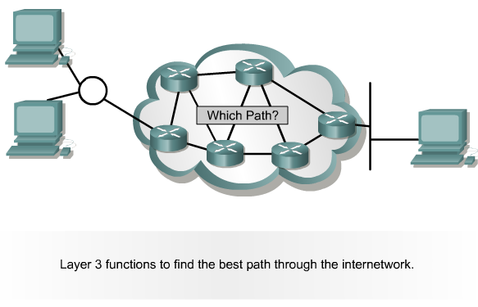
Route Source and Destination

Slide 33
Lab
Go back to the previous Packet Tracer lab using the same configuration used above and examine the routing table

Slide 34
Checking for Routing Updates
Sometimes you need to know if a routing update has been received, as well as when the next one will be received
For example as shown in the output of the show ip route rip command, each RIP learned route lists the time that has elapsed since the last routing update about the route

Slide 35
Checking for Routing Updates
In this case, it has been 7 seconds since this router last heard the update that advertised the route to 172.16.3.0/24
At the bottom of the example, the show ip protocols command lists the time since the last update from each neighbor

Slide 36
Checking for Routing Updates

Slide 37
Last Routing Update
Use the following commands to find the last routing update
  show ip route
  show ip route network
  show ip protocols
  show ip rip database

Slide 38
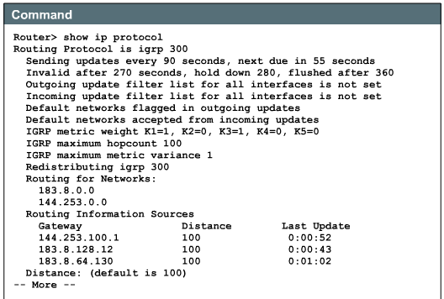
Show IP Protocols

Slide 39
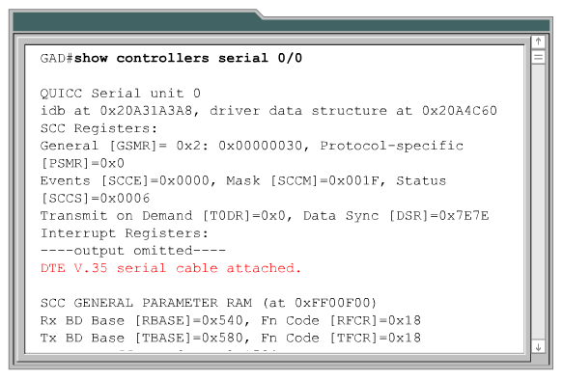
Show Controllers Serial

Slide 40
Lab
What do the
  show ip protocols
  and
  show controllers serial
commands show you

Slide 41
Cisco Online Tools
Next is some information on some tools found on the Cisco web site that will help you understand what the error messages and show command outputs are telling you
It is from a presentation at the 2011 Cisco Academy Conference titled Cisco Tools, Online Resources and IOS Fundamentals by Jessie Pagan

Slide 42
Error Message Decoder
He says
  The Error Message Decoder helps you to understand the meaning of the error messages displayed on the console of Cisco routers, switches and firewalls
  Error messages should be copied and pasted into the Error Message Decoder exactly as they appear in the console logs
  System error messages begin with a percent sign (%)

Slide 43
Error Message Decoder
  Standard error messages are generally all structured as follows
    %FACILITY-SEVERITY-MNEMONIC: Message-text
  Here is what the parts of the message mean
    FACILITY is a code consisting of two or more uppercase letters that indicates the facility to which the message refers. A facility can be a hardware device, a protocol, or a module of the system software

Slide 44
Error Message Decoder
    SEVERITY is a single-digit syslog code from 0 to 7 that reflects the severity of the condition
    MNEMONIC is a code that uniquely identifies the error message
    Message-text is a text string describing the condition
      This portion of the message sometimes contains detailed information about the event, including terminal port numbers, network addresses, or addresses that correspond to locations in the system memory address space, because the information in these variable fields changes from message to message, they are not required when using this tool

Slide 45
Error Messages
For example
  %SYS-2-MALLOCFAIL: Memory allocation of 68 bytes failed from 0x604CEF48, pool Processor, alignment 0 Process=2, ipl= 3
    This means the Operating System (SYS) is reporting a critical (2) message about a memory allocation that failed (MALLOCFAIL)

Slide 46
Error Messages
  %C6KPWR-SP-STDBY-4-DISABLED: Power to module in slot [dec] set [chars]
    This means the Catalyst Power System (C6KPWR) standby supervisor (SP-STDBY) is reporting a warning (4) message about power failure in a module (DISABLED)

Slide 47
Error Message Decoder
Here is the Error Message Decoder on the Cisco web site

Slide 48
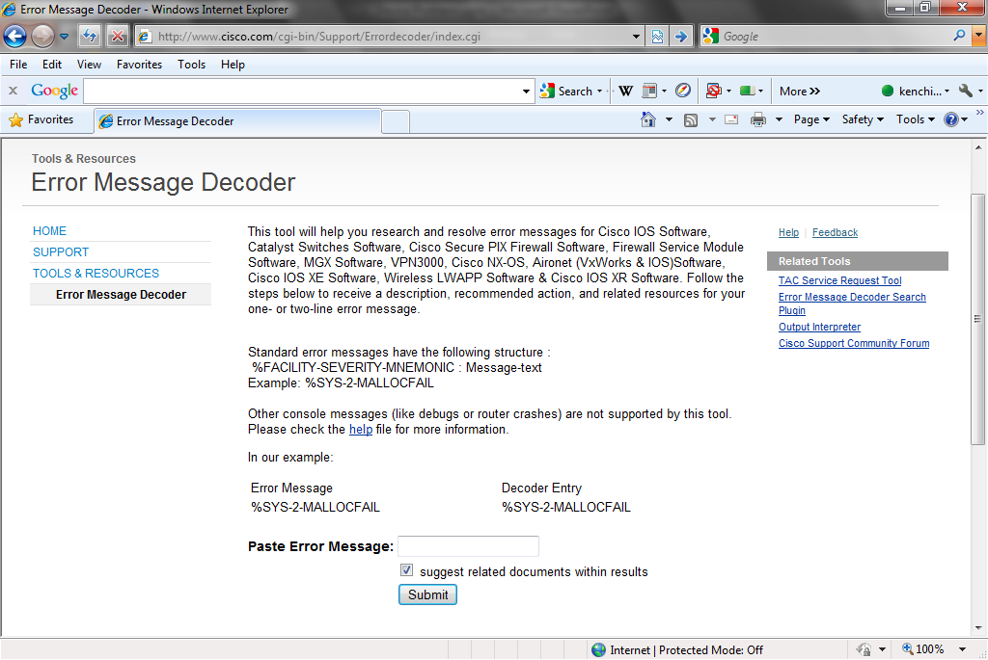
Error Message Decoder

Slide 49
Output Interpreter
Pagan goes on to say
  The Cisco Output Interpreter is a very powerful tool that allows for obtaining instant troubleshooting analysis and course of action for your device, using collected show commands output
  It analyzes output from show commands

Slide 50
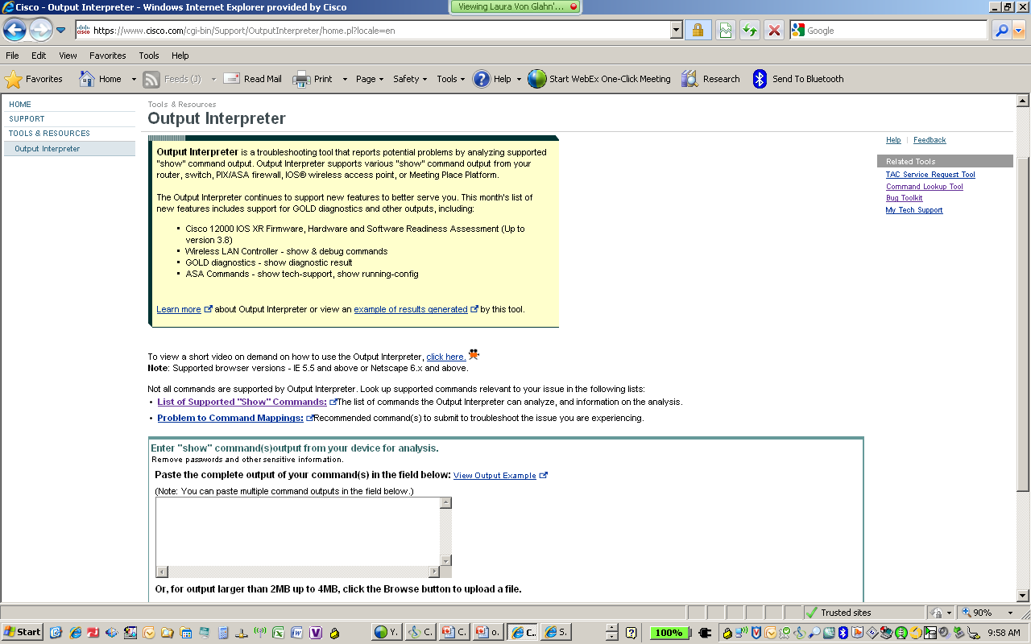
Output Interpreter

Slide 51
Routing Protocol Commands
There are several commands that show aspects of the routing protocol configuration
Here is a nice discussion of these from a 2010 white paper by Global Knowledge

Slide 52
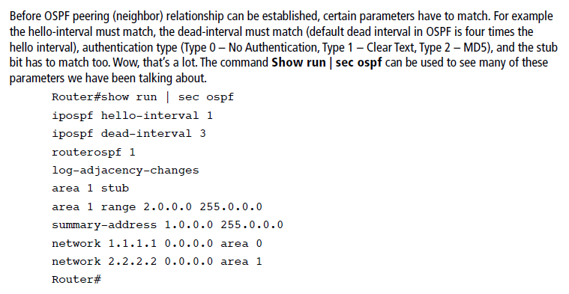
OSPF Commands

Slide 53
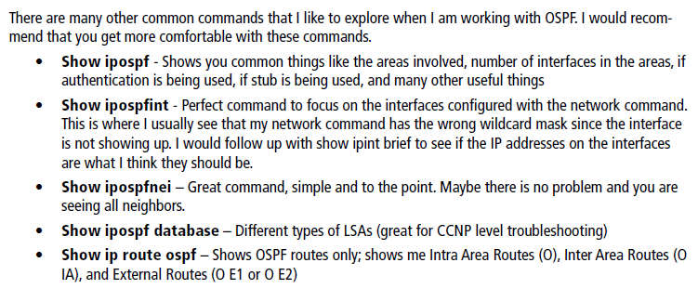
OSPF Commands

Slide 54
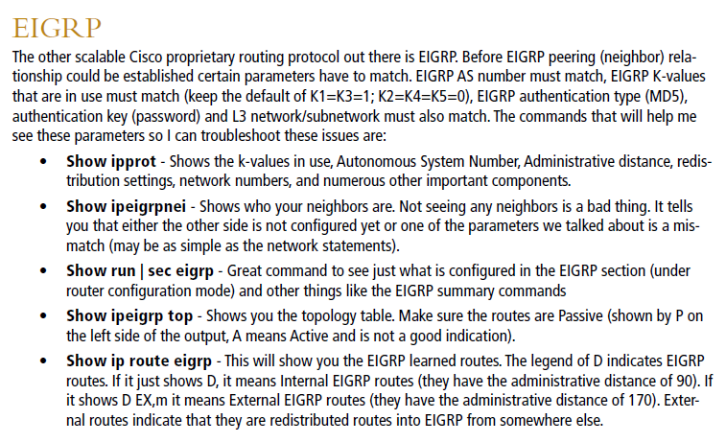
EIGRP Commands

Slide 55
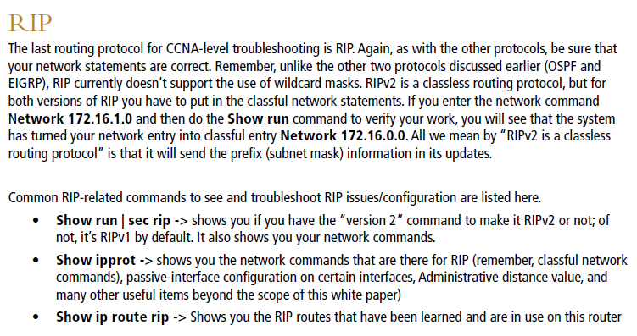
RIP Commands

Slide 56
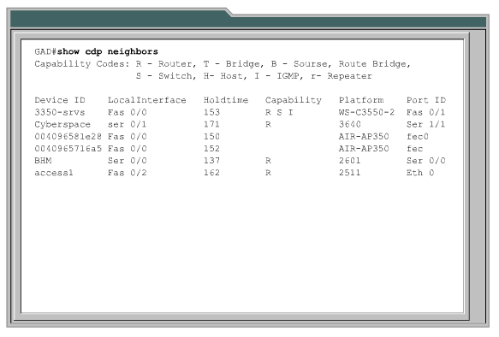
Show CDP Neighbors

Slide 57
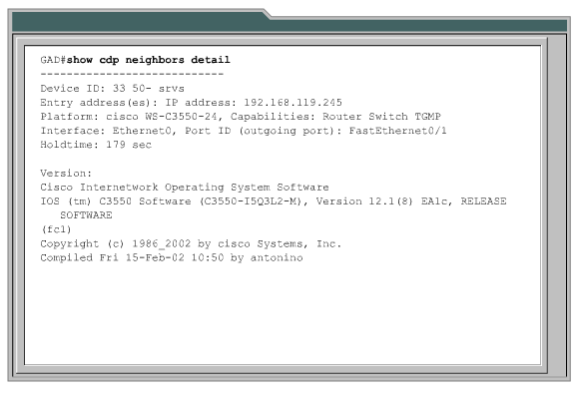
Show CDP Neighbors Detail

Slide 58
Debug
The debug command tells a router to display messages when certain events happen in a router
Unlike a show command, which displays a set of messages about the then-current status of the router, the debug command tells the router to watch for certain events

Slide 59
Debug
When those events occur, the router then sends a message, called a log message, to the console
These messages allow the CLI user to see information about the dynamic operations of the router, instead of the snapshot of information displayed by a show command

Slide 60
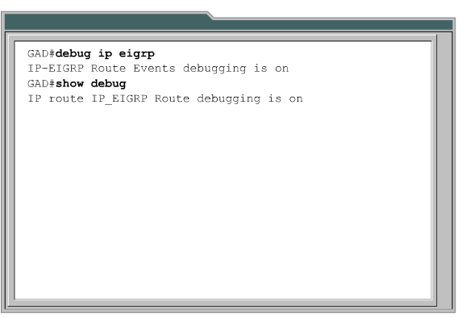
Debug

Slide 61
Lab
Run debug on the network

Slide 62
Lab
Let’s do the same thing using real routers instead of Packet Tracer

Slide 63
Common Problems
On end devices problems commonly seen and possible solutions for these problems include
  No Link State
  No or Bad IP Address
  Cannot Connect
  Connection Dropped
  Poor Performance

Slide 64
No Link State
If the link state cannot be established, in other words the link light does not come on or ipconfig says the cable is disconnected check these things
  Bad cable
  Bad connector on the cable
  Errors on the link
  Failed, marginal, blocked, or misconfigured port

Slide 65
No or Bad IP Address
If a valid IP address is not shown
  Determine if the address should be a static or dynamically assigned address
  If static
    Is it the correct one
    Is the subnet mask correct
    Is the default gateway correct
    Are the DNS servers correct
  If dynamic
    The same as above if there is an address shown

Slide 66
No or Bad IP Address
  If dynamic and the address shown is a Link Local address from the 169.254.0.0 range, then find out why a connection cannot be made to the DHCP server
  Which could be
    A network problem
    A router configuration problem

Slide 67
No or Bad IP Address
A bad IP address can also be a case where there are duplicate IP addresses on the network
The Fluke troubleshooting book says this about the technique to discover these
  A simple method to discover stations with duplicate IP addresses is to send ARPs to the problem IP address

Slide 68
No or Bad IP Address
  For each ARP request, you should usually see only a single ARP response
  There are at least three situations where you might receive multiple responses, though
    Two Stacks
      If a host has more than one IP protocol stack loaded, each stack responds to the ARP request
      All such responses have the same MAC and IP address in the response
      This is often a mysterious surprise but is not a problem situation

Slide 69
No or Bad IP Address
    Proxy ARP
      If Proxy ARP is running on a router servicing your subnet, the router may respond to local queries in addition to off-subnet queries
      You might receive a response from the target address as well as the router
      Routers that are acting in this manner simply forward subsequent traffic to the correct address, so this apparently duplicate response is not generally problematic

Slide 70
No or Bad IP Address
    Improper Configuration
      If two or more hosts are improperly configured to share the same IP address, each responds to the ARP
      Each responding host will answer with its own unique MAC address and the duplicated IP address

Slide 71
Cannot Connect
If a connection cannot be made to the resource needed the source of the problem can be local or remote
To check for local problems
  See if another user id and password work
  Observe the user logging in to check the procedure being used
  Determine which NIC is being used, wired or wireless, which one should be used

Slide 72
Cannot Connect
  Ensure the port in use is in the correct VLAN
To check for remote problems
  Look for a failed upstream connection
  See if the wrong route is being advertised
  Look for a broadcast storm
  Check the firewall configuration

Slide 73
Connection Dropped
If the network connection is lost after the initial connection
  Look for errors on the port
  Check the duplex settings on both ends
  Check the speed settings on both ends
  Look for a misconfigured spanning tree layout
  Test for EMI interference
  See if an application is using too many resources

Slide 74
Connection Dropped
  Look for a loose connection somewhere in the link to the resource

Slide 75
Poor Performance
Poor performance is usually manifested by complaints that the network is slow
In addition to the cannot connect and dropped connection procedures check
  That nothing has been recently changed on the problem station, or on the server, or service that may have caused this problem, such as reconfiguring or adding new software or hardware

Slide 76
Poor Performance
  Eliminate potential station memory allocation problems and software conflicts on the station by unloading all but the minimum software required to operate a test application across the network

Slide 77
Poor Performance
  Test the user’s station for viruses and look for applications that are consuming disproportionate amounts of the microprocessor resources or hanging the system long enough to exceed connection timers
    For this test disable any virus checking or security software, but re-enable it immediately after the test

Slide 78
Poor Performance
Check the speed and duplex settings as the autonegotiation process may not have connected the switch port and the NIC as the correct speed and duplex setting

Slide 79
Duplex Mismatches
On any device and especially on switches a duplex mismatch can be difficult to detect
When the interface is examined using the show interfaces status command the state will show up/up since the port will work, but just not well
The only wall to check for this is to check the duplex settings on each end

Slide 80
Duplex Mismatches
Then watch for increasing collision and late collision counters see in the show interfaces command

Slide 81
Cabling Problems
When the CRC counters seen in the show interfaces command for a port increase then a cabling or other hardware problem is likely the cause

Slide 82
Common Layer 1 Problems
Here is a table from the Wendell Odom ICND1 book that list the common layer 1 problems seen on ports

Slide 83
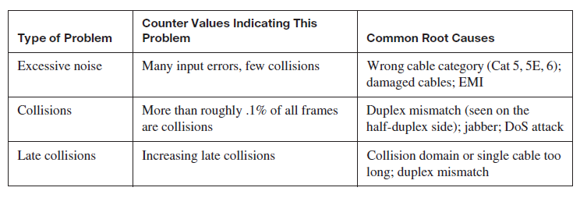
Common Layer 1 Problems

Slide 84
Poor Performance
The most common reasons for slow or poor performance include overloaded or underpowered servers, unsuitable switch or router configurations, traffic congestion on a low capacity link, and chronic frame loss
Tiered applications may suffer poor performance when any one of the servers in the tiered hierarchy suffers delays

Slide 85
Exogenous Factors
Also consider seemingly innocuous things that might impact the network, such as
  Temperature changes as heat is often a problem
  Electrical use from adjacent spaces – including nearby businesses, time of day, and influences from electronic sources
  Even the passage of an elevator, or use of a cordless phone, should be noted

Slide 86
Broadcast Storm
There is no easy way to detect a broadcast storm as the nature of the storm is to produce such high utilization on all the links that getting access to the equipment to diagnose the problem is very difficult

Slide 87
Broadcast Storm
About the only way to stop such as storm is to disconnect cables upstream from where the problem is being see until it stops
STP should prevent this problem
So check to see if it is in operation

Slide 88
Sources
Several of the passages here are copied directly or adapted from several articles and books by Laura Chappell and a white paper and book on network troubleshooting from Fluke Networks

Slide 89
For More Information
Introduction to Network Analysis, 2nd Edition
  Laura Chappell
  ISBN 1-893939-36-7
Network Maintenance and Troubleshooting Guide
  Neal Allen
  ISBN 978-0-321-64741-2

Slide 90
For More Information
Frontline LAN Troubleshooting Guide
  A white paper from Fluke
  2008

