Slide 1
Testing Fiber Optic Media Last Update 2013.08.03 2.0.0

Slide 2
Objectives
Learn how to test fiber optic cable

Slide 3
Testing Fiber Optic Media
In this presentation the emphasis is on the testing of fiber optic cable inside of a building as used for a backbone link
Typically this is multimode cable
Over the years there has been a lot of back and forth on this topic

Slide 4
Testing Fiber Optic Media
To summarize the detailed discussion below it should be recognized that in a LAN environment there is only one test that must be performed which is the attenuation of the signal
The attenuation test is done by injecting a known amount of light into one end of a fiber, and then measuring how much comes out the other end

Slide 5
Testing Fiber Optic Media
As long as the received power level is high enough that the device on the far end of the link can read the signal then the test is passed

Slide 6
Testing Fiber Optic Media
This method uses an optical light source and an optical power meter to compare the difference between two power levels
There are several different formats in which this attenuation test may be done
The most basic and most common attenuation test is called by one of these names

Slide 7
Testing Fiber Optic Media
One Jumper
Method B
Tier 1
With the current preferred name being One Jumper

Slide 8
One Jumper Test
The test configuration depicted in the illustration below includes a test source on one end which generates the light signal, and a test meter on the opposite end which receives the light signal
In addition, it is interesting to note that two test jumpers are included in this configuration despite it being referred to as a “One-jumper End-to-end Test”

Slide 9
One Jumper Test
The reason for this name is that only a single jumper from 1 to 5 meters long is included in the initial reference of the test source to the test meter
This test is used to tell the meter how much light the light source is sending
This process removes the value of the loss of the two jumpers from the displayed output on the measuring device

Slide 10
One Jumper Test
That way we know that the value displayed is all permanent link loss

Slide 11
One Jumper Test

Slide 12
One Jumper Test

Slide 13
Testing Tools
There are three tools than can be used to test fiber optic cable
These are
VFL
OLTS
OTDR

Slide 14
VFL
A VFL – Visual Fault Locator is an infrared laser that streams light into one end of the cable
In doing so, the VFL identifies the continuity and identifies the connectors in the patch panels or outlets, should they be transposed

Slide 15
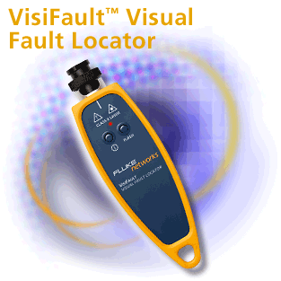
VFL

Slide 16
OLTS
An OLTS – Optical Loss Test Set incorporates two components - a light source and an optical power meter
The basic OLTS is a meter and a source contained in separate units that test one fiber at a time
This is also commonly called a LSPM in other words a Light Source Power Meter
This is the tool used most often

Slide 17
OLTS
There are manual and automatic versions of these products
With the manual version a reference measurement must be manually computed
The second type of OLTS automatically makes the calculation for the reference measurement and the test measurement

Slide 18
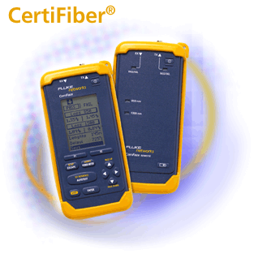
OLTS

Slide 19
OTDR
An OTDR – Optical Time Domain Reflectometer is an advanced optical-fiber certification and diagnostic tool that is used to characterize power loss by sending short pulses of light from one end of a fiber, then analyzing the backscattered light from the fiber

Slide 20
OTDR
Light backscattered from the fiber travels back to the OTDR, where its optical power and arrival time are recorded and graphically displayed as a trace
The OTDR has the capability to measure the length of the fiber and determine the power loss between any two points along the fiber

Slide 21
OTDR
The OTDR enables measurement of elements along a fiber link, including the segment length, attenuation uniformity and rate, connector location and loss, and other power-loss events such as a sharp bend

Slide 22
OTDR
Reflective events such as connections and fiber breaks and non-reflective events such as splices and tight bends can be located by analyzing the graphical trace or by using an event table that may be generated by the OTDR

Slide 23
OTDR

Slide 24
Example Output of an OTDR
Let’s see what a trace looks like as well as what each event is

Slide 25
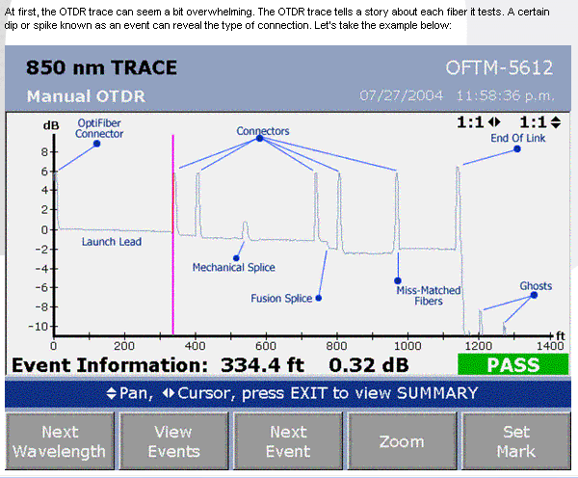
Example Output of an OTDR

Slide 26
Example Output of an OTDR
OptiFiber Connector
This is a reflective event and should be present on all traces
The reflection is caused by Fresnel Reflections
If you look out of your window at night, you will see your image on the window as well as what is outside
This is a Fresnel Reflection

Slide 27
Example Output of an OTDR
And just as with your window, you can have too much Fresnel Reflection to the point you can hardly see anything beyond the window

Slide 28
Example Output of an OTDR
Launch Lead
This is the tail after the OptiFiber
It can be large sometimes
A launch lead or long coil of fiber optic cable at the end of the link is used to control this to ensure the first event is seen

Slide 29
Example Output of an OTDR
Rayleigh Scattering allows fiber loss to be measured
Let’s look at some common causes of loss as seen by an OTDR

Slide 30
Example Output of an OTDR
Connectors
We can tell the events are connectors because they are reflective events with a significant amount of Fresnel Reflection with a loss

Slide 31
Example Output of an OTDR
Mechanical Splice
This event has a reflection but the reflection is not that large
This indicates that this is a mechanical splice
The reflection is caused by the index matching gel in the mechanical splice

Slide 32
Example Output of an OTDR
Fusion Splice
Here we see no reflection, just a loss
Fusion splices are the best method for a virtually lossless connection but a high quality fusion splice is required for this
The event shown here is significantly worse than the 0.3 dB permitted by the cabling standards

Slide 33
Example Output of an OTDR
Miss-Matched Fibers
This is often referred to as a gainer
Of course this is not a real gainer since all the components here are passive, it just appears that way
In this example a 50 µm fiber is connected to a 62.5 µm fiber
The step up is caused by there being a higher level of scattered signal coming from the larger core fiber

Slide 34
Example Output of an OTDR
End Of Link
This is shown as a very large reflective event with the tail dropping off the bottom of the trace
This may not be the end of the link, it could we where the fiber is broken
That is why you must run an OTDR test on a link in both directions if the length is not already known

Slide 35
Example Output of an OTDR
If you measure in one direction and it reports 75 m and the other direction reports 62 m then you know there is a break in the cable

Slide 36
Example Output of an OTDR
Ghosts
Ghosts are not real events
It is easy to anticipate where ghosts will appear on the trace and they can therefore be ignored
Also, the ghost will have no associated step down on the trace level since there is no loss at that point
This enables it to be identified as a ghost

Slide 37
Example Output of an OTDR
With the OptiFiber, most Ghosts will be seen after the End Of Link

Slide 38
Output Examples in General
Here are some more examples of common output on an OTDR from an article in the June 2009 issue of OSP

Slide 39
Output Examples in General
Launch

Slide 40
Output Examples in General
Opens

Slide 41
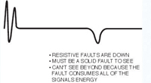
Output Examples in General
Resistive Faults

Slide 42
Output Examples in General
Splice

Slide 43
Output Examples in General
End of Cable

Slide 44
Testing Fiber Optic Media
The One Jumper - Method B - Tier 1 test is done using a OLTS
The test is performed on the permanent link
Here is an example of the setup for this type of test as seen in an article in Cabling and Installation Maintenance in December 2012

Slide 45
Testing Fiber Optic Media

Slide 46
Current Test Standards
The current standards that defines this test is found in TIA-526-14-B and TIA-568-C.0

Slide 47
Encircled Flux Testing
The test covered above applies to speeds at and below 1 Gbps
For higher speeds a new method called encircled flux testing is used
This capability is built into either the device in the network such as a switch, into the tester itself, or as a jumper for older testers

Slide 48
Encircled Flux Testing
Encircled flux testing adjusts for the launch of the signal into the fiber so as to produce an accurate test at these higher speeds

Slide 49
Tier 2
Tier 2 testing is optional
This test is not needed for in building installations
Tier 2 testing supplements Tier 1 testing with the addition of the OTDR trace of each fiber link

Slide 50
Tier 2
You can gain insight into the performance of the link components, such as cable, connectors, and splices and the quality of the installation by examining non-uniformities in the trace
An OTDR trace does not replace the insertion loss measurement with an OLTS

Slide 51
Tier 2
Most OTDRs are not appropriate for testing fiber optic cables in structured cabling systems, as they lack the distance resolution needed and do not give accurate loss data due to their different measurement technique

Slide 52
Tier 2
Few premises cabling installers are adequately trained in interpreting OTDR data and misreading them can cause good cables to be failed and vice versa
Finally, OTDR testing is expensive, greatly increasing the installed costs of fiber optic cabling

Slide 53
Alternate Attenuation Tests
There are other types of tests that will be encountered so let’s mention these

Slide 54
Method A
Method A is used for testing links in which the total attenuation is dominated by the loss in the fiber cable, rather than the loss of the connectors, as is often the case for data networks
The referencing procedure for Method A uses two patch cords and an adapter connector per fiber link to be tested

Slide 55
Method A
This method should not be used in a local area network environment where the links are less than 5,000 meters and typically contain only two splices per fiber link

Slide 56
Method A

Slide 57
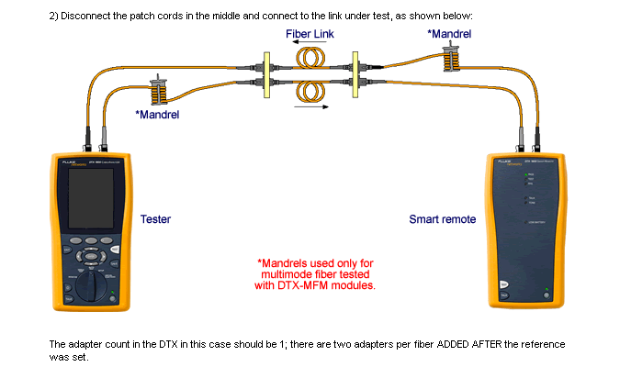
Method A

Slide 58
Method A

Slide 59
Sources
Most of this is copied directly from information provided by Fluke and Cabling and Installation magazine

