Slide 1
Fiber Optic Cable
Installation Outdoors
Last Update 2014.07.31
1.5.1

Slide 2
Objectives
Learn how to install fiber optic media outdoors

Slide 3
Installation Outdoors
To have fiber optic cable installed outside a utility contractor is normally used
They will use one of two basic methods to run the cable
  Cut and replace or trenching
  Directional boring

Slide 4
Cut and Replace
In cut and replace a trench is dug between the two points to be connected
If just dirt is there, it is a simple process
If it is covered by concrete or asphalt, then that must be removed and replaced

Slide 5
Cut and Replace
There are four ways of doing this
  Traditional Trenching
  Vibratory Plowing
  Soft Excavation
  Microtrenching

Slide 6
Cut and Replace
This is done using
  Trenching machine
  Backhoe
  Specialized plow

Slide 7
Trenching Machine
The trenching machine can be a walk behind unit or a Ride On type
Ditch Witch says this about these two methods

Slide 8
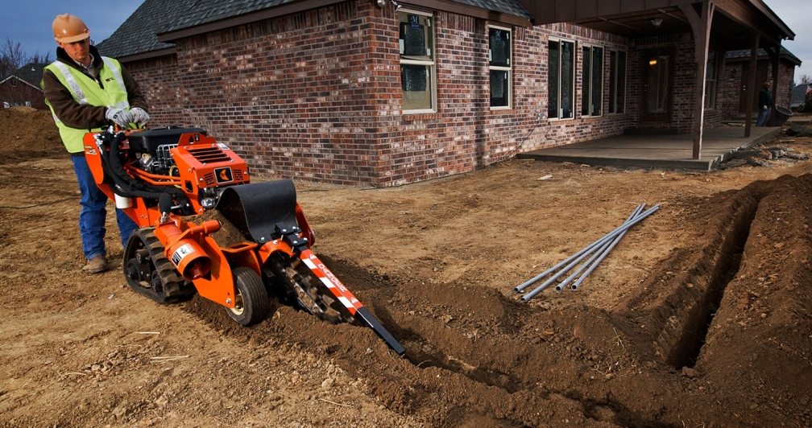
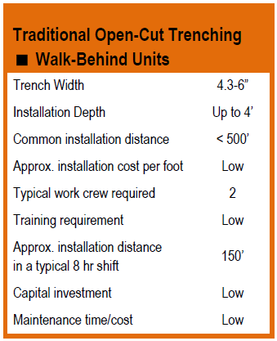
Trenching
Walk-Behind Units and
Compact Utility Equipment
Excellent for service drops
Easy to operate
Small enough to enter backyards and side lawns
Configuration options provide
the right tools for the job:
chain, digging teeth, tracks,
tires, boring attachment
Notes:
Includes pedestrian trenchers and mini-skid steers with multiple attachments for versatility
Rubber tires and tracks
Typically 10 to 25 hp machines
Capital investment for all slides:
Low: $0 - $20k
Med: $20k - $100k
High: over $100k

Slide 9
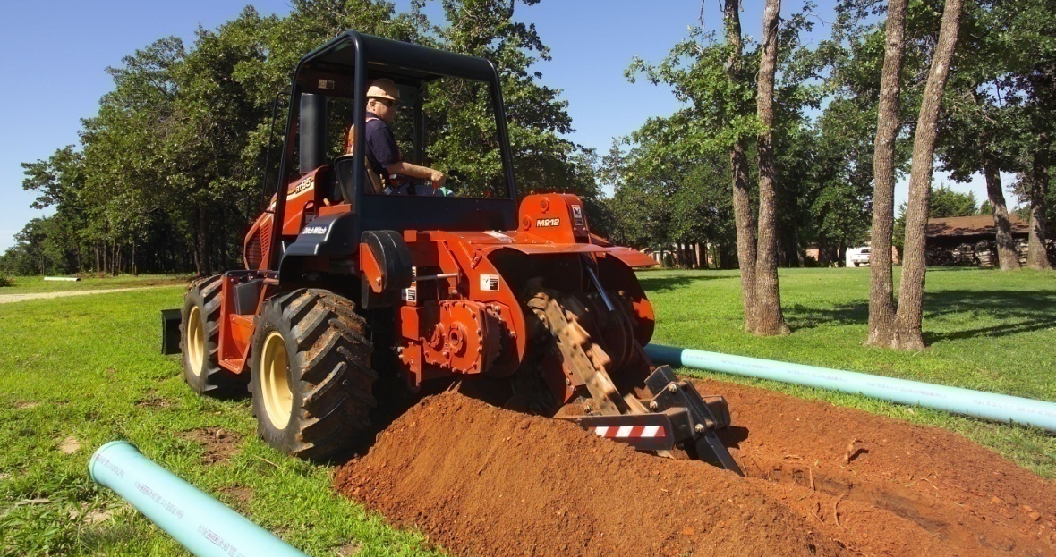
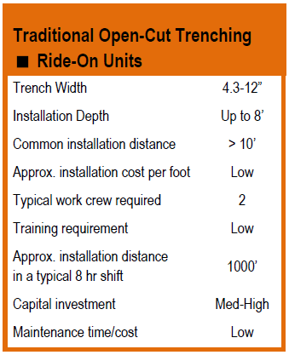
Trenching
Ride-On Units
Excellent in open greenfield
Capable of digging through rock, varying soils
Versatile digging systems: chain/teeth, saw, plow/combo
Notes:
Typically 40 hp and up

Slide 10
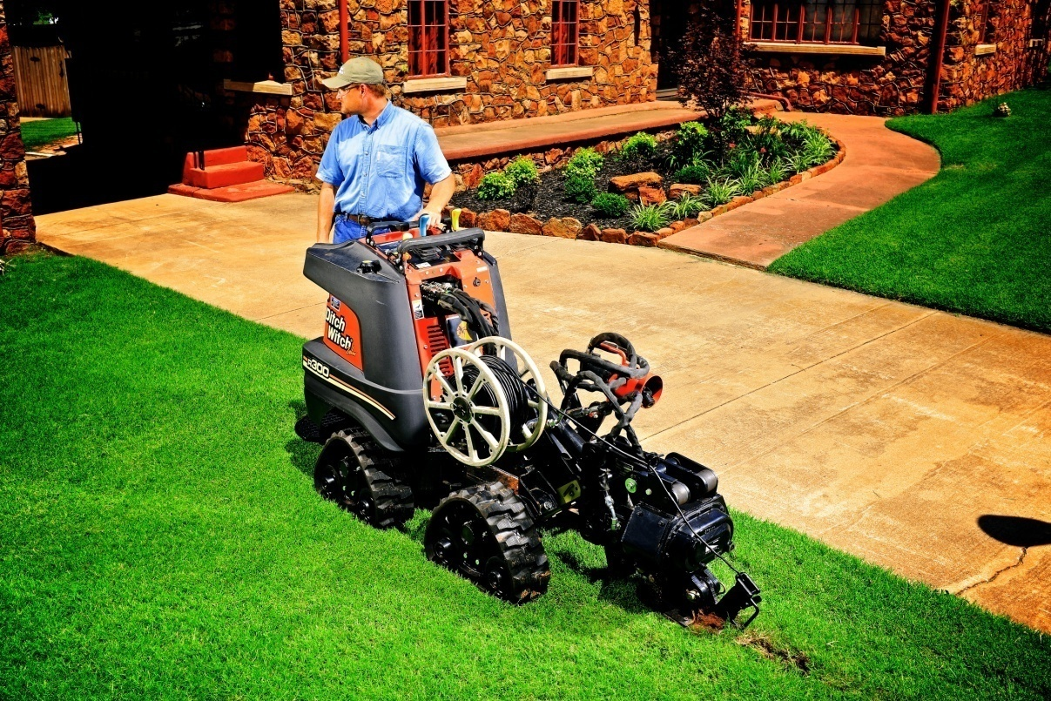
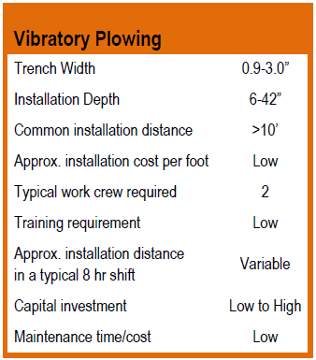
Vibratory Plowing
Walk-Behind, Ride-On, and Compact Utility Equipment
Fast and proven method for fiber
Cuts slot and installs product
in one pass
Minimal surface disturbance means reduced restoration
Walk-behind and ride-on units offer jobsite versatility.
Notes:
Best choice if no existing utilities and proper ground conditions
Pedestrian units 10 hp to dedicated 40 hp plows
Riders from 40 hp and up
Compact utility equip has multiple attachments for versatility – the same unit can be trencher and plow
Combo units on riders – both trencher and plow in same attachment

Slide 11
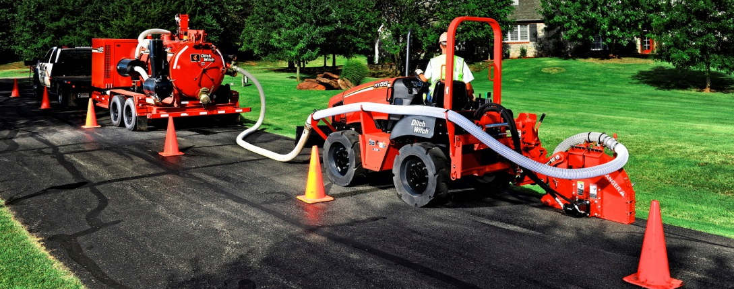
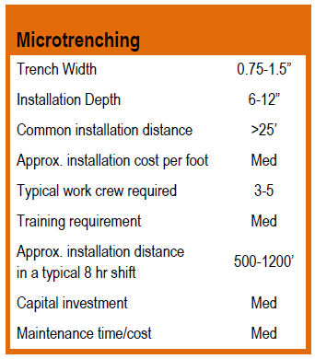
Microtrenching
Emerging technology designed for fiber installation
Cuts through asphalt, vacuum removes spoils
Minimal traffic interruption
Minimal surface disruption
Notes:
Theory – cut through solid upper layer (asphalt layer) into base material but stay above existing utilities (target zone: 6” to 12” depth)

Slide 12
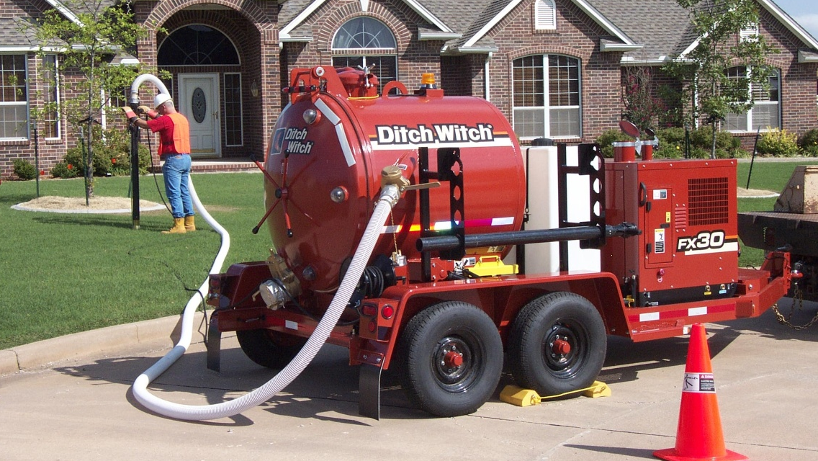
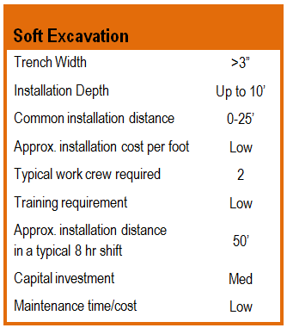
Soft Excavation
(HydroVac)
Safest digging option
near other utilities
Creates clean, efficient jobsite
Minimal turf, landscape disturbance
Equipment can be used with other excavation methods.
Notes:
Utilized initially for HDD support…utilization growing rapidly for excavation and damage prevention

Slide 13
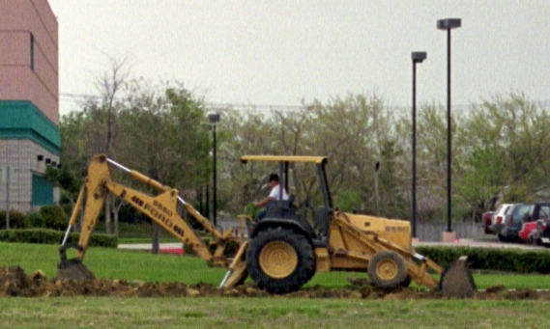
Backhoe

Slide 14
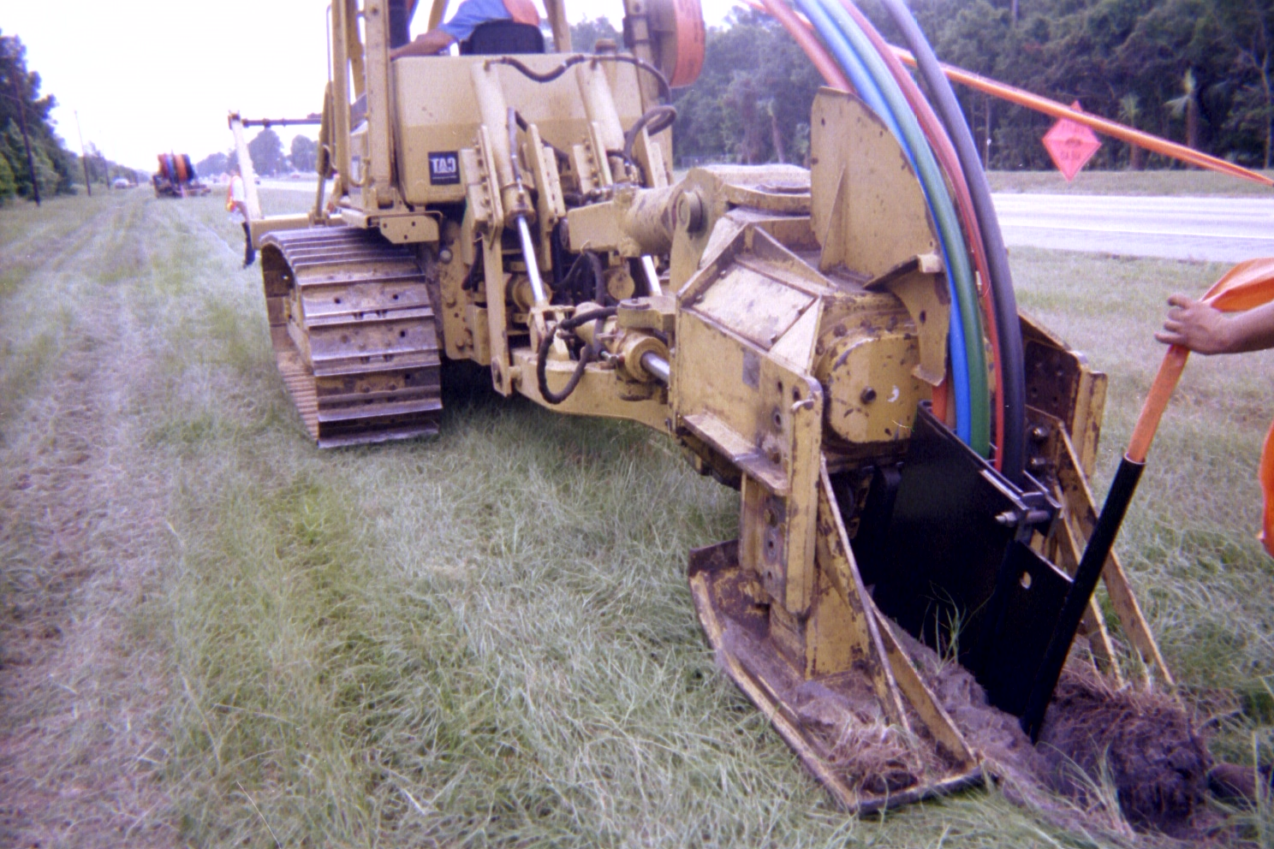
Specialized Plow

Slide 15
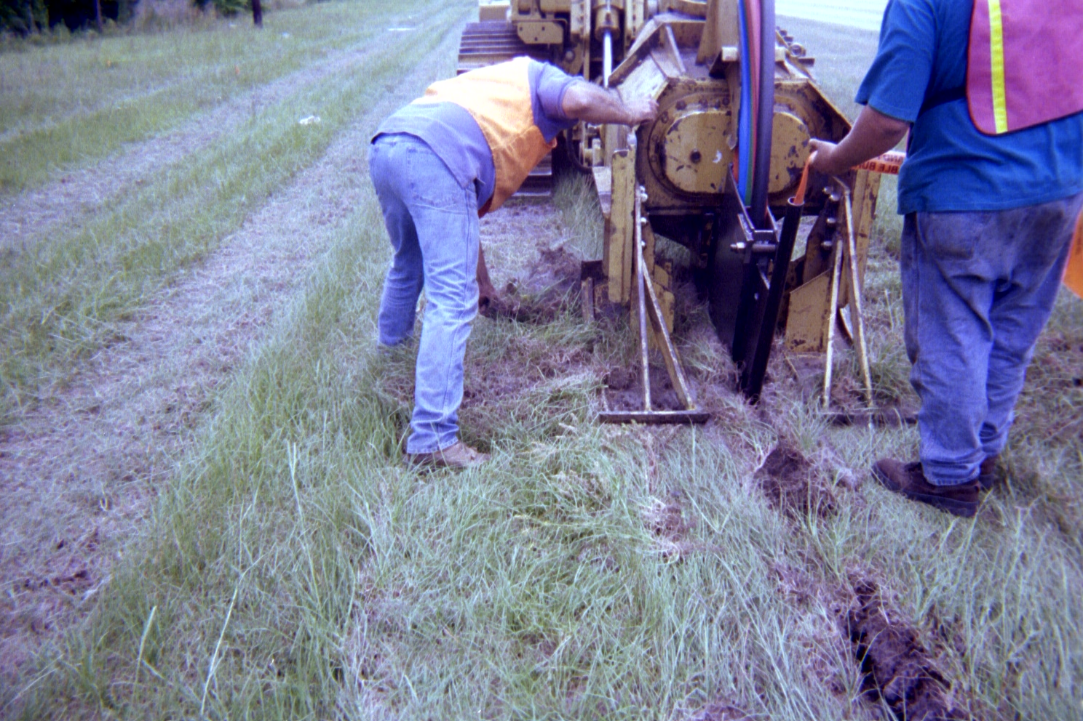
Specialized Plow

Slide 16
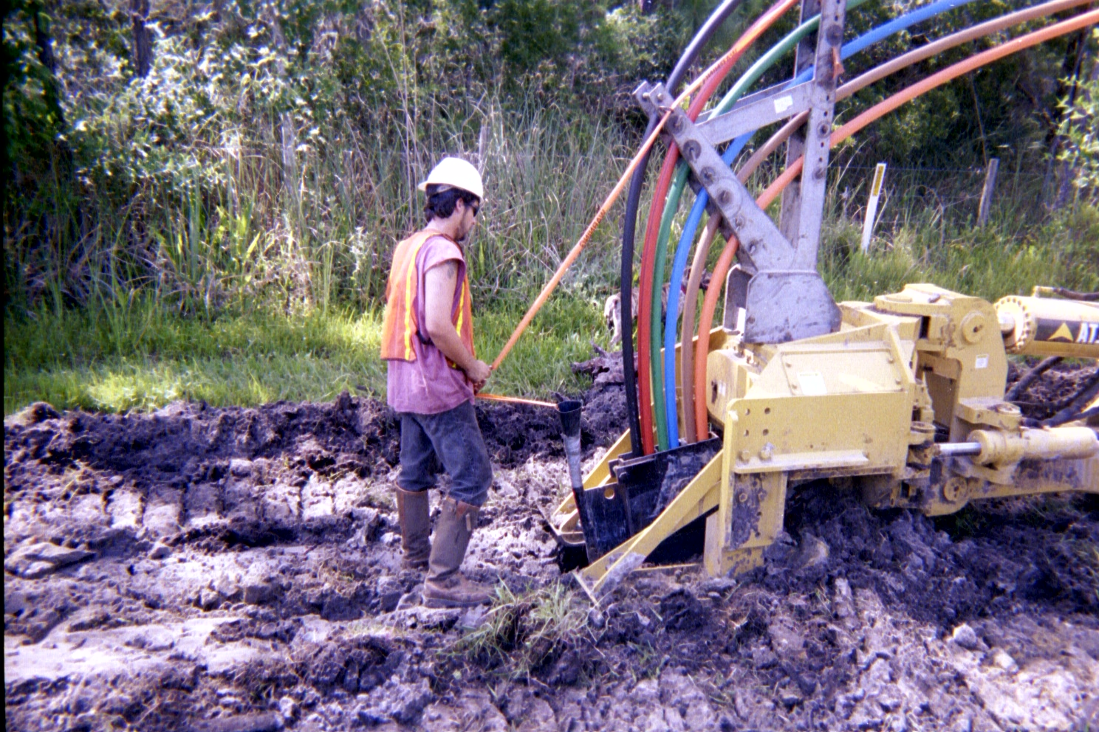
Specialized Plow

Slide 17
Cut and Replace
To do cut and replace the surface is removed if required, such as a concrete in a parking lot, then a trench is dug using a backhoe or trenching machine
Once the cable is laid and the dirt put back in place the dirt must be compacted
Compacting is done by a machine designed for this purpose

Slide 18
Cut and Replace
It just compresses the dirt so a dip in the surface does not develop later on
Especially in a city street, a city inspector will have to test the compaction to ensure it meets requirements before the concrete or asphalt is put back in place
If the test fails the dirt is left to sit or be compacted again, then the test is performed again

Slide 19
Cut and Replace
All of this of course takes time and disrupts traffic
So cities require that trenching be done in small sections so as to impede traffic as little as possible
For example

Slide 20
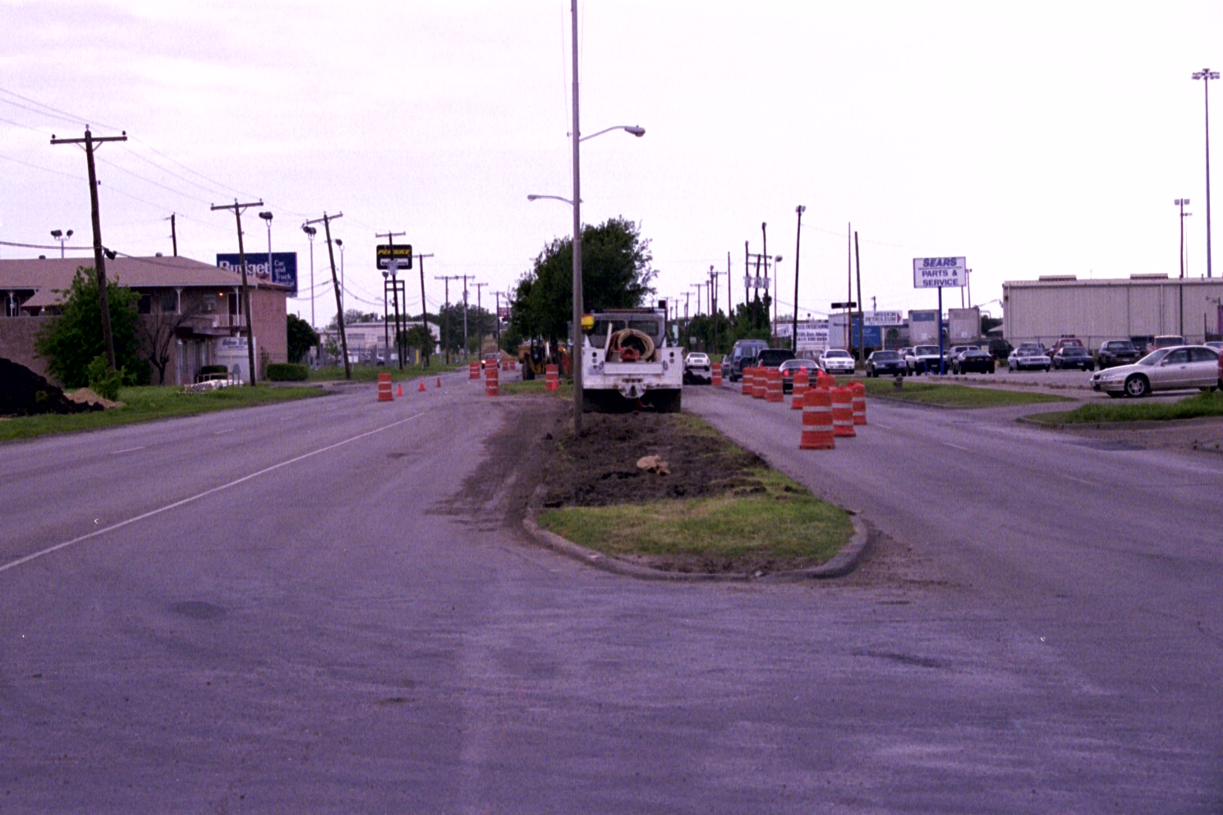
Cut and Replace

Slide 21
Cut and Replace
Such a requirement slows the rate of the job and therefore raises the cost
In general as seen next cities do not like cut and replace

Slide 22
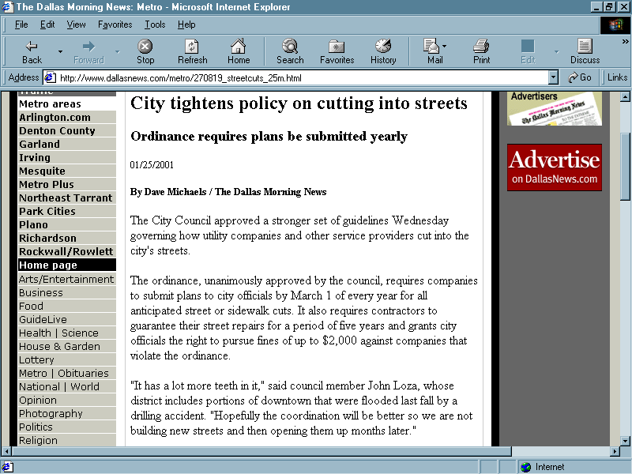
Cut and Replace

Slide 23
Directional Boring
Boring then has become a popular alternative
To bore, a backhoe is used to dig a single hole at each end of the cable run
The boring machine is then used to bore a small tunnel, about 6 inches for most fiber runs, from one hole to the other
A pipe is run through the tunnel and the cable is threaded inside the pipe

Slide 24
Directional Boring
The usual distance between the two holes is a few hundred feet, when doing utility work like this
This method is not foolproof
Problems encountered include dirt or rock that is difficult to bore through and potholes from shifting of the dirt

Slide 25
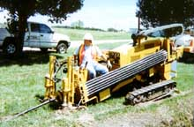
Directional Boring

Slide 26
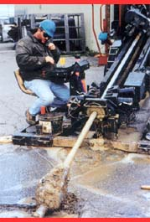
Directional Boring

Slide 27
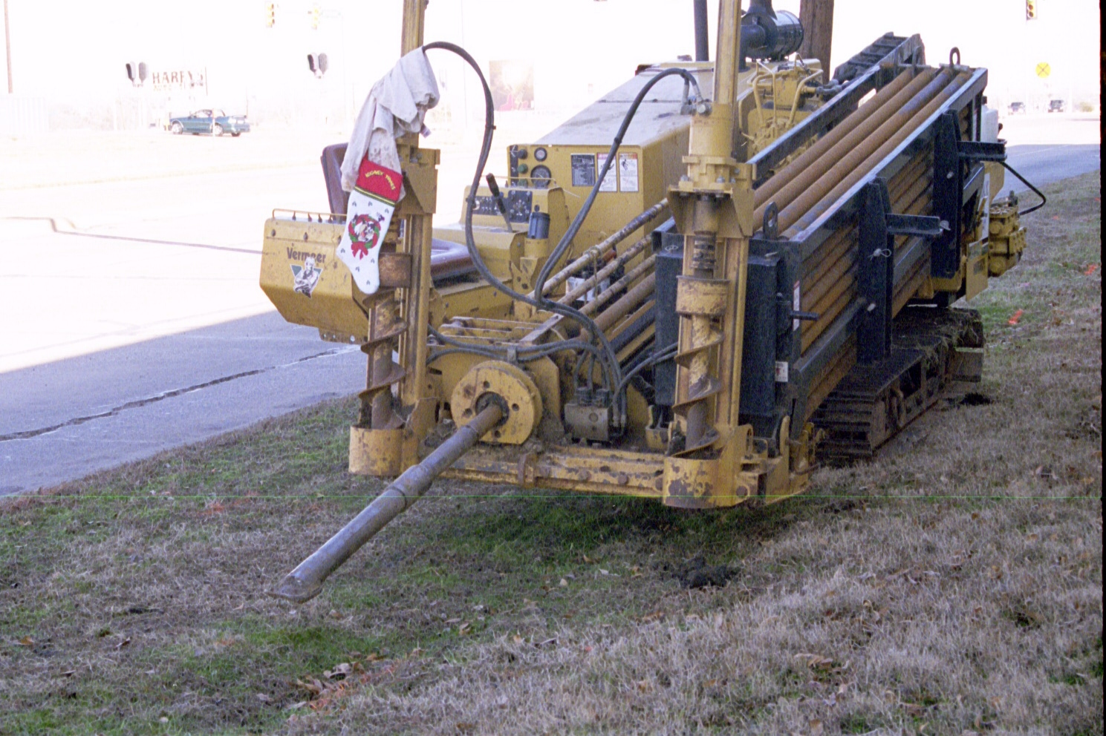
Directional Boring

Slide 28
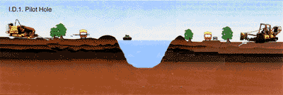
Directional Boring Example

Slide 29
Directional Boring
Ditch Witch adds this concerning directional boring

Slide 30
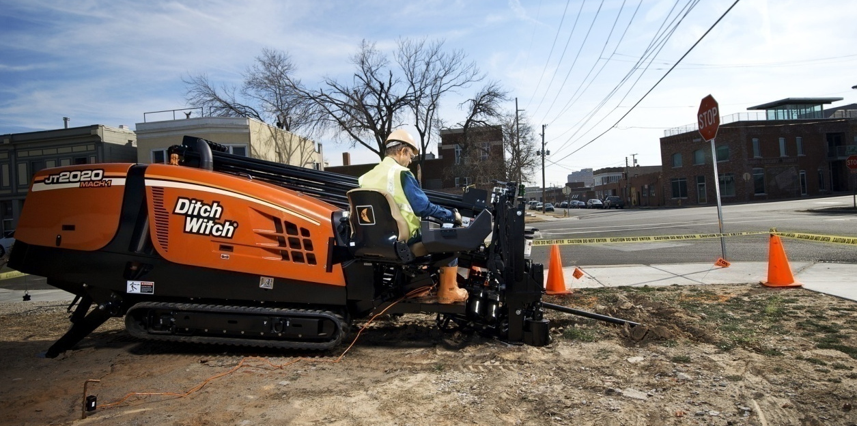
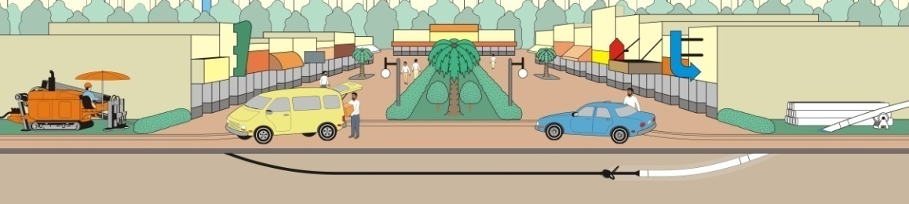
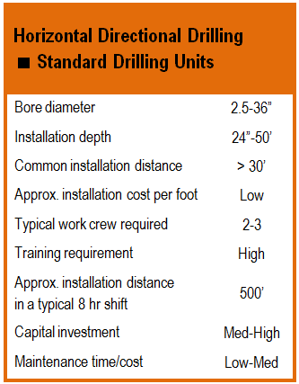
Horizontal Directional
Drilling
Minimizes surface disturbance
and hard-surface restoration
Steerable path can avoid most buried and surface obstacles
Limited traffic disruption
Low environmental impact
All Terrain technology provides
solutions to drilling in rock
Notes:
Most popular installation method
Rock drilling can get expensive, but is the only method in some conditions

Slide 31
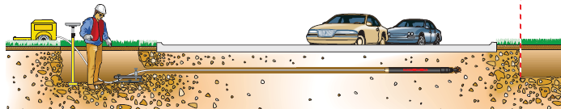
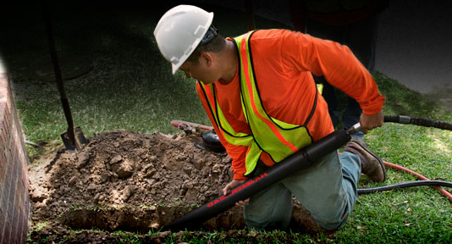
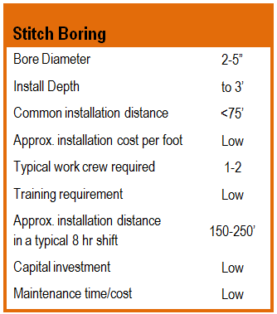
Stitch Boring
Ideal for FTTx installations and under curbs, sidewalks and driveways
Low cost on all points: investment, operation, labor
Single compressor runs multiple tools simultaneously
Minimal training required
Notes:
AKA piercing tool or mole
Compressed air actuates striker and forces tool through soil

Slide 32
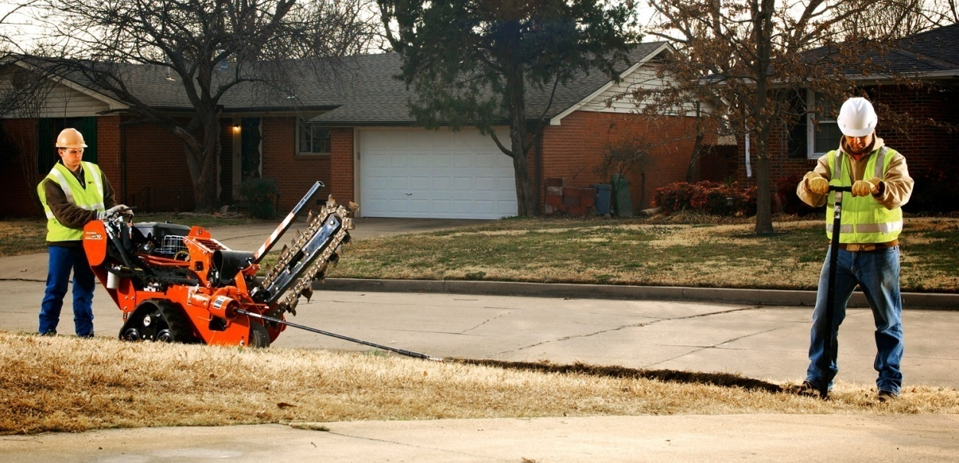
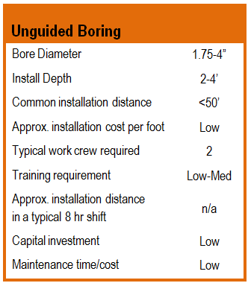
Unguided
Boring
Excellent for crossing driveways
and sidewalks
Easily mounts to other equipment (walk-behinds and riders)
Increases asset utilization by expanding capabilities
Counterpart to open-cut
trenching methods

Slide 33
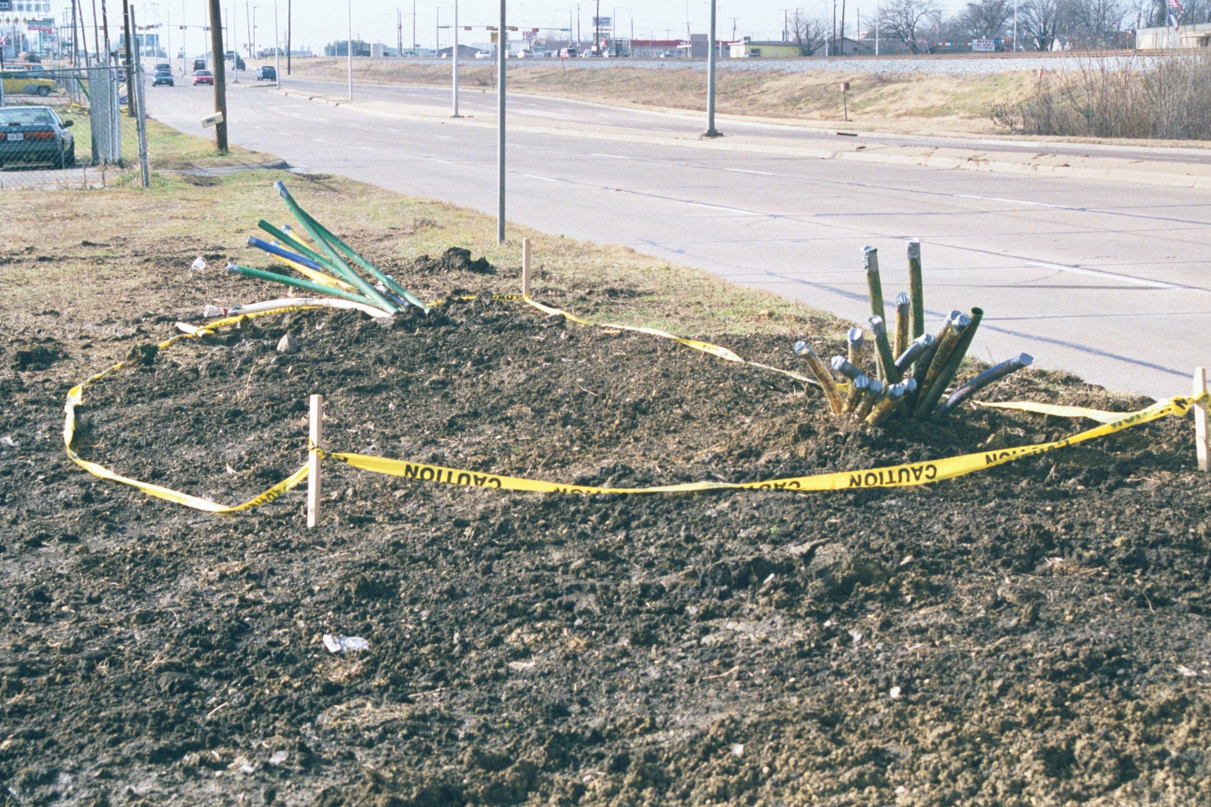
Cable in Ground

Slide 34
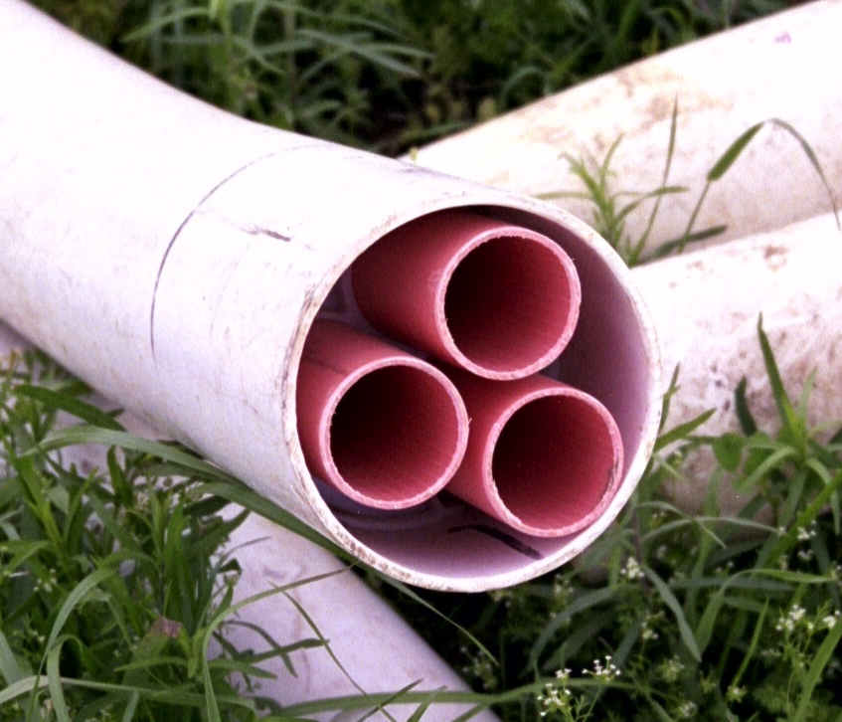
Tubes in Conduit

Slide 35
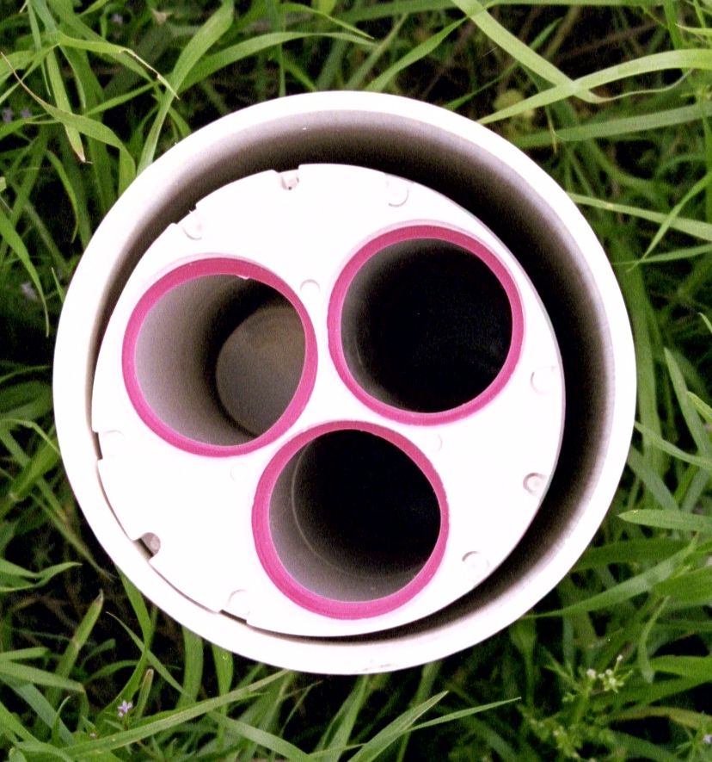
Tubes in Conduit

Slide 36
Service Loops
In the February 2012 issue of Cabling Installation and Maintenance magazine Eric Pearson points out the need for service loops in outdoor fiber optic cable installations
He says

Slide 37
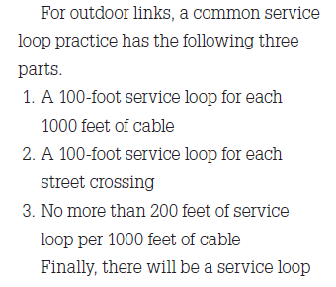
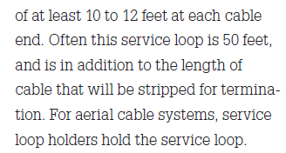
Service Loops

Slide 38
Thermal Expansion
He also points out the need to allow for thermal expansion by using sags in the cable
As he says

Slide 39
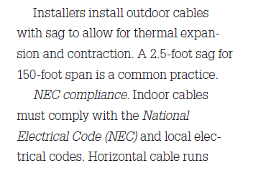
Thermal Expansion

Slide 40
Armored Cable
Instead of fiber and conduit armored cable can be used
This is just placed in the ground
There are three types of cable for this use
  Interlocking
  Corrugated
  Dielectric Armored

Slide 41
Armored Cable
Both interlocking and armored must be grounded as they contain metal
Dielectric armored does not
Here is a photograph from Corning on the grounding process

Slide 42
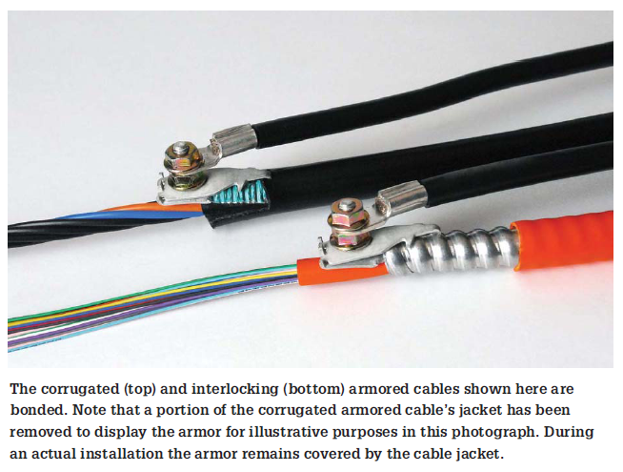
Armored Cable

Slide 43
Outdoor Installation Cost
What does all of this cost
Typical prices as of 2005 for small jobs, such as across the street to connect a CAN together, are
  $4 per foot for trenching through open ground
  $12 to $15 per foot for cut and replace
  $6 to $15 per foot for boring

Slide 44
Outdoor Installation Cost
In many cases trenching is used in areas controlled by the organization and boring is used to cross public right-of-way
For larger jobs, such as a MAN or dark fiber installation it very much depends on the location
Out in some parts of West Texas where cows outnumber people costs can be as low as $20,000 per mile

Slide 45
Outdoor Installation Costs
In large built up cities cost can be either side of $500,000 per mile
With the minimum being $100,000 per mile
These are underground costs
Aerial installation is much less, but rarely done

Slide 46
Right of Way Issues
These days right of way can be a major problem
If you own the right of way, then the only problem will be the appearance
If you do not own the right of way, you may find the owner is reluctant to have their property disturbed
In this case public right-of-way will have to be used, if it is available

Slide 47
Right of Way Issues
Most governmental entities, especially cities, will allow the easement area that runs along the edge of the street to be used for a fee
This is the same place water and sewer lines run
Their will be rules about when and how this is done

Slide 48
Right of Way Issues
Most cities have come to prefer boring over cut and replace when you cross their property or easements
Dealing with the government can also lead to delays
A permit is typically required
Such a permit often must be approved by the city council

Slide 49
Right of Way Issues
This can require several readings to allow for public input
All of this can take one to two months easily
Further, several sets of detailed engineering plans must be submitted for approval at the same time

Slide 50
Right of Way
Why all the hassle
Well on 5 September 2000 in Downtown Dallas Texas, as the local paper said
  A construction crew drilling to install fiber-optic cable struck a major downtown water line Monday afternoon, flooding streets for blocks around and inundating the basements of at least four buildings before city workers could stop the deluge

Slide 51
Right of Way
An easier place to run cable is along a railroad line
In this case fiber optic cable already installed under the ground is being marked so work being done along this area does not disrupt it
The cable in this case is owned by Sprint

Slide 52
Right of Way
The white arrow, for traffic control, is pointing to where the cable has been marked using orange paint as can be seen better in the following photos

Slide 53
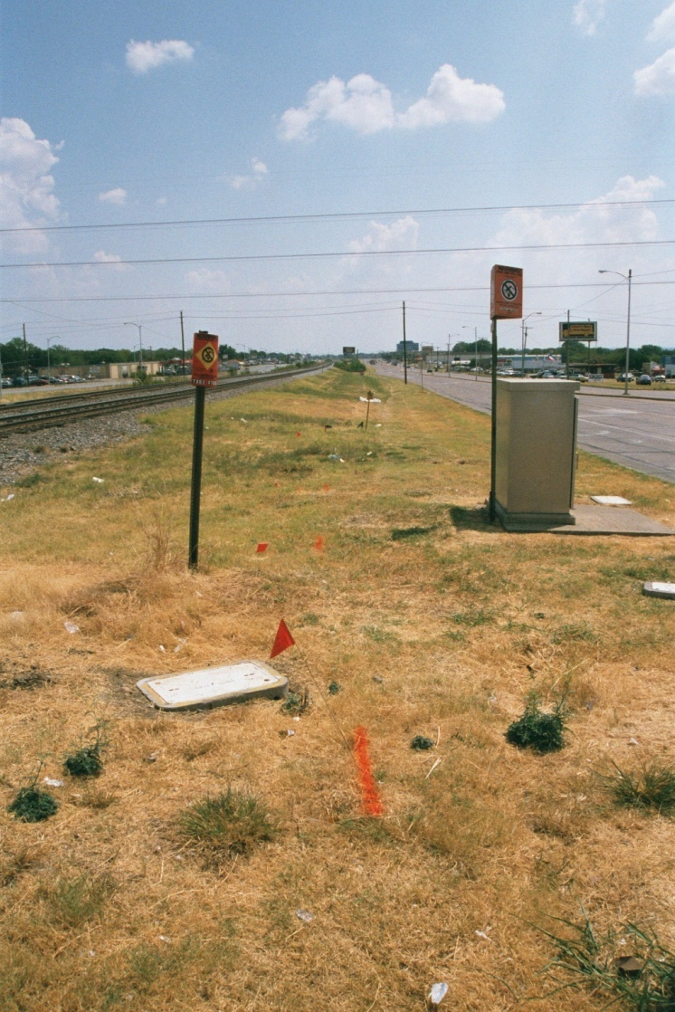
Right of Way
Flags and paint used to mark existing cable in this railroad right of way

Slide 54
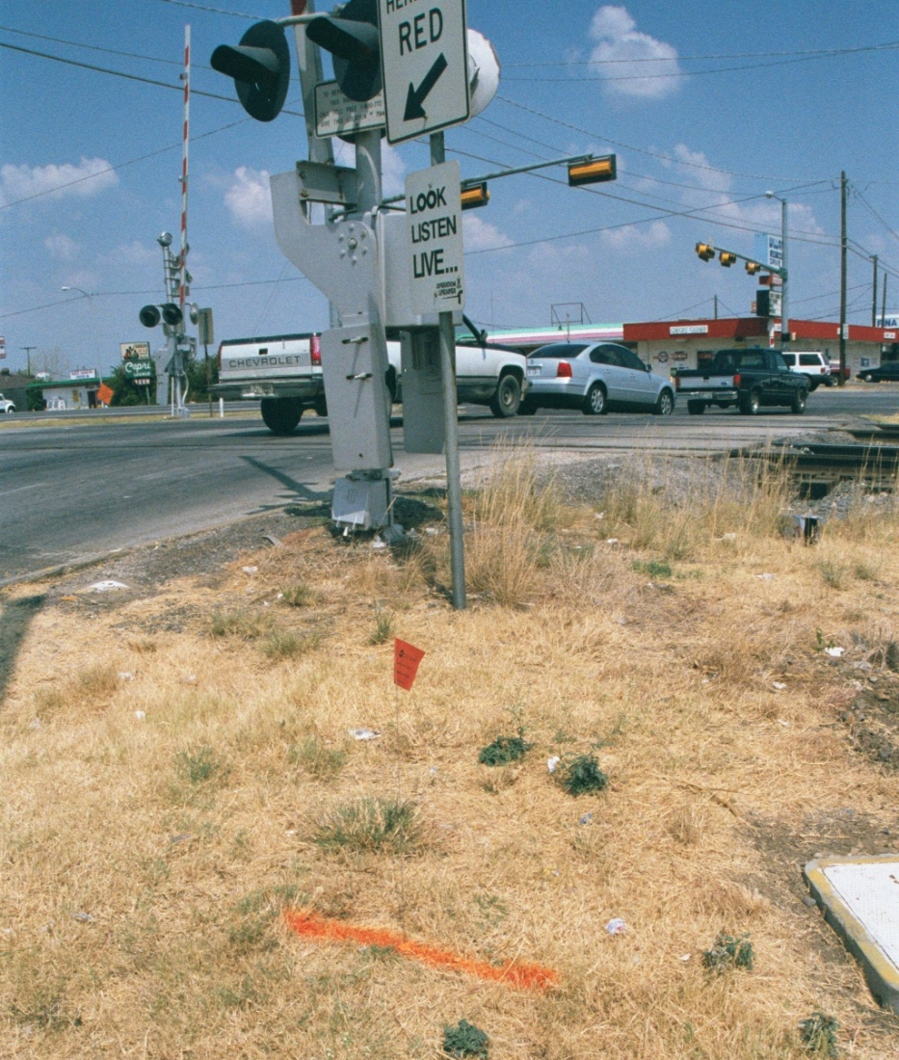
Right of Way
Flags and paint used to mark existing cable in this railroad right of way

Slide 55
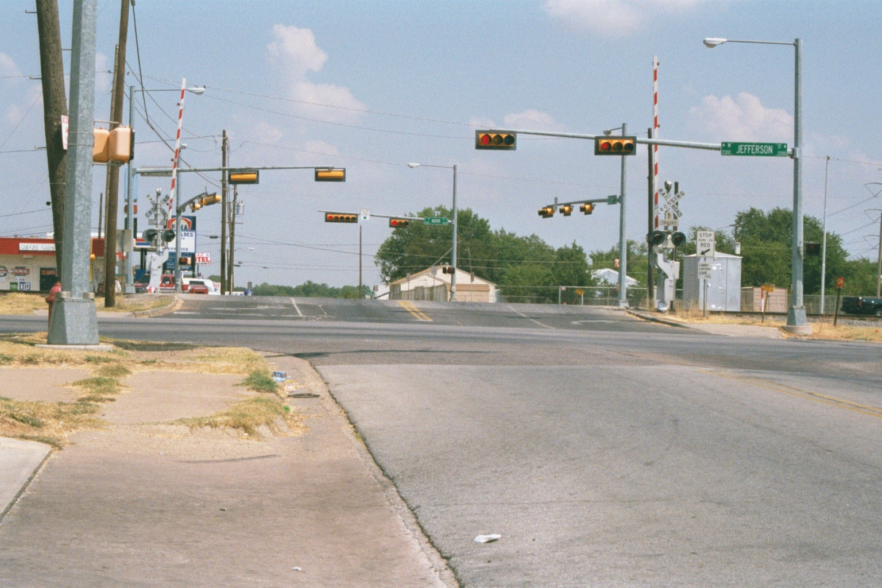
Right of Way
The cable crosses the city street here

Slide 56
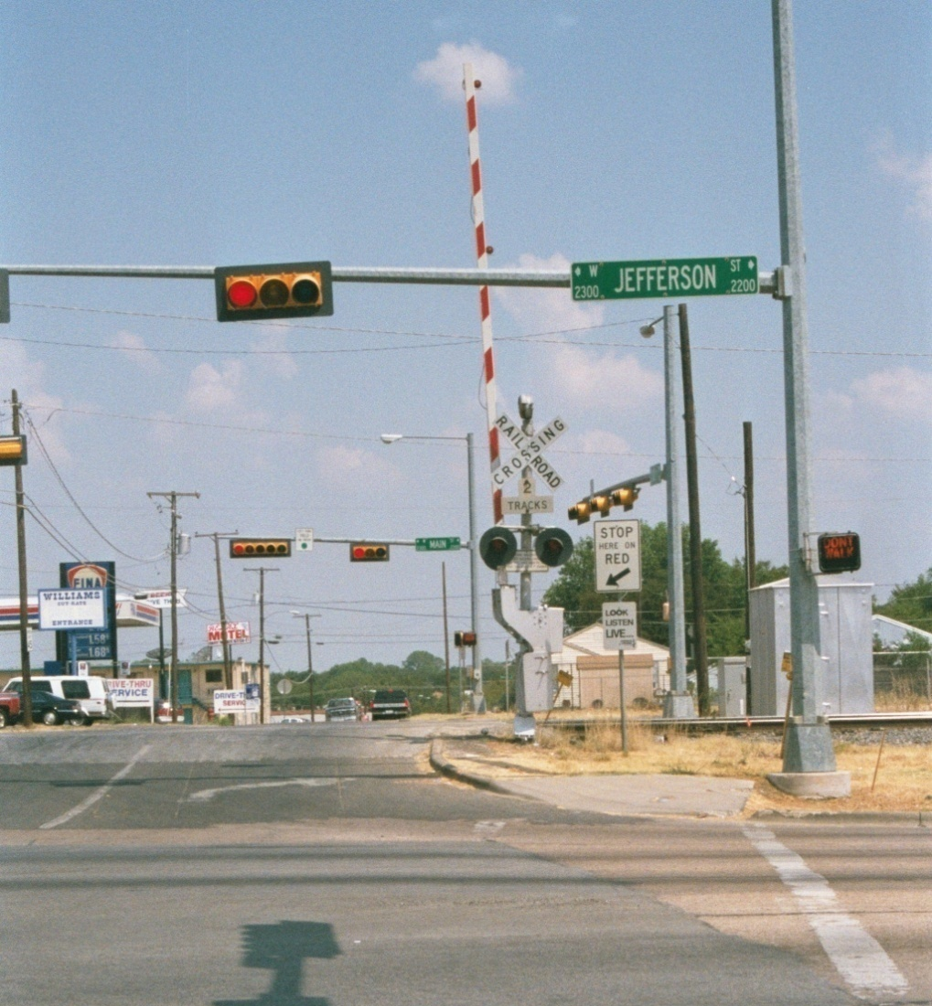
Right of Way
The cable crosses the city street here

Slide 57
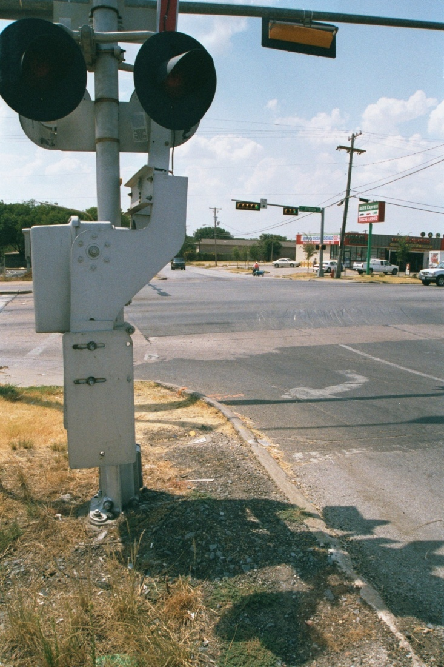
Right of Way
The cable crosses the city street here

Slide 58
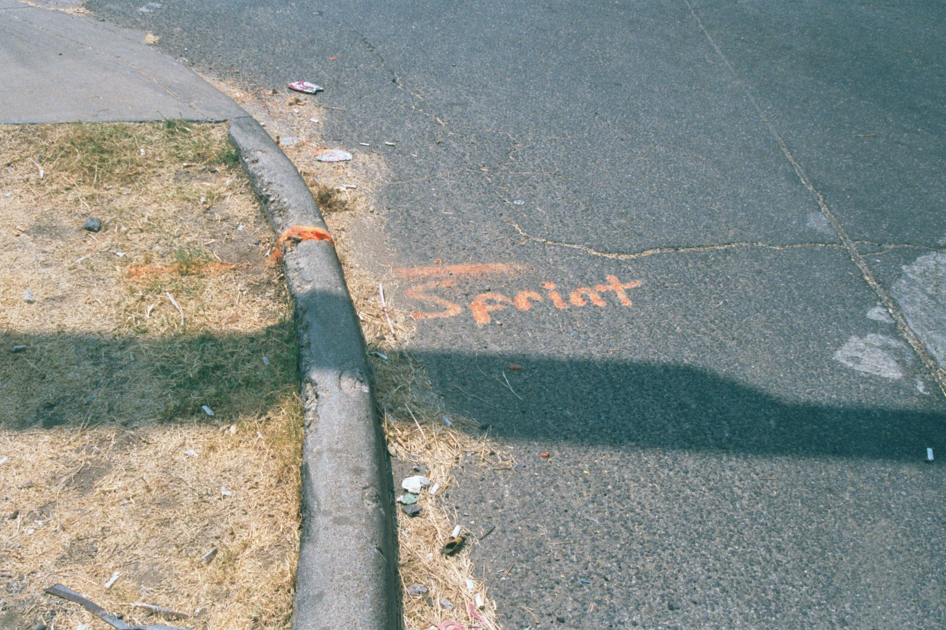
Right of Way
The cable crosses the city street here

Slide 59
Aerial Cables
If you control all of the ground between the points to be connected, sometimes you may want to run the fiber in the air between buildings, use existing poles, or sink the poles as required, such as telephone poles
This is similar to the way telephone or electrical wiring has been strung for all these many years

Slide 60
Aerial Cables
The costs for this method are
  Poles
  Placing the poles in the ground
  Cable
  Cable installation

Slide 61
Aerial Cables
It is critical that aerial cabling be installed in a fashion that meets strict standards since the cable is open to the environment and also often shares the pole with other utilities such as telephone or electricity

Slide 62
Aerial Cables
As a BICSI newsletter points out storm loading areas are another concern
Storm loading calculations are a critical design consideration that should not be taken lightly
Determination of a particular area can be found in several places and among the best is the NESC - National Electrical Safety Code, by the IEEE

Slide 63
Aerial Cables
Loading for grades B, C, and D construction can be found in the NESC under section 25
A map also shows the United States separated into storm loading districts
There are three storm loading districts
  Heavy
  Medium
  Light

Slide 64
Aerial Cables
This naming convention works the opposite of what most people would think
For example, one might assume that Miami, Florida is a heavy storm district because of the hurricanes
However, that is incorrect. Miami is in a light storm load district because storm load districts are based on the combined effects of wind and ice

Slide 65
Aerial Cables
The effects of that combination of factors can be readily seen during ice storms in Michigan, Minnesota and North Dakota, where outages and damage are common from wind and ice

Slide 66
Aerial Cables
BICSI goes on to say another consideration is the choice of the pole
The height of the pole is important because it is needed to maintain clearances over roads, railroad tracks, driveways, sidewalks and other areas
The size, or class, of pole is the next factor

Slide 67
Aerial Cables
There are nine classes of poles 1 through10
Bear in mind that the lower the number on the class of pole, the thicker it is and thereby more sturdy and capable of handling more cables or heavier cables

Slide 68
Aerial Cables
From a pure height requirement, consider that the pole will be set in the ground usually at a depth equal to ten percent of the pole length plus two feet
In addition, the first cable should be placed 18 inches down from the top of the pole

Slide 69
Aerial Cables
Use that resulting number with the sag estimation of your cable and strand assembly, and you can determine the required pole height
As a general rule of thumb, most of the poles used are 30, 35, 40 or 45 feet in height and are usually Class 4, 5, 6 or 7

Slide 70
Aerial Cables
For all practical purposes, the lower class numbers, four and five, go with the taller poles

Slide 71
Aerial Cables
Most importantly aerial cable must have a means of strain relief to support the hanging cable
This is accomplished by installing a messenger strand, usually a stainless steel cable with high weight support strength

Slide 72
Aerial Cables
The messenger may be installed first with the fiber being lashed to it for support, or the messenger may be built into the fiber optic cable itself to make installation easier
For example

Slide 73
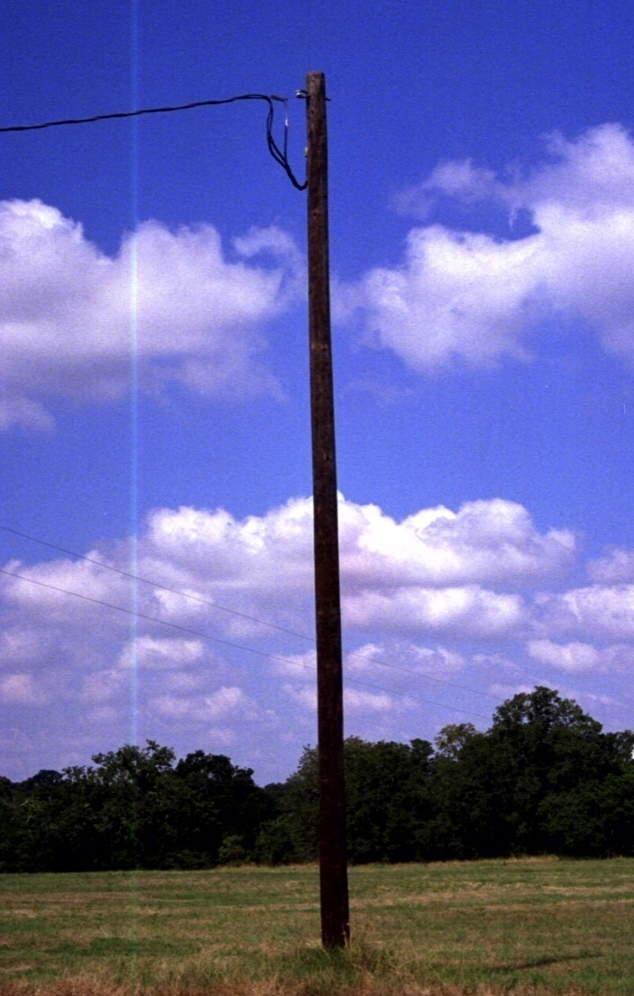
Aerial Cables on Poles

Slide 74
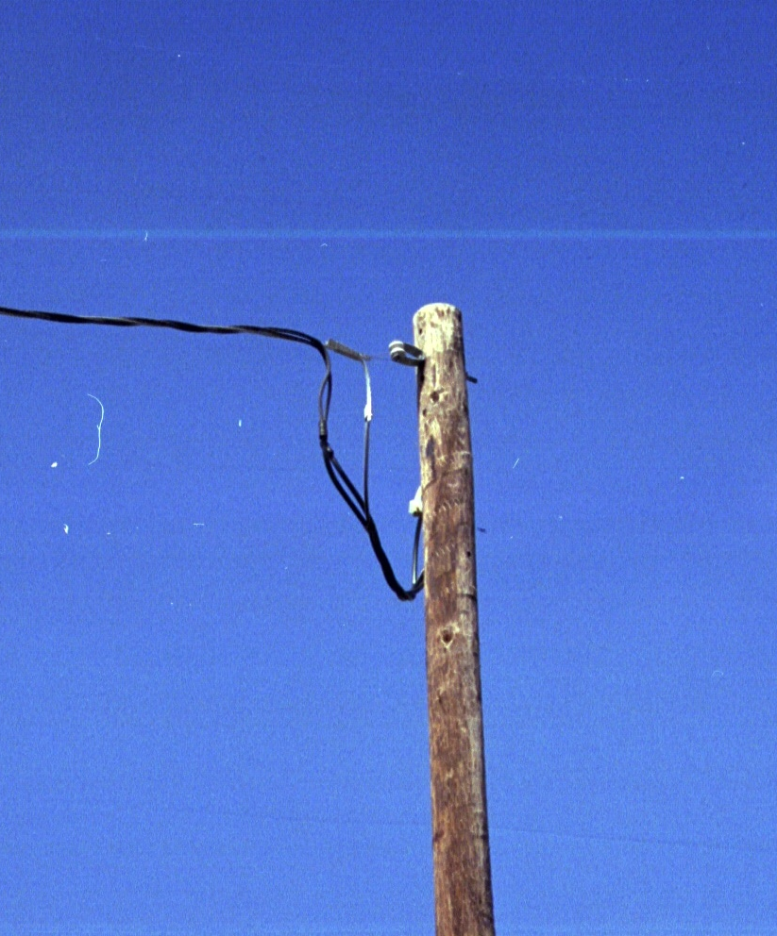
Aerial Cables on Poles

Slide 75
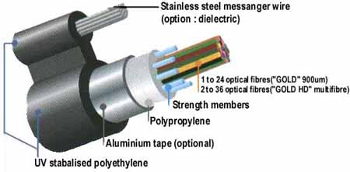
Aerial Cable

Slide 76

Aerial Cable

Slide 77
Aerial Installation
Typically poles are 35 feet in length
They are set 10 feet into the ground
At the ends guy wires must be installed to balance out the strain the messenger cable introduces
Poles are usually 225 feet apart

Slide 78
New Outdoor Methods
Two new methods are getting attention, but no wide use yet
First is sewer robotics
This method uses a robot to drag the fiber optic cable through a sewer, water, or gas pipes to the final termination point
There is no need to dig up the street
There is no possibility of cutting something

Slide 79
New Outdoor Methods
Although interesting, there are issues with this method as well
Such as
  Old sewer pipes that collapse when touched
  Obstructing the pipe with the cable and years of accumulated crud
Of course some people may object to having to move their computer to the restroom

Slide 80
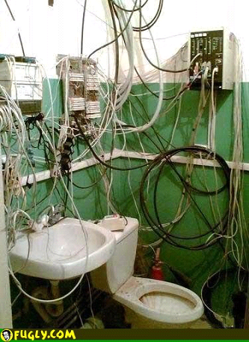
Old John Version

Slide 81
New iLoo Version
They might however be more comfortable in the newer version

Slide 82
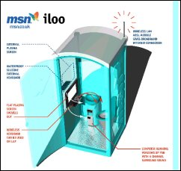
New iLoo Version

Slide 83
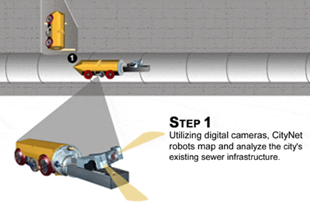
Sewer Robots

Slide 84
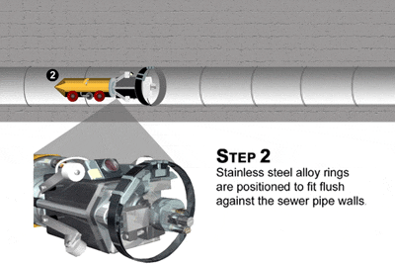
Sewer Robots

Slide 85
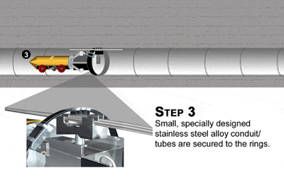
Sewer Robots

Slide 86
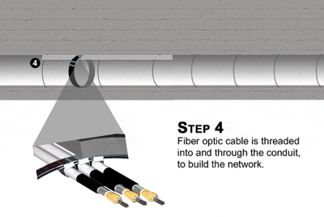
Sewer Robots

Slide 87
New Outdoor Methods
Gas pipes and water pipes can be used the same as sewer pipes for this purpose

Slide 88
New Outdoor Methods
Another method called MCS by Corning places an armored cable a few inches down into the street or sidewalk surface

Slide 89

MCS Road

Slide 90
Lab
Do Lab 4 from the Lab Manual

Slide 91
Sources
The Ditch Witch slides are from a presentation at the OSP Expo in September 2011

Slide 92
For More Information
Cabling: The Complete Guide to Network Wiring
  David Groth and Jim McBee
  ISBN 0782126456
The Cabling Handbook - 2nd Edition
  John R. Vacca
  ISBN 0130883174

Slide 93
For More Information
Fiber Optic Technicians Handbook
  Jim Hayes
  ISBN 076681825X
Understanding Optical Communications
  Harry Dutton
  ISBN 0130201413
Understanding Fiber Optics
  Jeff Hecht
  ISBN 0139561455

Slide 94
For More Information
TIA/EIA-758 standard for outside plant installation

