Slide 1
FLSM Last Update 2012.09.29 1.4.0

Slide 2
Objectives of This Section
Learn how to do Fixed Length Subnet Masking

Slide 3
What is Subnetting
What is subnetting
Subnetting is where bits are taken from the host portion of the IP address and used to create subnetworks
In other words new networks that exist below or subordinate to larger networks
The original largest networks were those 256 networks

Slide 4
Let’s Switch Gears
Now before we can learn to subnet we need to sidestep from the discussion of the network addressing to discuss numbering systems conversions as we will need to be able to do this so we can learn how subnetting is done

Slide 5
Numbering Systems of Interest
We need to be able to convert in our heads back and forth between decimal and binary numbering systems
Base 10 – Decimal
Base 2 – Binary

Slide 6
Base 10 Numbers
Humans use decimal numbers
Computers do not use these

Slide 7
Base 2 Numbers
Computers use the binary number system as they are composed of transistors for the most part
Recall that these are simple on off devices
This is easily represented by 0 or 1 in a numbering system

Slide 8
Conversion of Decimal to Binary
A common task is to convert a decimal number to a binary number
To do this one must first learn the bit positions

Slide 9
Binary Bit Positions
Reading from left to right
Bit Position | 8 | 7 | 6 | 5 | 4 | 3 | 2 | 1

Slide 10
Binary Bit Positions
Each of these bit positions has a value
Bit Position | 8 | 7 | 6 | 5 | 4 | 3 | 2 | 1
Value | 128 | 64 | 32 | 16 | 8 | 4 | 2 | 1

Slide 11
Conversion of Decimal to Binary
To convert a decimal to a binary number use the bit position values to find the binary number that equals the decimal number
For example

Slide 12
Conversion of Decimal to Binary
To convert 168 into binary
Moving from left to right, if the value for the bit position is less than or equal to the decimal number assign a 1 to that bit position in the binary number
If it does not, then assign a 0
Then subtract that bit position value from the remainder
Go to the next bit position and do the same thing

Slide 13
Conversion of Decimal to Binary
Add the numbers where 1s are together
The result should be the decimal number
8 | 7 | 6 | 5 | 4 | 3 | 2 | 1
128 | 64 | 32 | 16 | 8 | 4 | 2 | 1
1 | 0 | 1 | 0 | 1 | 0 | 0 | 0

Slide 14
Conversion of Binary to Decimal
To convert from binary to decimal do the reverse
Add the decimal values of the binary position values where a 1 is used
For example
10011011
8 | 7 | 6 | 5 | 4 | 3 | 2 | 1
128 | 64 | 32 | 16 | 8 | 4 | 2 | 1
1 | 0 | 0 | 1 | 1 | 0 | 1 | 1

Slide 15
Conversion of Binary to Decimal
The result is
155

Slide 16
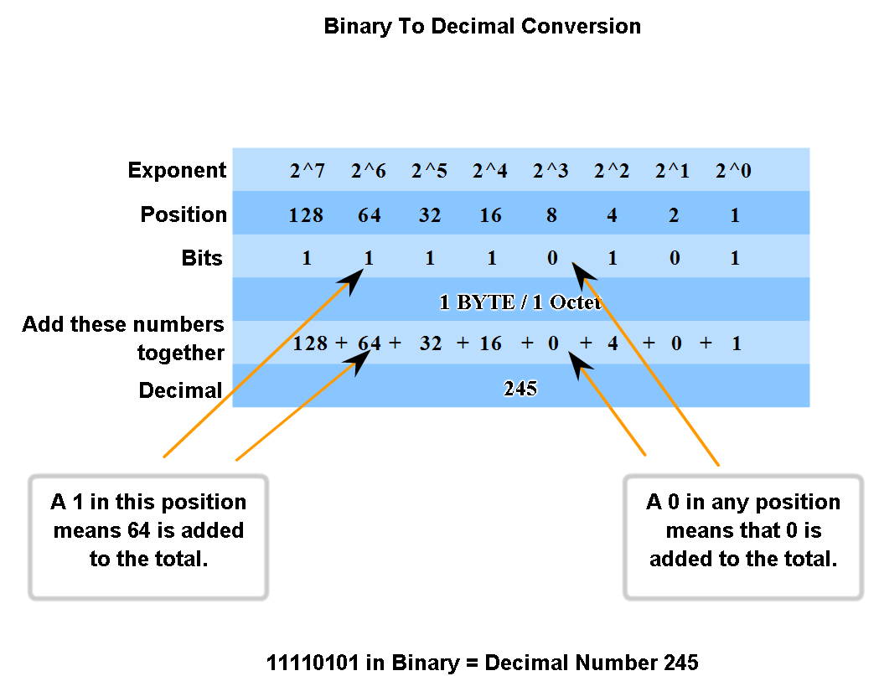
Conversion of Binary to Decimal

Slide 17
ANDing Binary Numbers
Binary numbers can be added together to yield a new number
This is called ANDing
We will use this procedure below
To AND two binary numbers
A 1 and a 1 is a 1
A 0 and anything is a 0

Slide 18
Reasons for Subnetting
Back to subnetting
Over the years the method developed for IP addressing did not generate enough network addresses
To help this subnetting was developed
To be a proper networking nerd you must understand subnetting

Slide 19
Reasons for Subnetting
The first step in this understanding is said to be to learn to subnet using only your brain
I know this is a scary thought
But you must learn to do this

Slide 20
How to Think About Subnetting
Subnetting is easy to understand
Let’s use an analogy
Suppose you buy a piece of land at the end of a road with the intention of building houses on it
For example

Slide 21
How to Think About Subnetting
End of the Road
We Are
Going to Build Houses Here

Slide 22
Our Road Layout
To build houses on this land we must build roads on it, then build houses on those roads
For example

Slide 23
Our Road Layout
The Houses On Each Road
Our New Roads

Slide 24
How to Think About Subnetting
Just like a subdivision you are going to have to figure out how many roads you need for the subdivision plus how many houses to build on each road
Once the roads are in place you need to know that the house numbers will be on each road
This is all there is to subnetting
It is exactly the same thing

Slide 25
General Approach
As we will learn later on there is no such thing as address classes anymore
However when doing this in your head subnetting is much easier if you do it based on address classes
Which is way you had to learn about the old address classes

Slide 26
The Basics
Recall that the purpose of a subnet mask is to allow a device to know what part of the address represents the network and what part the host
To create a subnet, bits are taken from the host portion of the address
This will mean fewer bits for the host
And the same number of bits for the network
Remember we are creating not a network, but a subnetwork

Slide 27
The Basics
First, memorize the Powers of 2
2¹ = 2
2² = 4
2³ = 8
2⁴ = 16
2⁵ = 32
2⁶ = 64
2⁷ = 128
2⁸ = 256

Slide 28
The Basics
Second, recall the Bit Position Values
8 = 128
7 = 64
6 = 32
5 = 16
4 = 8
3 = 4
2 = 2
1 = 1

Slide 29
The Basics
Third, try to memorize the Bit Patterns
10000000 = 128
11000000 = 192
11100000 = 224
11110000 = 240
11111000 = 248
11111100 = 252
11111110 = 254
11111111 = 255

Slide 30
Notice the Pattern

Slide 31
Notice the Pattern
As a bit is stolen to create a subnet the number of subnets doubles and the number of hosts on any subnet is cut in half

Slide 32
Subnetting by Hand Methods
There are several ways to do subnetting by hand or using only your brain
We will cover two of these
They are
The Five Question Method
/ Notation Method

Slide 33
The Five Question Method
Answer the following questions
How many networks can we create
How many devices can be on each network
What are the network names
What are the device names
What is the broadcast address of each subnet

Slide 34
Subnetting a Class C Address
In the case of a Class C address bring to mind the standard mask for a Class C address of 255.255.255.0
Notice that this leaves only the last octet for use by both the subnetwork and the host
So we only have 8 bits to work with

Slide 35
Subnetting a Class C Address
How many networks can we create
Formula
2^{N} = Number of Subnets
Where N is the number of bits stolen for the subnetwork

Slide 36
Subnetting a Class C Address
For example
00000000 2⁰ = Not used creates no subnets
10000000 2¹ = 2 subnetworks using the 128 mask
11000000 2² = 4 subnetworks using the 192 mask
11100000 2³ = 8 subnetworks using the 224 mask
11110000 2⁴ = 16 subnetworks using the 240 mask
11111000 2⁵ = 32 subnetworks using the 248 mask
11111100 2⁶ = 64 subnetworks using the 252 mask
11111110 2⁷ = Not used as no hosts are left
11111111 2⁸ = Not used as no hosts are left

Slide 37
Subnetting a Class C Address
How many devices can be on the network
Formula
2^{H} – 2 = Number of Hosts per Subnet
Where H is the number of bits left for the hosts after the subnet is created

Slide 38
Subnetting a Class C Address
For example
00000000 - 2⁸ - 2 = Not used creates no subnets
10000000 - 2⁷ - 2 = 126 using the 128 mask
11000000 - 2⁶ - 2 = 62 using the 192 mask
11100000 - 2⁵ - 2 = 30 using the 224 mask
11110000 - 2⁴ - 2 = 14 using the 240 mask
11111000 - 2³ - 2 = 6 using the 248 mask
11111100 - 2² - 2 = 2 using the 252 mask
11111110 - 2¹ - 2 = Not used as no hosts left
11111111 - 2⁰ - 2 = Not used as no hosts left

Slide 39
Subnetting a Class C Address
What are the network names
Formula
0 is the first network number
Then 256 – the subnet mask number in decimal is the base number
The base number is the second subnetwork number
The base number plus the last subnetwork number is the next subnetwork number
Until the subnet number in decimal is reached which is the last subnetwork number

Slide 40
Subnetting a Class C Address
For example
Three bits were used so 224 is the subnet mask number
256 – 224 = 32
32 then is the base number
Therefore

Slide 41
Subnetting a Class C Address
0
32
32+32=64
64+32=96
96+32=128
128+32=160
160+32=192
192+32=224
The eight subnetwork numbers then are
0-32-64-96-128-160-192-224

Slide 42
Subnetting a Class C Address
What are the device names on each network
Formula
The Numbers Between Each Subnet Number, except for the last number
For example

Slide 43
Subnetting a Class C Address
Subnetwork Numbers
0 | 32 | 64 | 96 | 128 | 160 | 192 | 224
Host Address Range
1 | 33 | 65 | 97 | 129 | 161 | 193 | 225
30 | 62 | 94 | 126 | 158 | 190 | 222 | 254

Slide 44
Subnetting a Class C Address
What is the broadcast address for each network
Formula
The number with all the bits turned on
or
The number just before the next subnet number
For example

Slide 45
Subnetting a Class C Address
Subnetwork Numbers
0 | 32 | 64 | 96 | 128 | 160 | 192 | 224
Broadcast Address
31 | 63 | 95 | 127 | 159 | 191 | 223 | 255

Slide 46
The / Notation Method
Here is a another method which may prove easier for you
Go from / notation to
The subnet mask to
The network addresses to
The number of hosts
For example

Slide 47
The / Notation Method
With a /26
A subnet mask of 255.255.255.192
Network address block size of 256 minus the subnet number
For example, 256-192=64
0
64
128
192

Slide 48
The / Notation Method
Number of hosts network size-2
64-2
62

Slide 49
Subnetting a Class B Address
On to the Class B address
The default subnet mask for a Class B address is
255.255.0.0
Notice that we now have two octets or 16 bits to work with
So the valid subnet masks are

Slide 50
Subnetting a Class B Address
For the third octet, all of which may be stolen
1 bit stolen - 255.255.128.0
2 bits stolen - 255.255.192.0
3 bits stolen - 255.255.224.0
4 bits stolen - 255.255.240.0
5 bits stolen - 255.255.248.0
6 bits stolen - 255.255.252.0
7 bits stolen - 255.255.254.0
8 bits stolen - 255.255.255.0

Slide 51
Subnetting a Class B Address
If the third octet is used since this is a Class B address the third octet may be used as well
9 bits stolen - 255.255.255.128
10 bits stolen - 255.255.255.192
11 bits stolen - 255.255.255.224
12 bits stolen - 255.255.255.240
13 bits stolen - 255.255.255.248
14 bits stolen - 255.255.255.252
Stop here as the RFCs say at least two bits must be left

Slide 52
Subnetting a Class A Address
On to the Class A address
The default subnet mask for a Class A address is
255.0.0.0
Notice that we now have three octets or 24 bits to work with
So the valid subnet masks are

Slide 53
Subnetting a Class A Address
For the second octet, all of which may be stolen
1 bit stolen - 255.128.0.0
2 bits stolen - 255.192.0.0
3 bits stolen - 255.224.0.0
4 bits stolen - 255.240.0.0
5 bits stolen - 255.248.0.0
6 bits stolen - 255.252.0.0
7 bits stolen - 255.254.0.0
8 bits stolen - 255.255.0.0

Slide 54
Subnetting a Class A Address
The third octet maybe used since this is a Class A address
9 bits stolen - 255.255.128.0
10 bits stolen - 255.255.192.0
11 bits stolen - 255.255.224.0
12 bits stolen - 255.255.240.0
13 bits stolen - 255.255.248.0
14 bits stolen - 255.255.252.0
15 bits stolen – 255.255.254.0
16 bits stolen – 255.255.255.0

Slide 55
Subnetting a Class A Address
If the fourth octet is used
17 bits stolen - 255.255.255.128
18 bits stolen - 255.255.255.192
19 bits stolen - 255.255.255.224
20 bits stolen - 255.255.255.240
21 bits stolen - 255.255.255.248
22 bits stolen - 255.255.255.252
Stop here as the RFCs say at least two bits must be left

Slide 56
A Final Note on This Procedure
What is the point in all of this
Once you get past the old Class C examples above the actual listing of the bit patterns, the subnet numbers, the host addresses, and so on gets so lengthy and so prone to typical human error and typos that what’s the point
No one would actually do this
So we will stop here

Slide 57
Decimal Method Subnetting
David Schamus in a presentation for the 2011 Cisco Academy Conference presented another method for subnetting by hand
This method uses only simple arithmetic
I have changed the names of the parts in some cases
Let’s look at it

Slide 58
Network Address
First what is the network address for a combination of IP address and subnet mask
The IP address in this example is
10.1.1.84
The subnet mask is
255.255.255.224

Slide 59
Network Address
As this subnet is not on a fixed length boundary such as 255.255.255.0 the network address is not obvious by just looking at the two
We will calculate it

Slide 60
Network Address
The procedure is
256 - The Subnet Mask Number = Result 1
The IP Address Shown / Result 1 = Result 2
For Result 2 ignore the decimal places
Result 2 * Result 1 = The Network Number
Put this number in the octet with the non 255

Slide 61
Network Address
For example
256 – 224 = 32
84 / 32 = 2
2 * 32 = 64
We were given 10.1.1.84 255.255.255.224
The network address is then 10.1.1.64

Slide 62
Network Address
Let’s look at another example
172.31.33.84
255.255.240.0
256 - 240 = 16
33 / 16 = 2
16 * 2 = 32
172.31.32.0
Here are four more examples using his naming

Slide 63
Network Address

Slide 64
Broadcast Address
This just adds one more step to the Network Address procedure
This step is
Network Address + Result 1 – 1
64 + 32 – 1 = 95
In the first example above this would result in
10.1.1.95
as the broadcast address

Slide 65
Broadcast Address
For the 172.31.33.84 255.255.240.0 example
32 + 16 – 1 = 47
172.31.47.255 is the broadcast address
Another example using his naming scheme

Slide 66
Broadcast Address

Slide 67
Host Addresses
Now what are the host addresses on the network
This is just all the addresses between the network address and the broadcast address
For example

Slide 68
Host Addresses
We were given 10.1.1.84 255.255.255.224
The network address is then 10.1.1.64
Because
256 – 224 = 32
84 / 32 = 2
2 * 32 = 64

Slide 69
Host Addresses
And the broadcast address is
Because
Network Address + Result 1 – 1
64 + 32 – 1 = 95
This would result in
10.1.1.95
as the broadcast address
So the brackets are
10.1.1.64 and 10.1.1.95

Slide 70
Host Addresses
The host addresses are
65 to 94
Some example using his naming scheme

Slide 71
Host Addresses

Slide 72
A Subnet Calculator
Well that was all fascinating
Yes you are correct
No one does it this way in the real world
They use a subnet calculator
Let’s look at one
Go to www.boson.com

